Slide 2
How to Make Black Swans Extinct
And Why ISO31000 is the Weapon of Choice
Julian Talbot
Managing Director, SRMBOK Ltd
www.juliantalbot.com

Slide 3
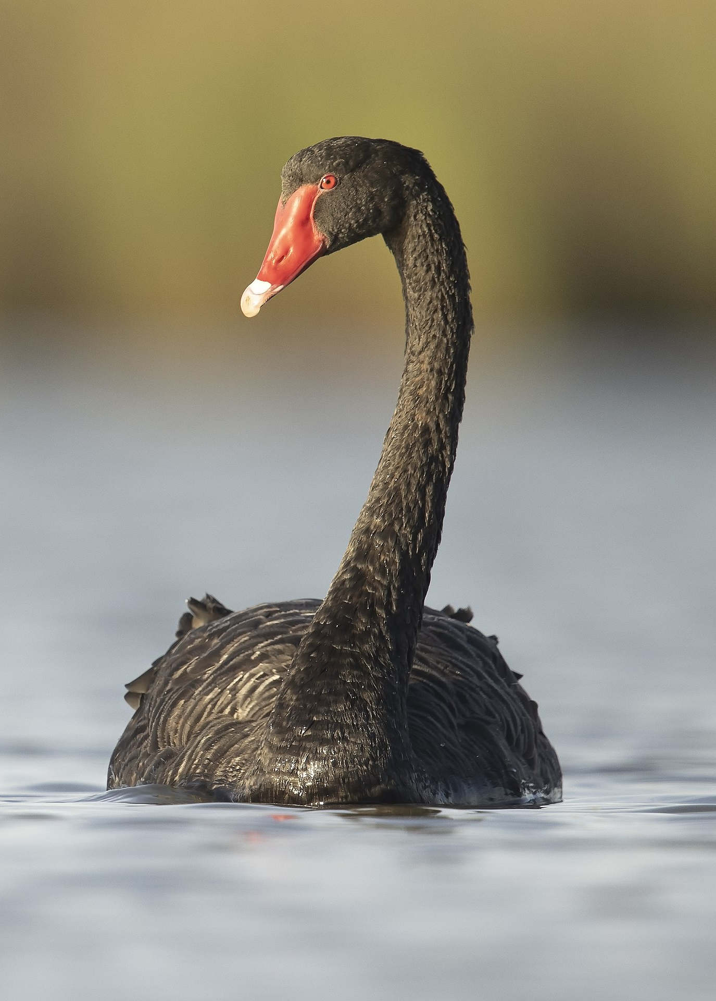
The Bird
Cygnus atratus
”a large waterbird, a species of swan which breeds mainly in the southeast and southwest regions of Australia"

Slide 4

The Book
An essay with one single idea:
"our blindness with respect to randomness, particularly large deviations"

Slide 5
Black Swan
A black swan is an extremely rare event with severe consequences. It cannot be predicted beforehand, though after the fact, many falsely claim it should have been predictable.
Reliance on standard forecasting tools can both fail to predict and potentially increase vulnerability to black swans by propagating risk and offering false security.
Unpredictable event beyond what is normally expected and with severe impact
extreme rarity
severe impact
widespread insistence they were obvious in hindsight
Source: https://www.investopedia.com/terms/b/blackswan.asp

Slide 6

The truth …
“On a long enough timeline, the survival rate for everyone drops to zero.”
― Chuck Palahniuk, Fight Club

Slide 7
Black Swan Examples
(Wikipedia)
Rise of the Internet
The personal computer
World War I
Dissolution of the Soviet Union
September 11, 2001 attacks
Major scientific discoveries, historical events, and artistic accomplishments

Slide 8

EXPERTS ESTIMATE 40,000 DEATHS THIS YEAR.
IS THERE A NEED FOR ACTION?
THAT DEPENDS WHETHER YOU ARE TALKING ABOUT A PANDEMIC OR DIABETES.

Slide 9
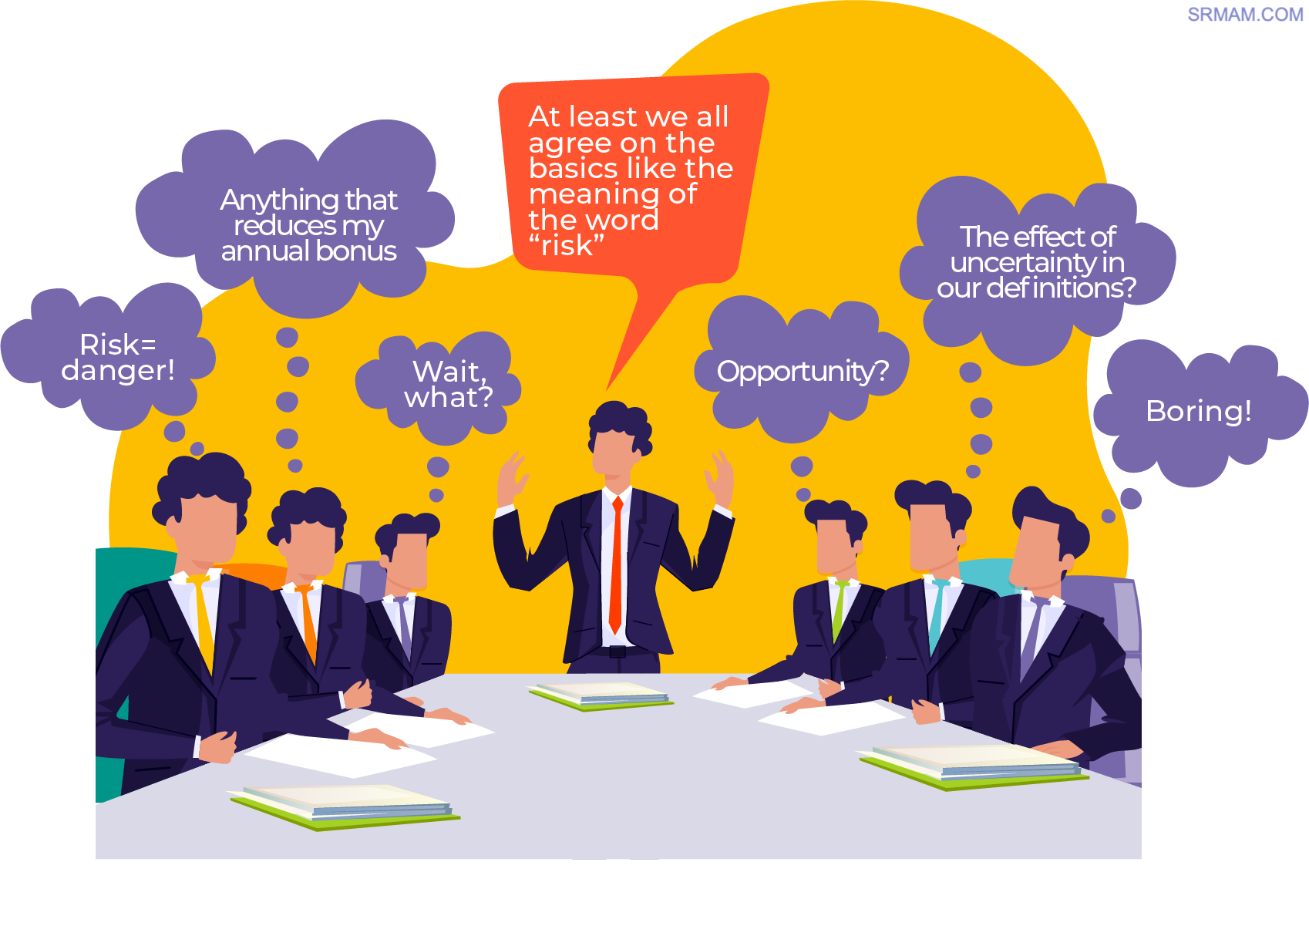

Slide 10
“The effect of uncertainty on objectives”
ISO31000:2018 Risk Management Guideline

Slide 11
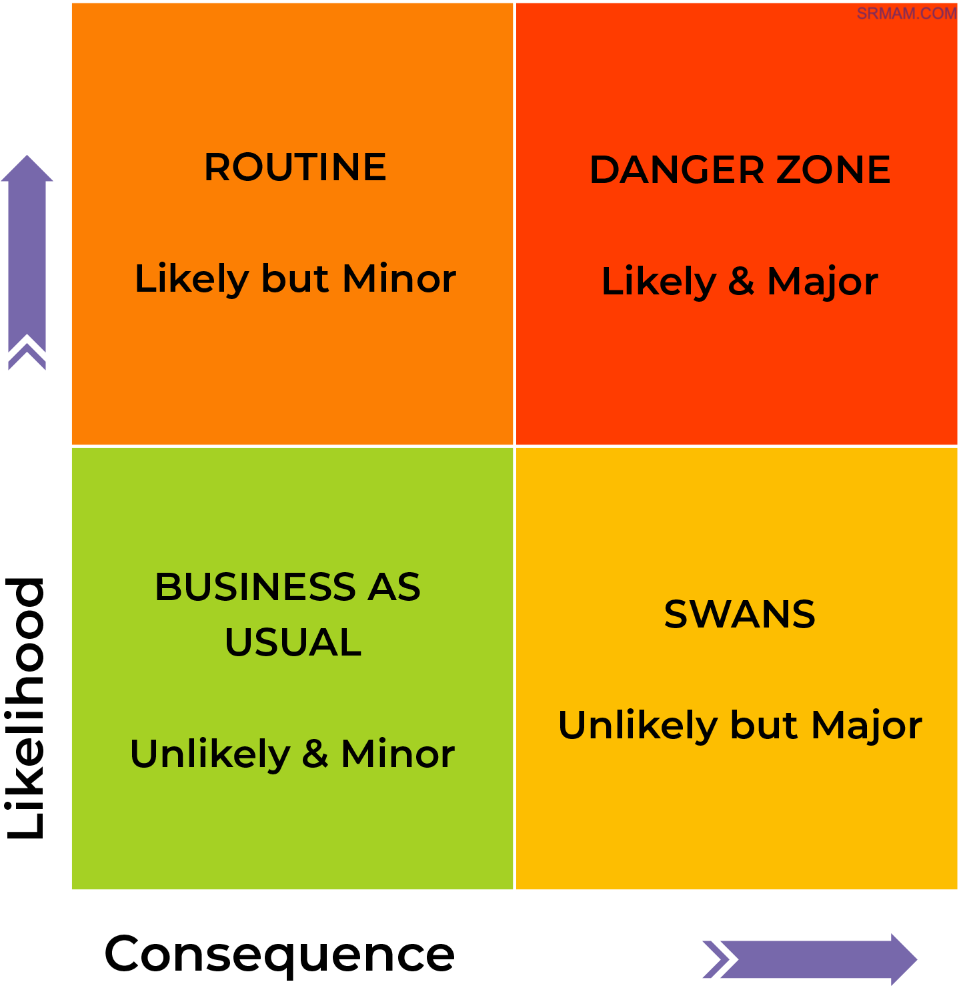
STROUD MATRIX
BAU – Petty Theft
ROUTINE - Fraud
SWANS – Insider Threat
DZ – Cyber Attack

Slide 12
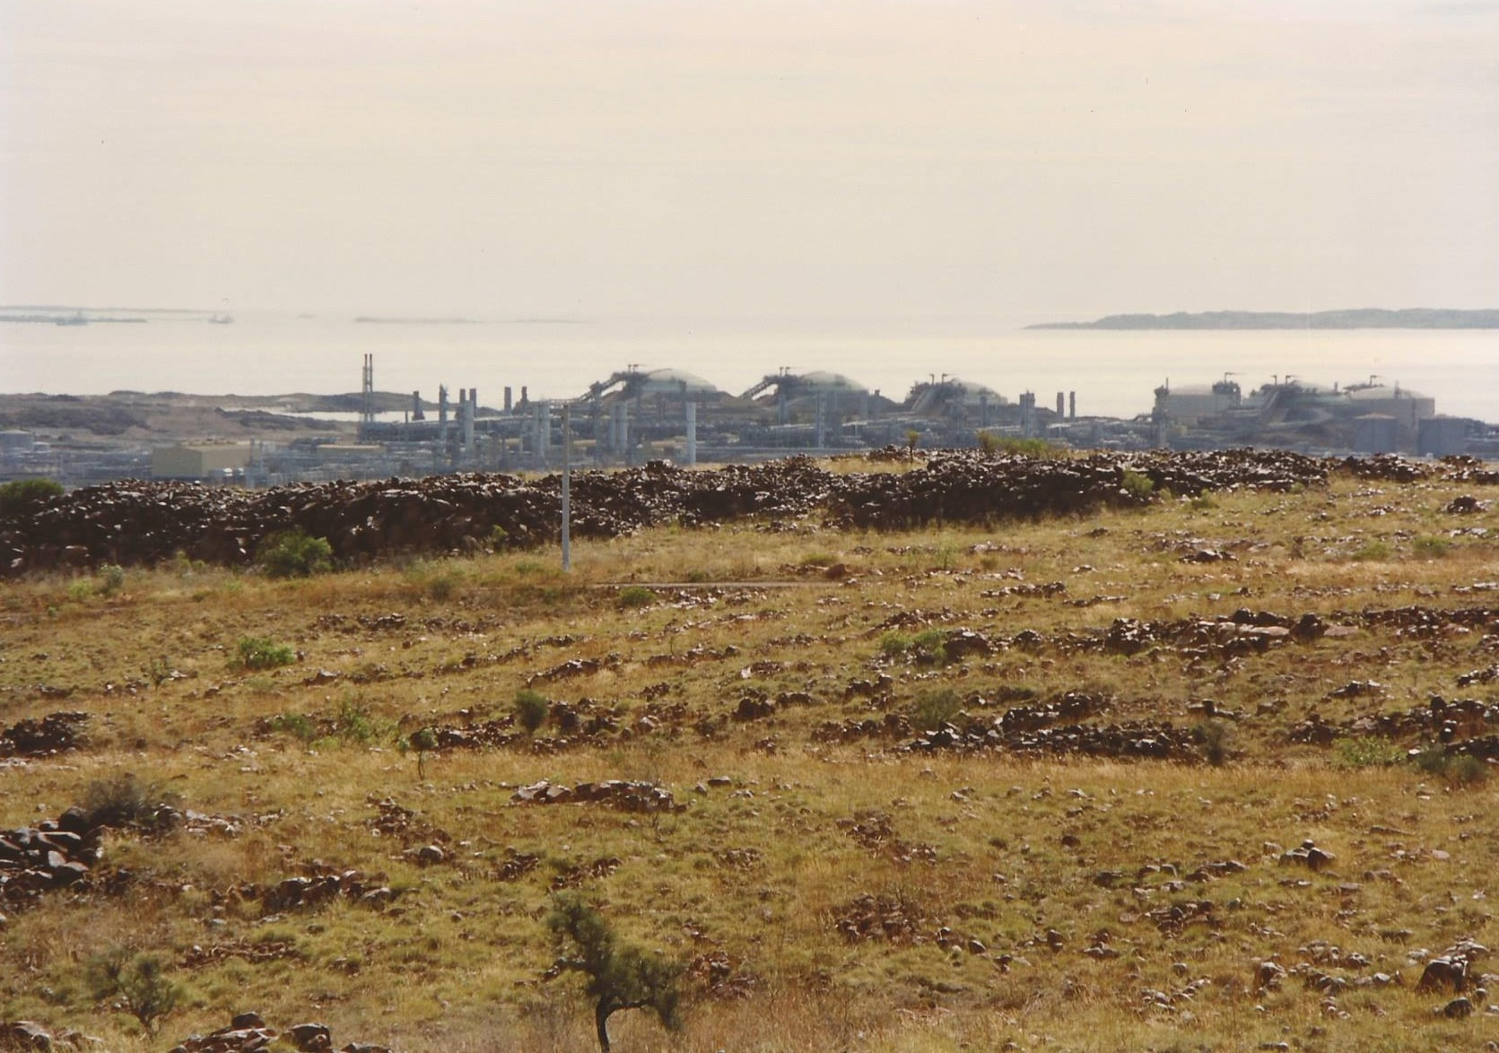

Slide 13
All-Hazards Approach
Treating the top 10 risks will address most risks
Main objectives
  Comprehensive
  Robust
  Defensible
  Prioritized
Avoid exact risk ratings or values
300 risks for an enterprise security risk assessment
50 risks for a project, facility, or single location (eg: gas station)
Varies depending on scope (Location, domain, etc)
Aggregate/combine/eliminate to produces less than 50 key risks
Top 10 risks

Slide 14
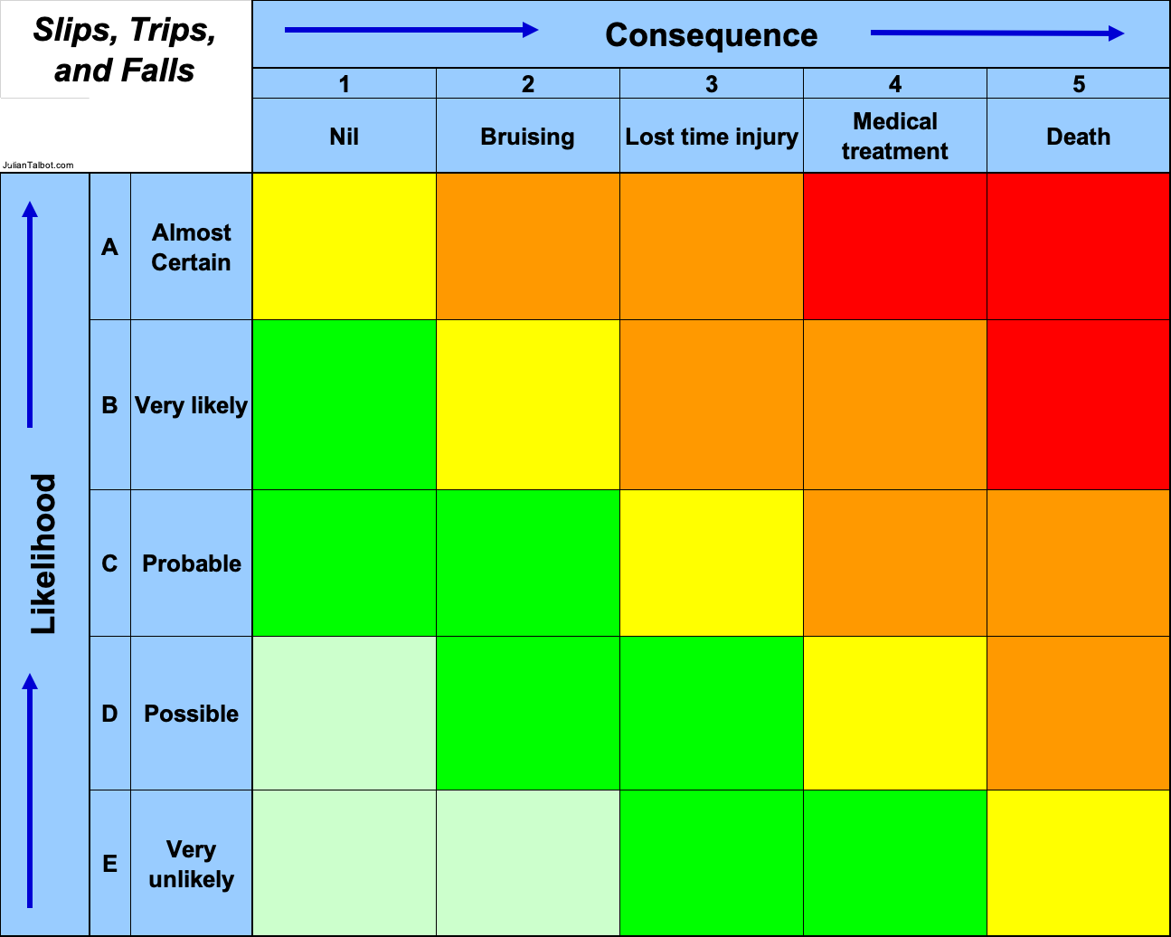


Slide 15






Slide 16
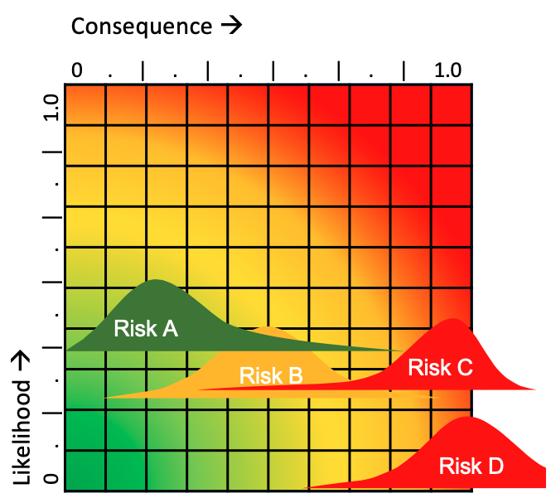
The Analysis
Likelihood = 0.0 to 1.0
  Where 1.0 = 100% certainty
Consequence = 0.0 to 1.0
  Where 1.0 = existential threat for the organization or person
  Financial or other terms

Slide 17
Breaking the Causal Chain
CONSEQUENCE
S
O
U
R
C
E
H
A
Z
A
R
D
T
H
R
E
A
T
S
E
F
F
E
C
T
Risk
Event
CONSEQUENCE
BARRIERS
ESCALATION
CONTROLS
ESCALATION
FACTORS
ESCALATION
FACTORS
THREAT
BARRIERS
ESCALATION
CONTROLS
LIKELIHOOD
MANAGEMENT
CONSEQUENCE
MANAGEMENT

Slide 18
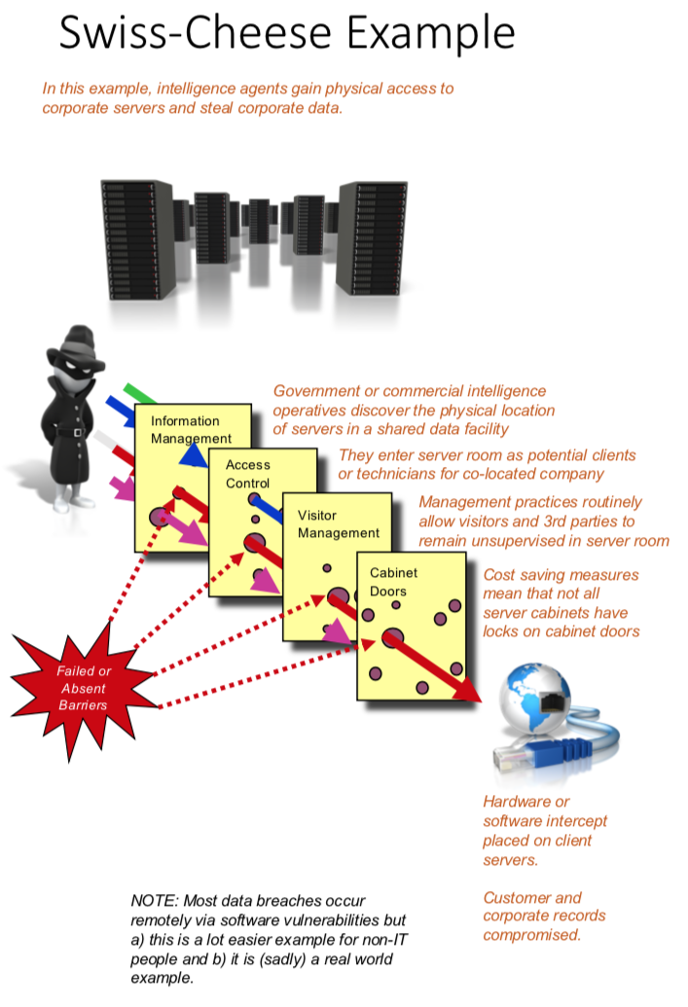
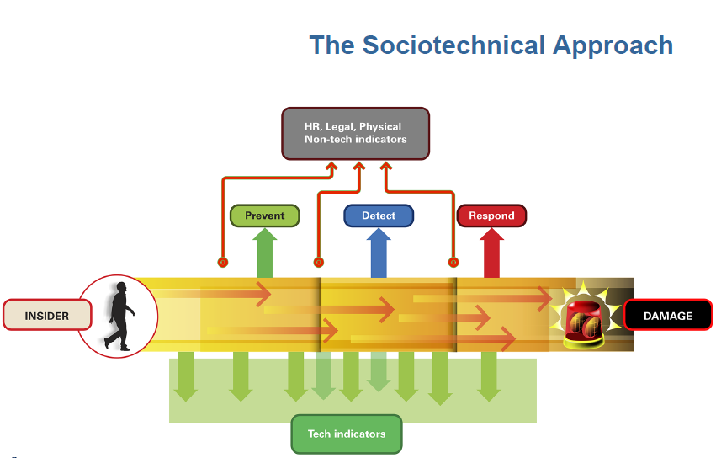
Notes:
24

Slide 19
Pre-Event (to the left)
Post-Event (to the right)

Slide 20
How Management Systems Work
Input
Process
Output
Feedback

Slide 21
How Risk Management Systems Work
Undesired future
Unplanned future
Desired future
Events
Risk
Unintended
Consequences
Lead Indicators
Lag Indicators

Slide 22
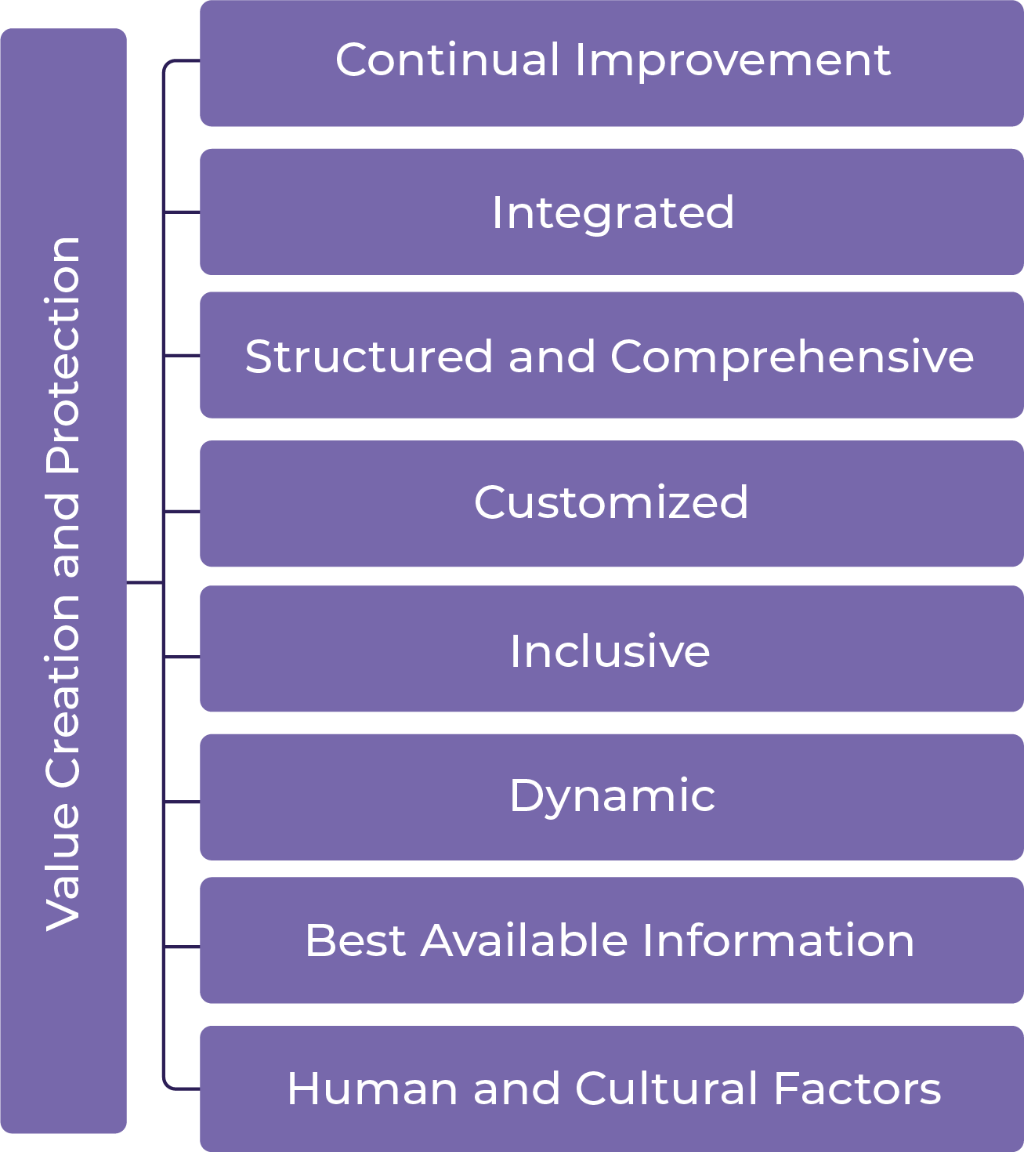
ISO31000 Principles

Slide 23
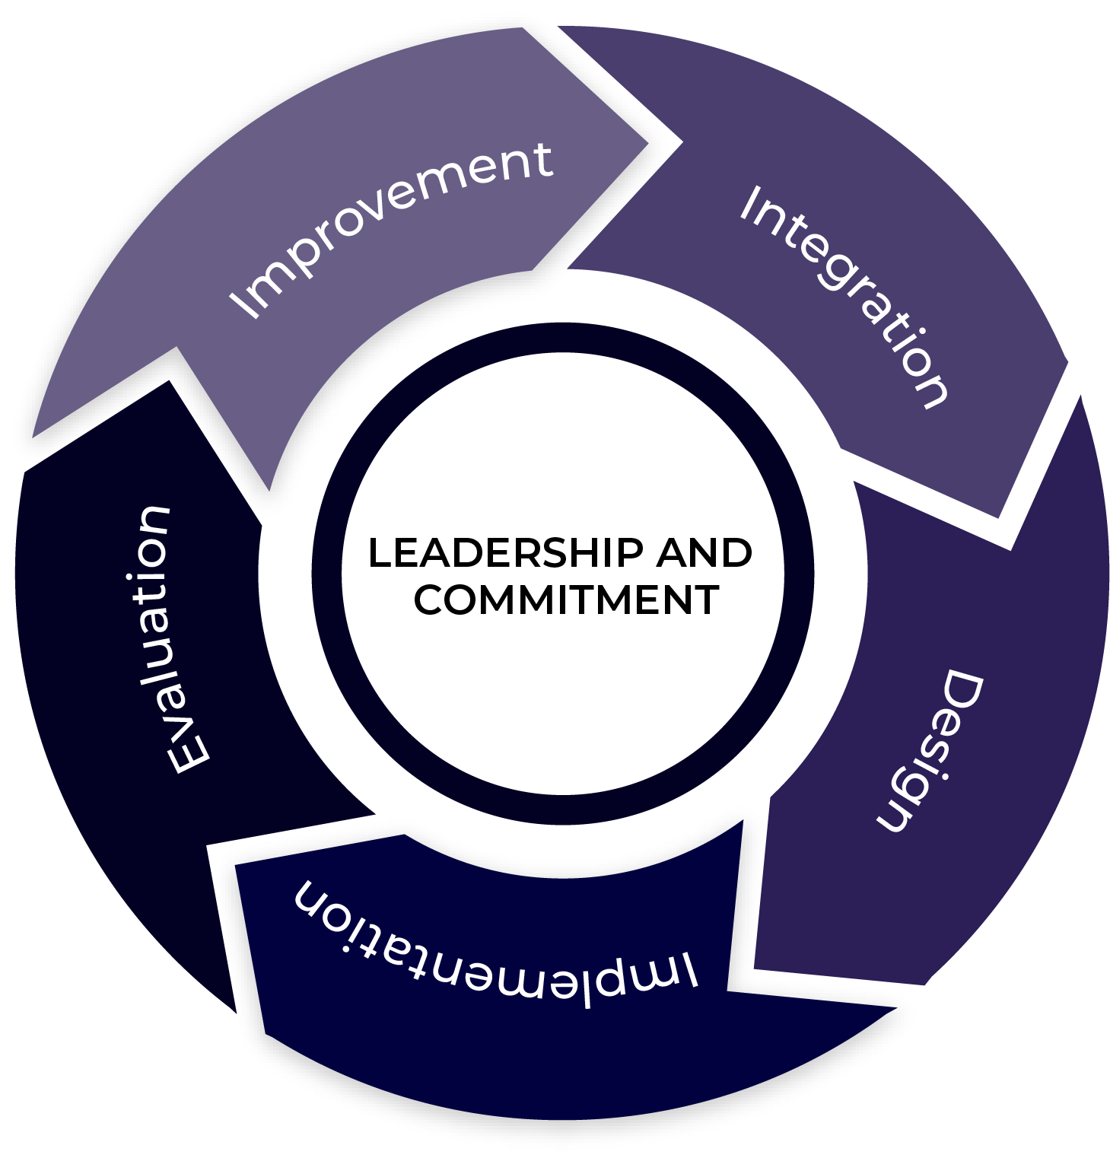
ISO31000 Framework

Slide 24
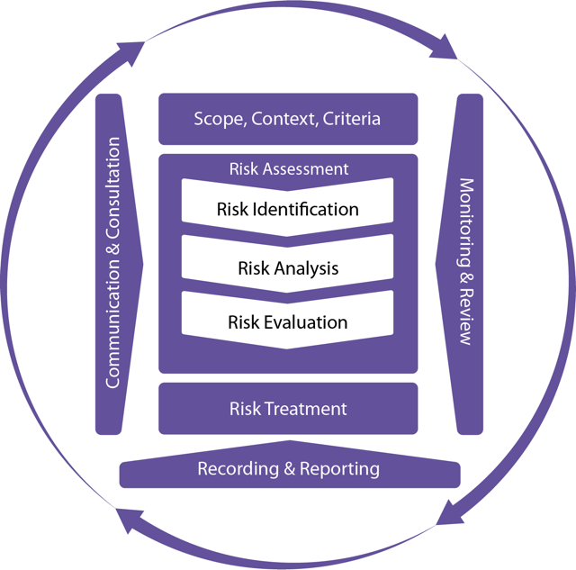
ISO31000 Process

Slide 25
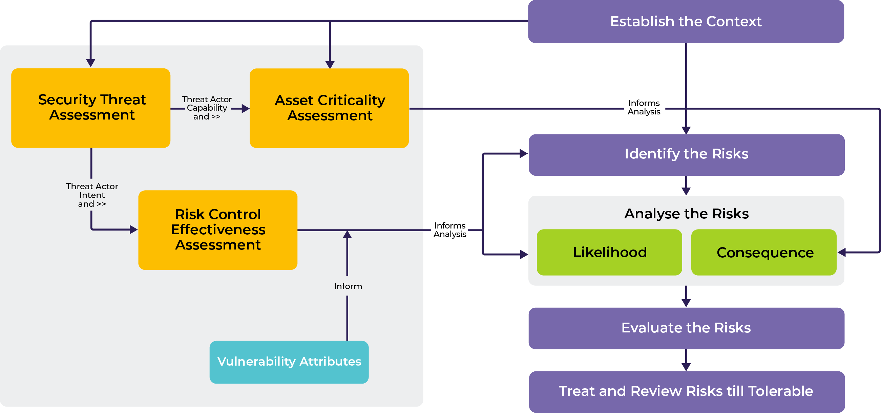
ISO31000 Process

Slide 26
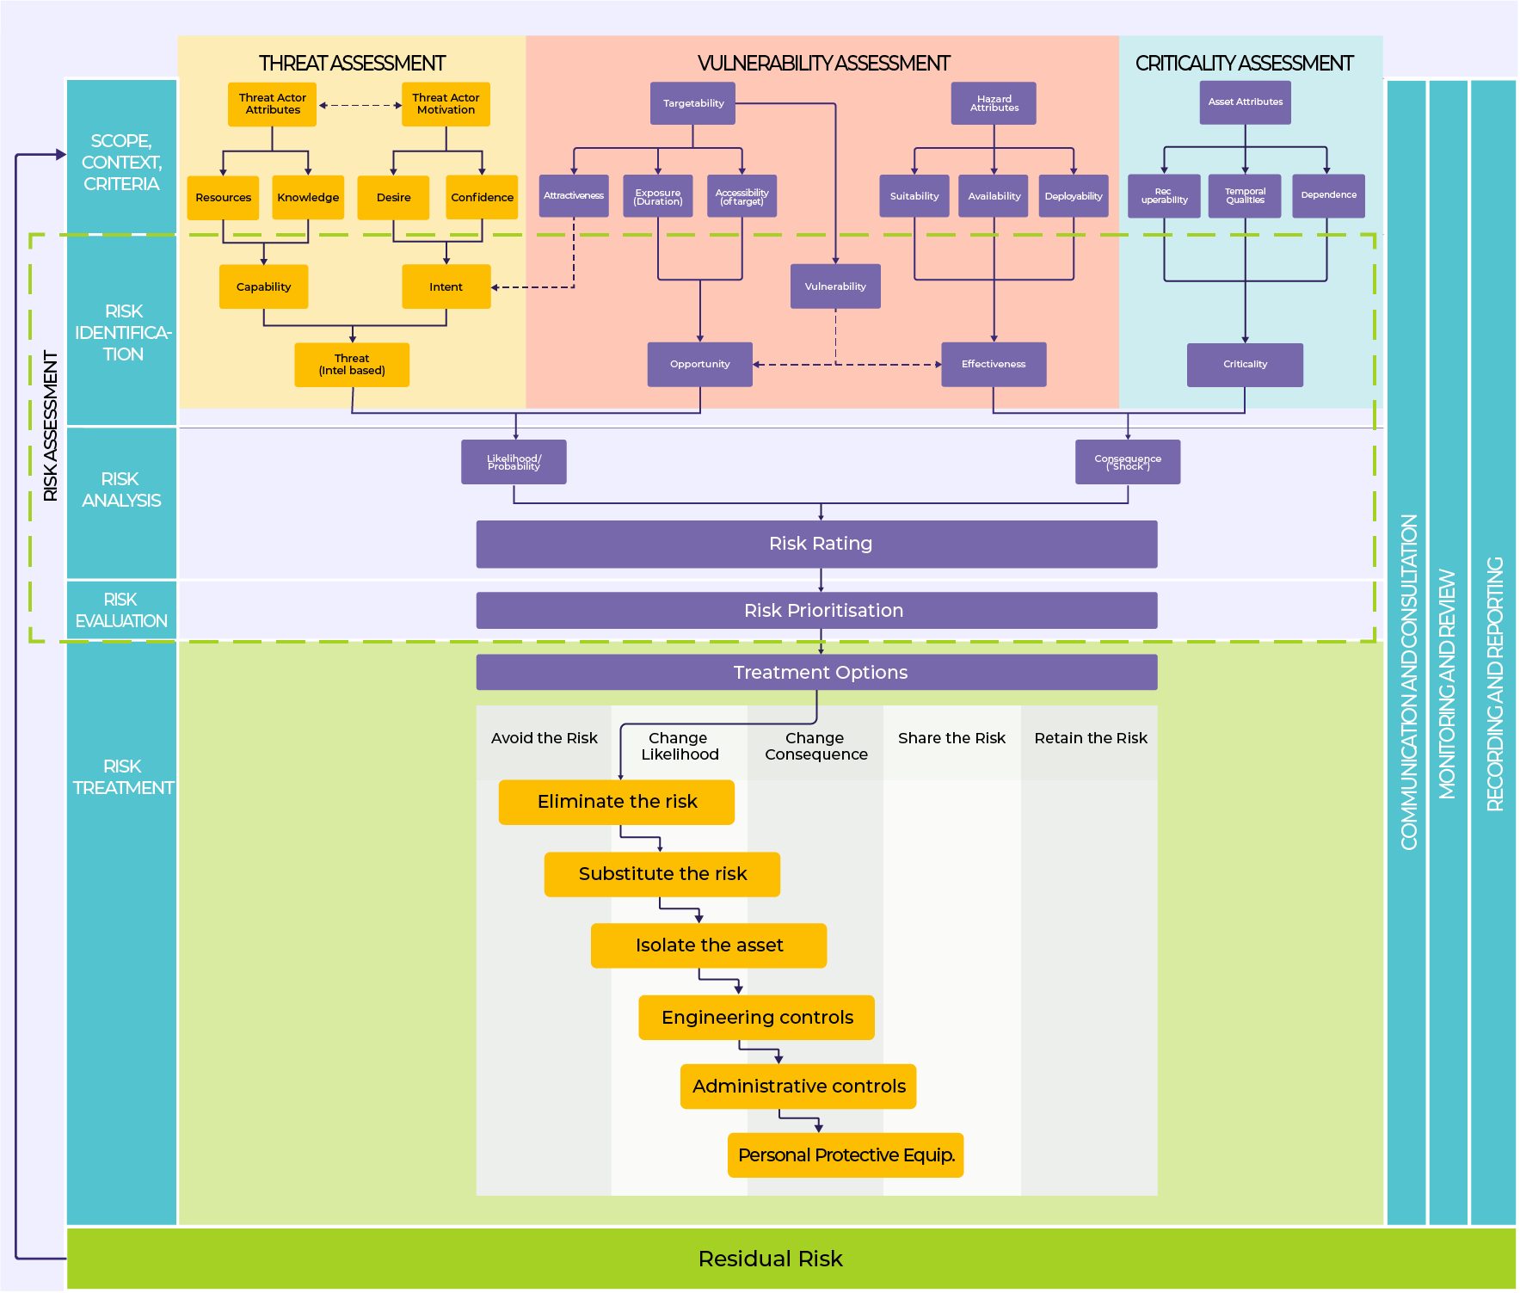
ISO31000
Expanded

Slide 27
ISO31000 Process

Slide 28




SOURCE
EVENT
ASSET
CONSEQUENCE
OBJECTIVES
STATE ACTOR
COMMERCIAL OPERATIONS DATA
LOST SALES MARGIN DUE
PROFIT TARGETS
ORGANIZED CRIME
NETWORK BREACH
CLIENT CREDIT CARD DATA
REPUTATION
IPO/GROWTH OBJECTIVE
TRUSTED INSIDER
OUTDATED SECURITY PATCH
VULNERABILITY
VULNERABILITY
Loss of profits due to foreign intelligence service (FIS) breaching network and providing sensitive production and cost information to their major corporations (our buyers).

Slide 29
C.A.S.E.
Consequence
Objectives
Assets at risk
Resources
Source
Threats & Hazards
Event
Incident

Slide 30
Consequence | Asset | Source | Event
Death Injury Illness First Aid | People Staff Visitors Customers | Insiders Petty Criminals Organized Crime Cybercriminals Terrorists Issue Motivated Groups (IMGs) State Intelligence Services (SIS) Competitors | Arson Social Media attack Blockade Petty theft Armed robbery Hacking Man-in-the-middle Data theft Denial of service Break and enter Bomb threat Bombing Ransomware Data compromise Network compromise Malware Drive by shooting Violent protest Street violence Assault
Confidentiality Integrity Availability | Information Data Records Knowledge
Loss Damage Theft | Property Intangible Tangible Virtual
Costs Lost revenue Capital erosion | Economic Revenue Capital reserves
Viability Creditworthiness Shareprice | Reputation Brand Value Goodwill

Slide 31
Swans of all colors
Consequence | Asset | Source | Event | Objectives
Harm | People | Inadequate maintenance | Slips, trips, falls | Safety
Loss | Information | State sponsored hackers | Ransomware | Customer satisfaction
Theft | Property | Competitors | Petty theft | Compliance
Inadequate product quality | Economic | Religious fundamentalists | Improvised explosive device | Capability
Hight staff turnover | Reputation | Pandemic | Illness | Profit
Sales | Inventory | Wholesalers | Trade Fair | Revenue Growth
Sales | Equipment | International markets | Webinars | Health

Slide 32
Swans of all colors
Consequence | Asset | Source | Event | Objectives
Harm | People | Inadequate maintenance | Slips, trips, falls | Safety
Loss | Information | State sponsored hackers | Ransomware | Customer satisfaction
Theft | Property | Competitors | Petty theft | Compliance
Inadequate product quality | Economic | Religious fundamentalists | Improvised explosive device | Capability
Hight staff turnover | Reputation | Pandemic | Illness | Profit
Sales | Inventory | Wholesalers | Trade Fair | Revenue Growth
Sales | Equipment | International markets | Webinars | Health

Slide 33


Slide 34
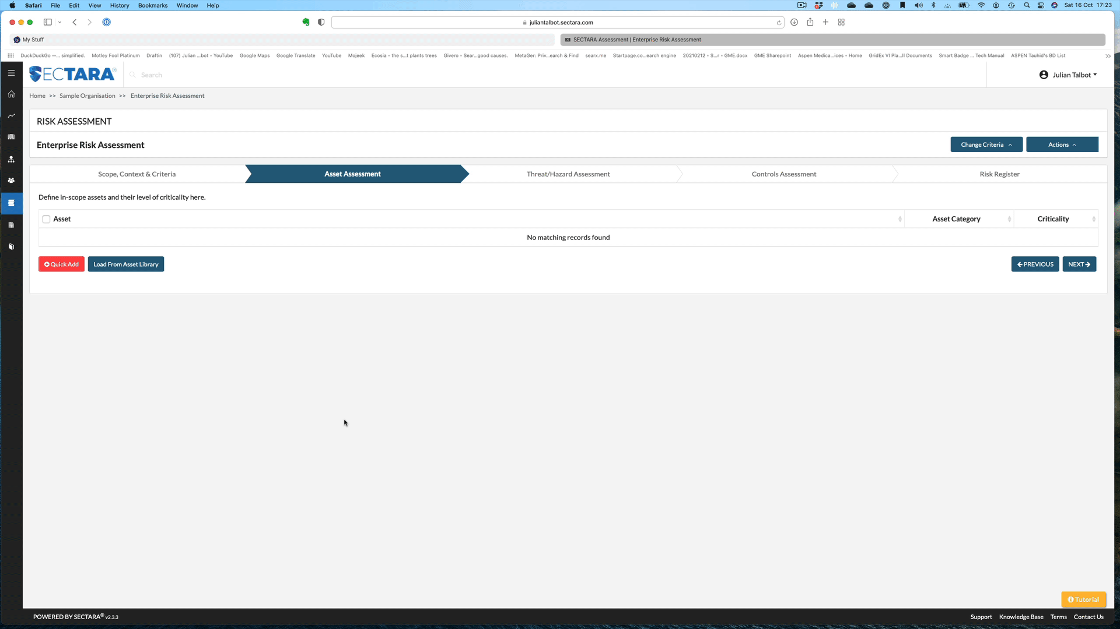

Slide 35
Just say no to
Black Swans

Slide 36
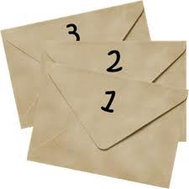

Slide 37
www.juliantalbot.com

