Slide 1
Security Risk Management Masterclass 28JAN20
Julian Talbot

Slide 2

Agenda
0830 Introductions & review agenda
0900 SRMBOK, ISO31000 updates
1030 Morning tea
1100 Security Risk Assessments
1300 Lunch
1400 Career, leadership, promotion, income
1600 General discussion
1630 Finish

Slide 3
Introductions
Name
Experience
Something unusual about you
Objectives for today

Slide 4
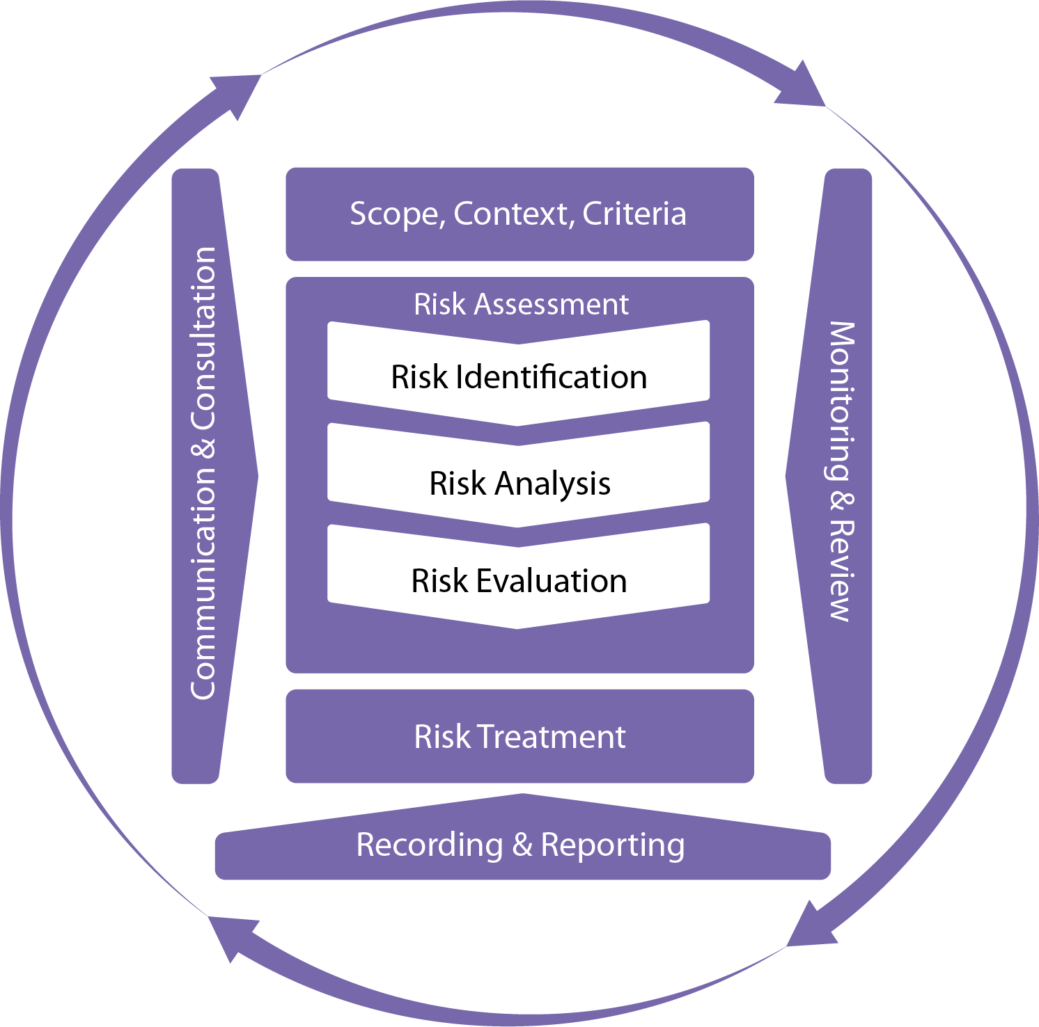
ISO 31000 Process

Slide 5
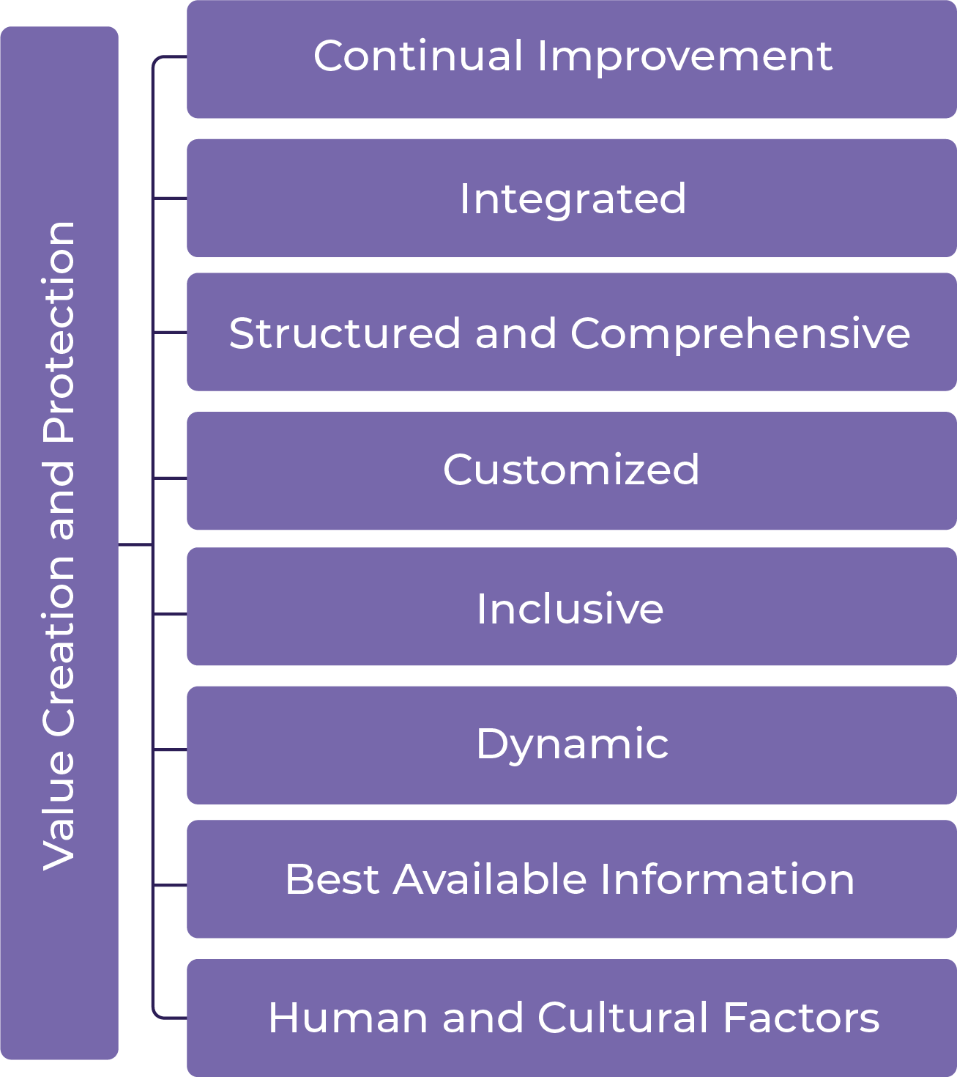
ISO31000 Principles

Slide 6

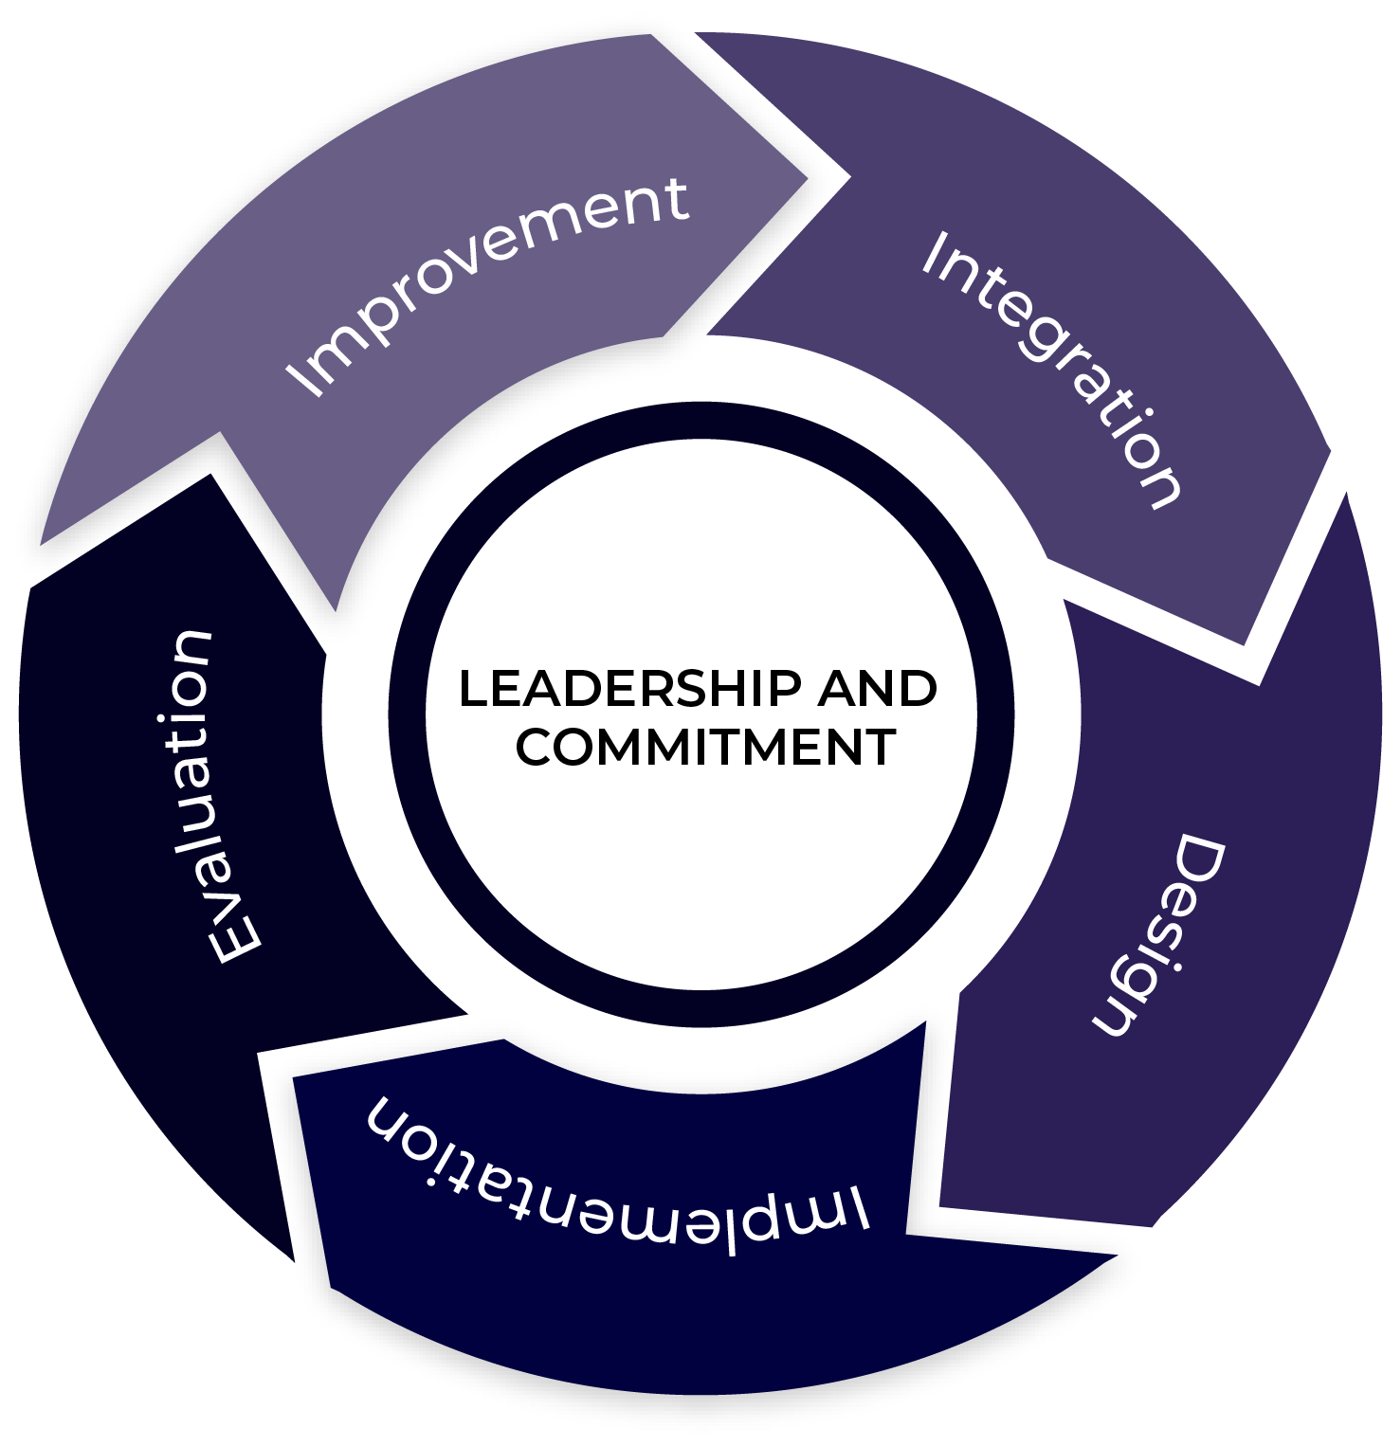
ISO31000 Framework

Slide 7
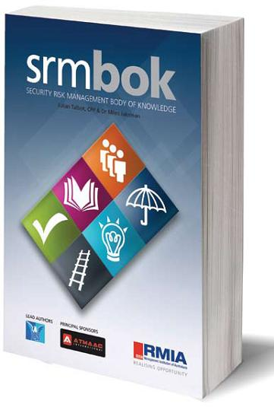

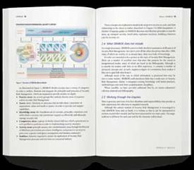
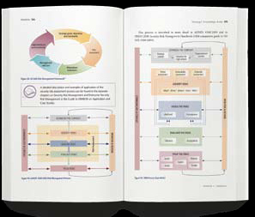

SRMBOK. In the beginning …

Slide 8
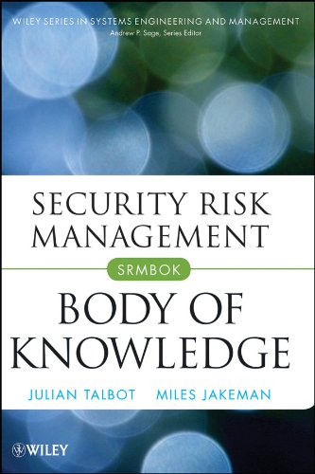
Second Edition
2009

Slide 9
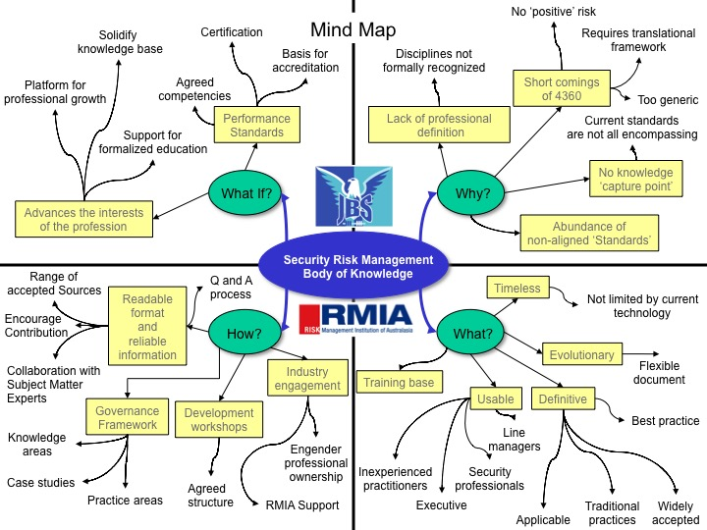

Slide 10
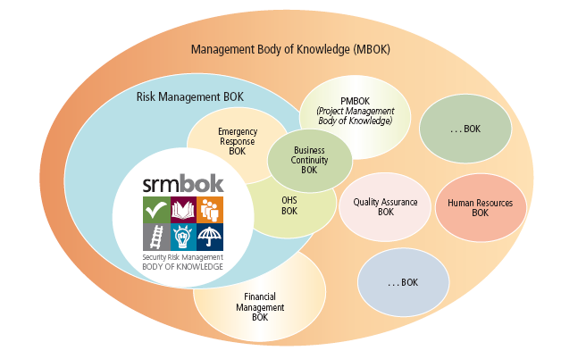
SRM & RM

Slide 11
What SRMBOK includes
Introduction and Overview
SRM Context
Security Governance
SRMBOK Framework
Practice Areas
Strategic Knowledge Areas
Operational Competency Areas
Activity Areas
SRM Enablers
Asset Areas
SRM Integration
SRM Lexicon
Sample Templates
Bibliography

Slide 12
Audience for SRMBOK
Security Advisers
Security Managers
Line Managers
Students
Consultants
Security professionals
Directors
Senior Managers
Chief Executive Officers
Chief Security Officers

Slide 13
Terminology
Risk
Threat
Hazard
Source
AAAARGH!

Slide 14
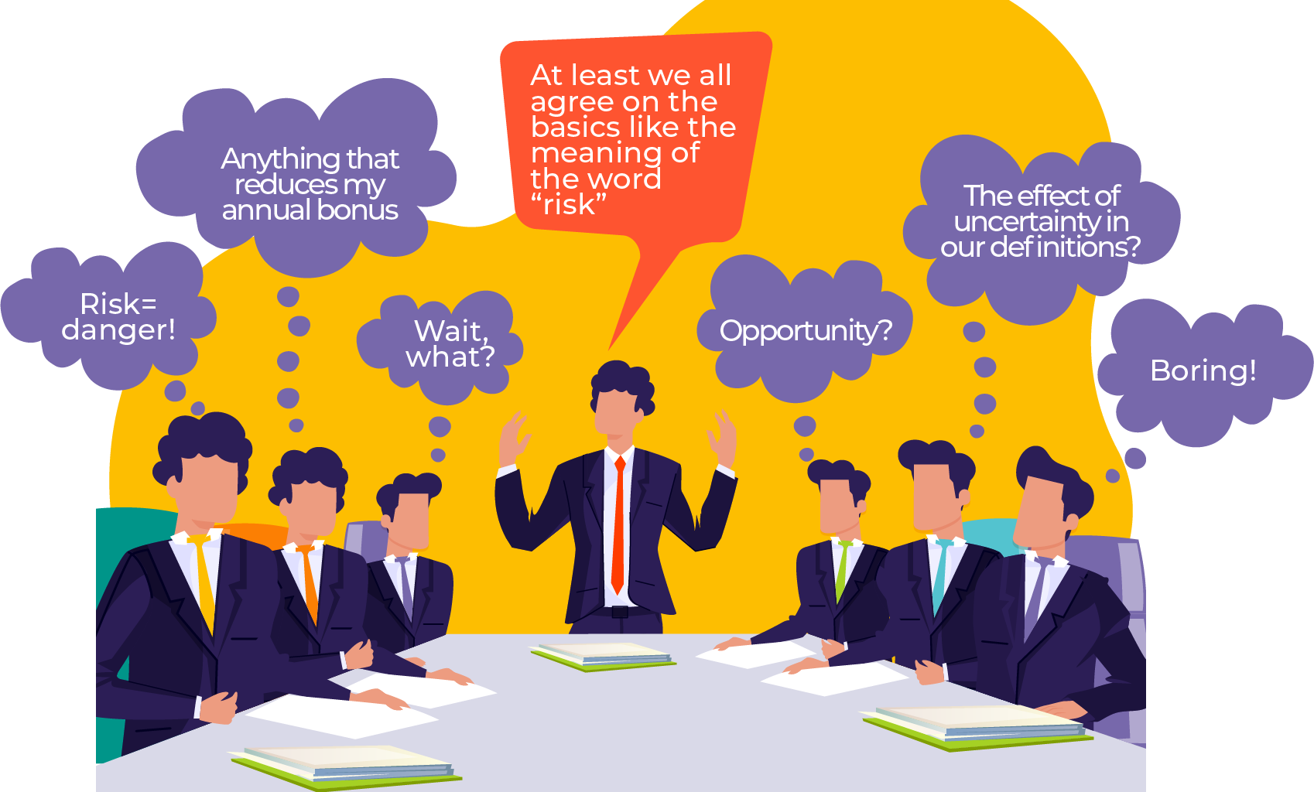

Slide 15
SRMBOK Framework
Activity
Areas
Practice Areas
Strategic Knowledge Areas
Security-In-Depth
Exposure
Risk
Resource
‘Quality’
SRM Integration
Integration
Design
Application
Assurance
Operational Competency Areas
Enablers
Regulation and Policy
Training and Education
Operations and Application
Governance and Oversight
Sustainability and Resilience

Slide 16
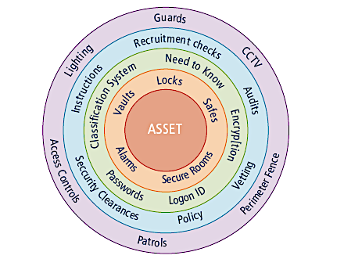
Security In Depth
ASSET
ASSET
Notes:
Security-in-depth is a multilayered system in which measures combine to support and complement each other making it hard for an intruder to gain unauthorised access.
Physical measures:
- Barriers to deter, detect and delay entry
- alarms to detect unauthorised access and alert a response
- access control measures – front desk staff, guards, swipe cards
- keys and containers
Complimented with procedural and personnel security measures such as:
- the “need to know” principle
- security classification system
- security clearances for personnel
It is only effective if everyone involved with protecting official resources is aware of their responsibilities.

Slide 17
Hierarchy of Controls
Source: NOHSC
Eliminate
Eliminate
Substitute
Isolate
Engineer
Administrative Controls
Personal Protection
ASSETS

Slide 18
OIL EXPLORATION EXAMPLE
Eliminate
E Don’t explore for oil
S Mauritania not Iraq
I Staff in remote areas not city
E Fence, gates, armoured veh.
A Policies, Travel safety training
P Bullet-proof vests
ASSETS

Slide 19

Core line descriptions
Eliminate the risk
Substitute the risk
Assets/resources/capabilities and objectives
Administrative solutions
Engineering solutions

Slide 20
Eliminate
Substitute
Isolate
Engineer
Administrative Controls
Personal Protection
Eliminate

Slide 21
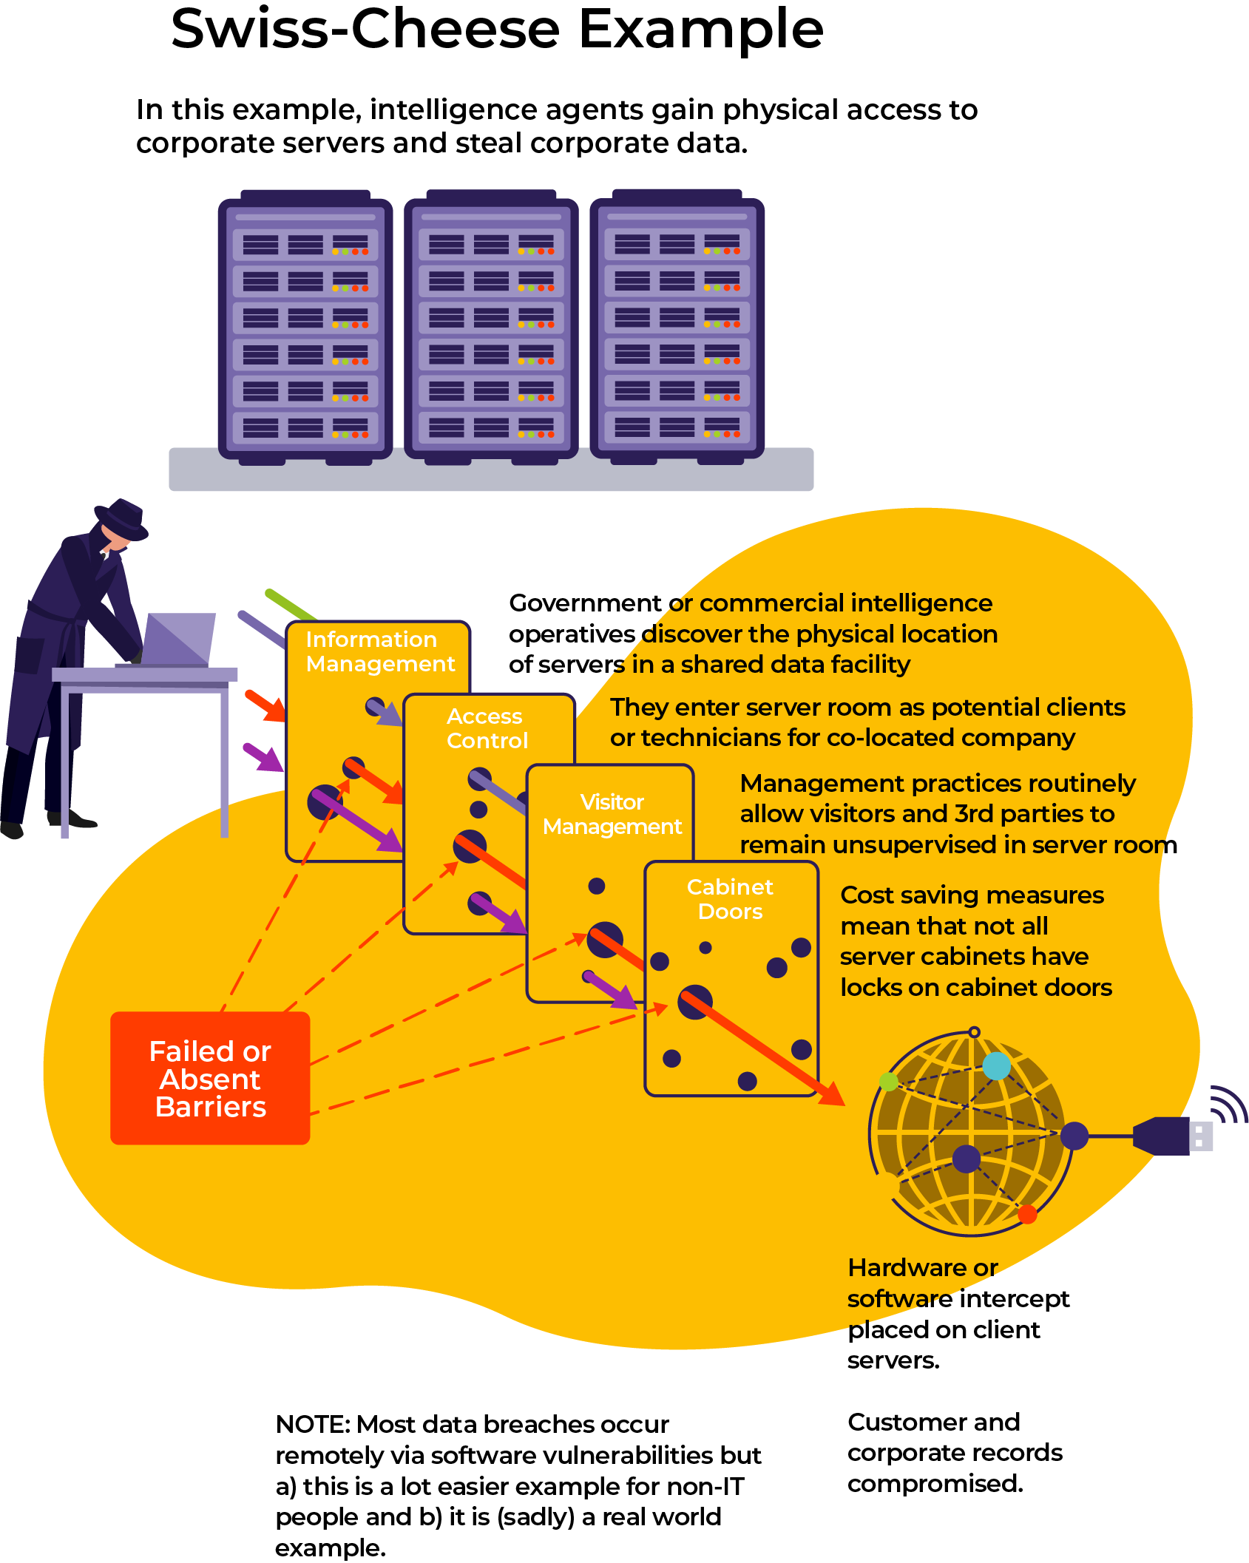
SWISS CHEESE

Slide 22
SWISS CHEESE

Slide 23
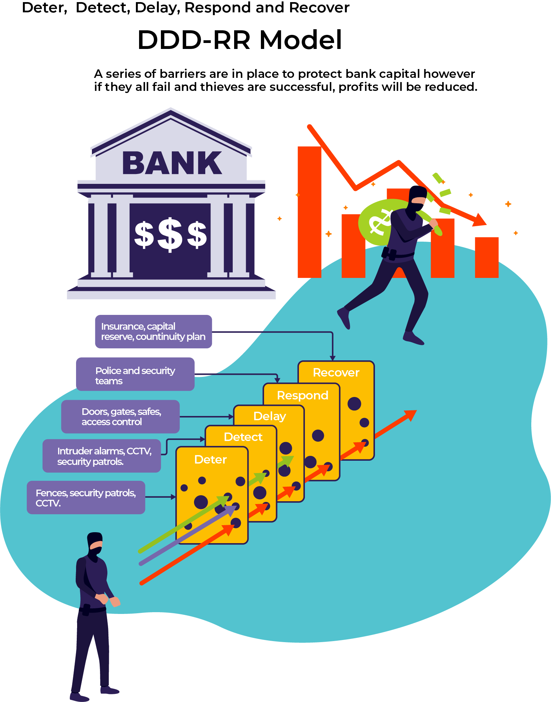
DDDRR

Slide 24
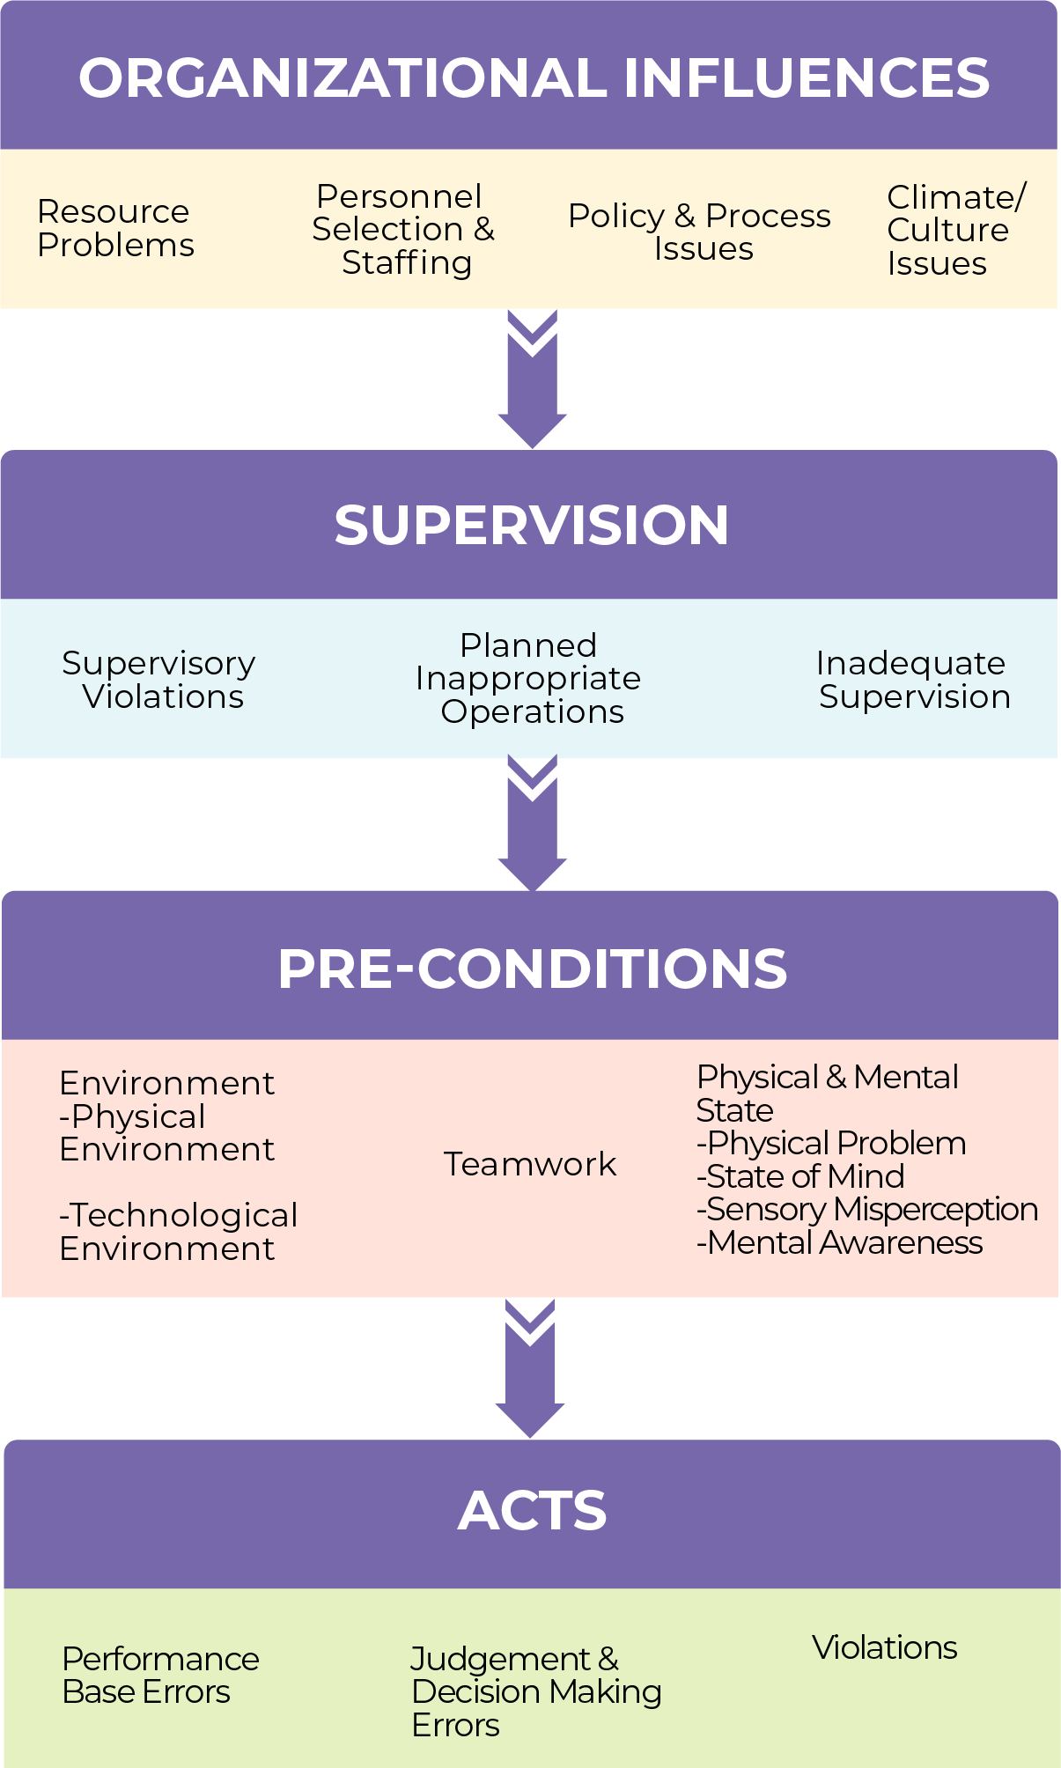
HFACS

Slide 25
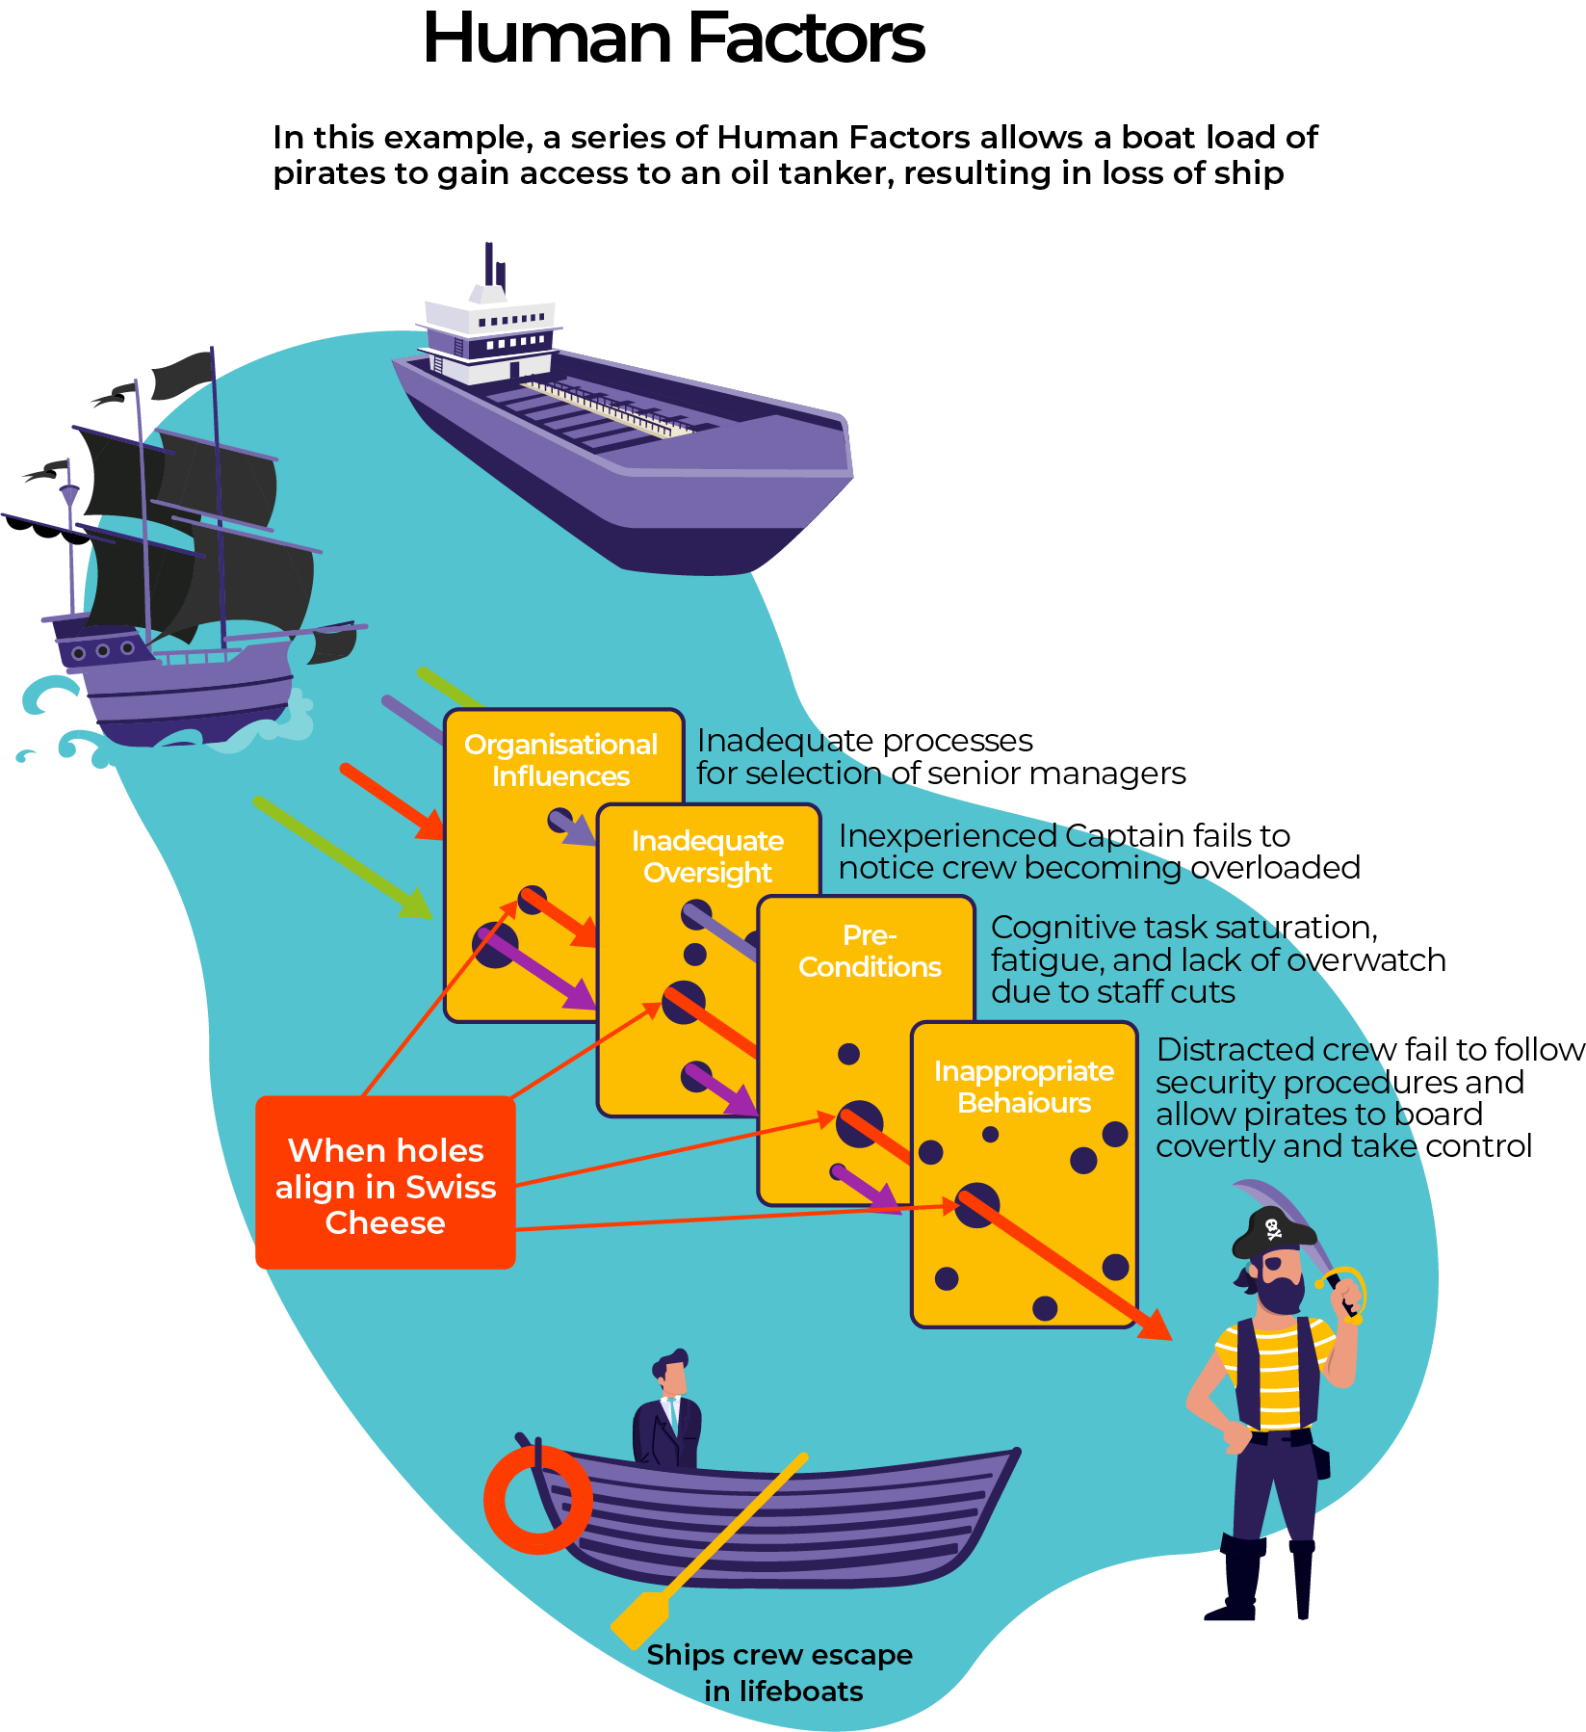
HUMAN
FACTORS
ANALYSIS CLASSIFICATION
SYSTEM

Slide 26
HUMAN
FACTORS
ANALYSIS CLASSIFICATION
SYSTEM

Slide 27
Defining Terms by Relationships
CONSEQUENCE
S
O
U
R
C
E
H
A
Z
A
R
D
T
H
R
E
A
T
S
E
F
F
E
C
T
Risk
Event
CONSEQUENCE
BARRIERS
ESCALATION
CONTROLS
ESCALATION
FACTORS
ESCALATION
FACTORS
THREAT
BARRIERS
ESCALATION
CONTROLS
LIKELIHOOD
MANAGEMENT
CONSEQUENCE
MANAGEMENT

Slide 28
PRACTICE
AREAS
Physical
Security
Information
Security
Security
Management
People
Security
ICT
Security

Slide 29
RESILIENCE
Capabilities
Functions
People
ICT
Information
Physical
Operating Environment

Slide 30
SRM INTEGRATION

Slide 31
Cost/Benefit of Mitigation
“A level of risk that is tolerable and cannot be reduced further without the expenditure of costs that are disproportionate to the benefit gained or where the solution is impractical to implement”
Level
of Risk
Risk
Cost
$, Resources, Effort
Cost / Benefit
ALARP

Slide 32

Light, strong, & cheap
Scope, Resources, Schedule (& Quality)
Chemical chain reaction

Slide 33
KNOWLEDGE AREAS
Risk
Resources
Quality
Exposure

Slide 34
Risk Equilibrium (Optimal Trade-Off)
Resources
Quality
Magnitude of Risk
Lower Risk Higher Risk
Intolerable
Resources and Quality in appropriate proportion to the Exposures for end result of risk ALARP
ALARP
Tolerable
Exposure

Slide 35
Risk High if Resources & Quality Low
Magnitude of Risk
Lower Risk Higher Risk
10
9
8
7
6
5
4
3
2
Quality
Resources
Risk
Exposure

Slide 36
As Low As Reasonably Practicable
Magnitude of Risk
Risk Increasing
Intolerable levels of risk
Adverse risks are intolerable
whatever the benefits and risk
mitigation measures are essential
at any cost if activity is to continue.
Intolerable
Cost Increasing
As Low as Reasonably Practicable
A level of risk that is tolerable and cannot
be reduced further without expenditure of
costs disproportionate to the benefit gained or
where the solution is impractical to implement
ALARP
Ideal levels of risk
Risks are negligible, or so small that they can be
managed by routine procedures and no additional risk treatment measures are needed.
Tolerable

Slide 37
Resources High but Quality Low
Magnitude of Risk
Lower Risk Higher Risk
10
9
8
7
6
5
4
3
2
Quality
Resources
Risk
Exposure

Slide 38
ASSETS (Resources)
PHYSICAL
PROPERTY
PEOPLE
CAPABILITY
INFORMATION &
COMMUNICATION
TECHNOLOGIES
INFORMATION

Slide 39
COMPETENCY AREAS
Business
Integration
Functional
Design
Implemenation
Assurance

Slide 40
SRMBOK FRAMEWORK
Strategic Knowledge Areas
Security-In-Depth
Exposure
Risk
Resource
‘Quality’
SRM Integration
Integration
Design
Application
Assurance
Operational Competency Areas

Slide 41
SRMBOK Framework
Activity
Areas
Practice Areas
Strategic Knowledge Areas
Security-In-Depth
Exposure
Risk
Resource
‘Quality’
SRM Integration
Integration
Design
Application
Assurance
Operational Competency Areas
Enablers
Regulation and Policy
Training and Education
Operations and Application
Governance and Oversight
Sustainability and Resilience

Slide 42
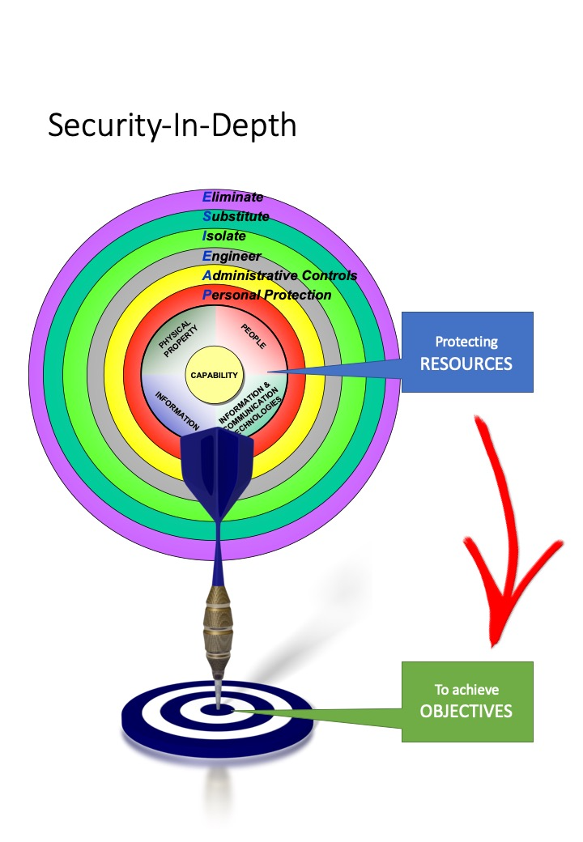

Slide 43
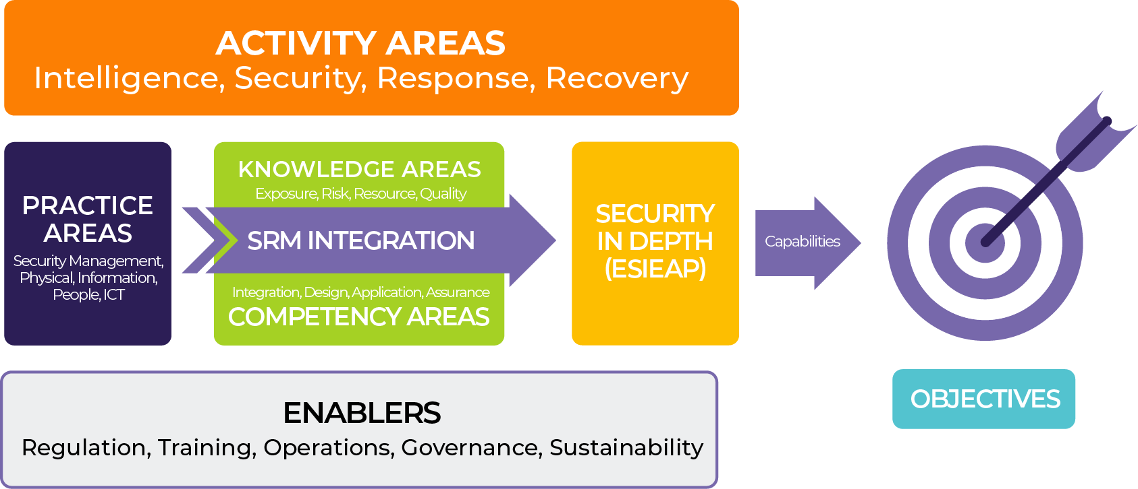

Slide 44
SECURITY GOVERNANCE
Security Governance refers to the processes by which organisations are directed, controlled and held to account. It encompasses authority, accountability, stewardship, leadership, direction and control exercised in the organisation. Generally focuses on two main requirements:
  Performance: whereby the organisation uses its security governance arrangements to contribute to its overall performance, the delivery of its products/services, and general resilience; and
  Conformance: whereby the organisation uses its security arrangements to ensure it meets the requirements of the law, regulations, published standards and community expectations.

Slide 45
ACTIVITY AREAS
BowTie Model
CONSEQUENCE
H
A
Z
A
R
D
T
H
R
E
A
T
S
E
F
F
E
C
T
Event
SRMBOK Activity Areas
REVENTION
PPRR Model
Notes:
AGREEING ON KEY TERMINOLOGY AND PROCESS
In developing methods to provide guidance on risk management, the different levels of readiness and experience across the organisation need to be recognised. Methods need to be flexible and simple using clear language to ensure open channels of communication. Agreed definitions of Risk, Source, Threat, Event, Impact, etc, and the relationships between them, will be fundamental to integrating risk management across the Department.
Example 1: Risks associated with driving a car using the ‘Risk Bow Tie’ model above.
SOURCE THREAT THREAT EVENT ESCALATION IMPACT
BARRIERS BARRIERS
MOTION other cars separation COLLISION Seat belts DEATH
mech failure training design
inattention common sense
Example: Grants Management
Risk: Misuse of public monies by Grant recipients
Sources: Departmental negligence, Criminal activity
Threats: Inadequate guidelines, changing environment, too few staff
Threat Barriers: Reporting, KPI’s, Training, Data-mining (profiling)
Event / Incident: Budget money is misused/misappropriated
Escalation Barriers: Insurance, Audits, Redundant systems, Budget reserves, Media liaison, Police investigation,
Impact: Financial loss, Service delivery, Reputation impact, Sanctions
WHITE BOARD SESSION:
use white board session to illustrate bow-tie model; example to use is driving a car. Aim to end up with something like below.

Slide 46
Activity Areas
Practice Areas

Slide 47
Activity Areas
Practice Areas
Investigators
Close Personal
Protection
Firefighter
Access Control
Fraud Analysts
IT Security
Advisers
Public Affairs
Recover
Class. Docs.
Intelligence
Professionals
Chief Security
Officer
Incident
Control
Project
Managers
Prison Officers
Vetting Officer
First Aid
Psychologists
Decryption
Specialists
Firewall
Programmer
Emergency
Comms
Technicians

Slide 48
Activity Areas
Practice Areas
Investigators
Close Personal
Protection
Firefighter
Access Control
Fraud Analysts
IT Security
Advisers
Public Affairs
Recover
Class. Docs.
Intelligence
Professionals
Chief Security
Officer
Incident
Control
Project
Management
Prison Officers
Vetting Officer
First Aid
Peer Support
Training
Decryption
Specialists
Firewall
Programmer
Emergency
Comms
Restore
Networks

Slide 49
…1,000 WORDS

Slide 50
SRM INTEGRATION
Activity
Areas
Practice Areas
Strategic Knowledge Areas
Security-In-Depth
Exposure
Risk
Resource
‘Quality’
SRM Integration
Integration
Design
Application
Assurance
Operational Competency Areas
Enablers
Regulation and Policy
Training and Education
Operations and Application
Governance and Oversight
Sustainability and Resilience

Slide 52

Morning Tea
1030 to 1100

