Slide 1
SRM Masterclass Singapore 28JAN20 Career Management
Julian Talbot

Slide 2
Career
Management
Goals
Leadership
Success!

Slide 3
Topics
Career management
Ethics and integrity
Increasing income
Improving skills
Dealing with senior managers and Boards
Qualifications
Pathways to CSO and CEO

Slide 4
“You’ll either pay the price of success or the price of regret… It’s your choice.”
Ruben Gonzalez Three-time Olympian

Slide 5
Options and choices will help you:
Love the job you are in
Be a better (security) manager
Protect people more effectively
Find more satisfaction in life
Reduce stress
Travel/play/learn more
Live more comfortably
Send kids (and yourself) to schools of choice
Retire comfortably

Slide 6
The game of
Life is like a Game
You play, you work, you play some more, you plan and prepare, but most of all you persist.
The harder you work, the luckier you get.
Whatever you can conceive and believe, you can achieve.
Know the rules. And if you don’t like them, change them.
Business &
LIFE
BE CREATIVE & BUILD YOUR OWN CUSTOM BOARD GAME!
WHAT MILESTONES ARE IMPORTANT TO YOU
YOUR OWN
WORDS
HERE!
START
YOUR FIRED
GO BACK TO START!
YOUR FIRED
GO BACK TO START!
YOUR
GAME
CREATE YOUR TEXT ADD INS HERE
MOVE ITEMS AS WELL AS CHANGE THE COLOR OF SQUARES
INSERT YOUR TEXT
GO TWO STEPS BACK!
Insert your personal
words

Slide 7
Steps to Career Success
Step 1
Step 4
Determination &
Hard Work
Willing to improvise
Step 2
Step 5
Teamwork
Develop Strategy
Step 3
Step 6
Study a lot!
Time & Patience

Slide 8
This first part is about…

Slide 9
A ‘How to’ Guide…
Julian Talbot
… 33% more income every 3 years

Slide 10
I noticed a funny thing
1. 33% pay increases
2. “Studied for this job”
3. 20/20 Hindsight
4. Non-salary income
5. Non-linear

Slide 11
Triple 3
Flow Chart Start
Step 1
Step 2
Step 3
Step 4
Flow Chart End

Slide 12
33% more $ every 3 years
1. Education
2. ‘Work’ experience
3. Promotions
4. Investing
5. Strategy

Slide 13
Why listen to me?

Slide 14
Why listen to me?

Slide 15
No, I’m not a property developer

Slide 16
Four Steps to 33/3
Opportunities to interview
Prepare
Networks
Education
Apply
Research
Interview
Demonstrate
Communicate
Experience
Resume
Grow Income
Raises
Investments
Promotions
Connect
Application
Options and choices
Earning a higher salary

Slide 17
Income continuum
Employee
Businessperson
Business owner
Investor

Slide 18
Career path
Student
Academic
Business owner
Employee
Business
Manager or specialist
Consultant or contractor
Investor
Business owner
Investor
Investor
Mentor

Slide 20
Follow your passions!
Is bad advice

Slide 21
Goals are useful. Systems are essential.

Slide 22
Don’t ”follow your passion”
Play to your strengths
You need simple systems that improve your odds

Slide 23
Examples of systems
“Systems improve your odds of success (however you define success) over time.”
Putting on gym gear
Enrolling in courses
Getting up early
Setting a schedule
Read one hour per day

Slide 24
Making yourself more valuable is a system
Aiming for your boss’s job is a goal
Public speaking
Qualifications
Second language
Business communication
Technology

Slide 25
Systems:
Goal:
Write a book
Write 1,000 words/day
Start the day by writing
Allocate 6-day blocks (away from home) to write
Write in cafes
Use a system to copy, categorize, and store references (Eg: Evernote)

Slide 26
Habits = Systems
“Successful people are simply those with successful habits.”
Brian Tracy
“Your success in life and work will be determined by the kinds of habits that you develop over time. The habit of setting priorities, overcoming procrastination, and getting on with your most important task is a mental and physical skill. As such, this habit is learnable through practice and repetition, over and over again, until it locks into your subsconscious mind and becomes a permanent part of your behaviour.”
Brian Tracy

Slide 27
OBJECTIVES
You won’t know if you are successful unless you know what you set out to achieve.

Slide 28
Play to your strengths
Pick 3 things you do well.
Things you do so well you in the top 25% in the world.
The intersection of those 3 things is where you will be in the top 1% in the world.
Security
Training
Management
If you think you aren’t in the top 25% anywhere, keep looking.
Read, study, listen an average of 1 hour per day and you’ll be in the top 25% in under a year.

Slide 29
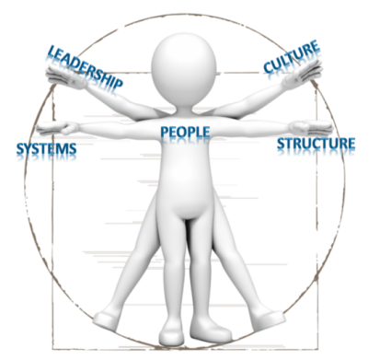
Career Management
Professional Development Series
The Secrets of Job Hunting
Julian Talbot

Slide 30
New Jobs and Promotions
Catch 22 (you need experience to get the job)
Why a new job is better than starting a business
Two page application that gets you interviews
Common resume mistakes
Build rapport at interview in 90 seconds
How to tell interviewers that you are BRILLIANT
while sounding modest…
Increase your income without changing jobs

Slide 31
The Promotion Cycle
Do well. Focus on what you can influence
Build your skills, knowledge and abilities
Increase your credentials
Professional associations
Scan for opportunities
Update your CV
Job application letter
Job interview

Slide 32
Preparation
Qualifications, opportunities, team.

Slide 33
Networks
Lunch
Coffee
Dinner
Seminars
Conferences
LinkedIn
Discussion groups

Slide 34
Education
Be selective – increase your options
Just take the first step
Even enrolled is better than not enrolled

Slide 35
Experience
Missing some experience such as:
Project Management
Leadership
?
Volunteer and take a role as an Officer in a professional association

Slide 36
Apply
Or don’t …

Slide 37
Research
Internal vacancies
Networks
Online
Colleagues
LinkedIn

Slide 38
Career Management
Professional Development Series
The Secrets of Job Applications
Julian Talbot

Slide 39
Application
Purpose: Gain an interview
Purpose: Gain an interview
Purpose: Gain an interview
Your application should:
Standout from the crowd
Be succinct - 2 pages is ENOUGH… Really!

Slide 40
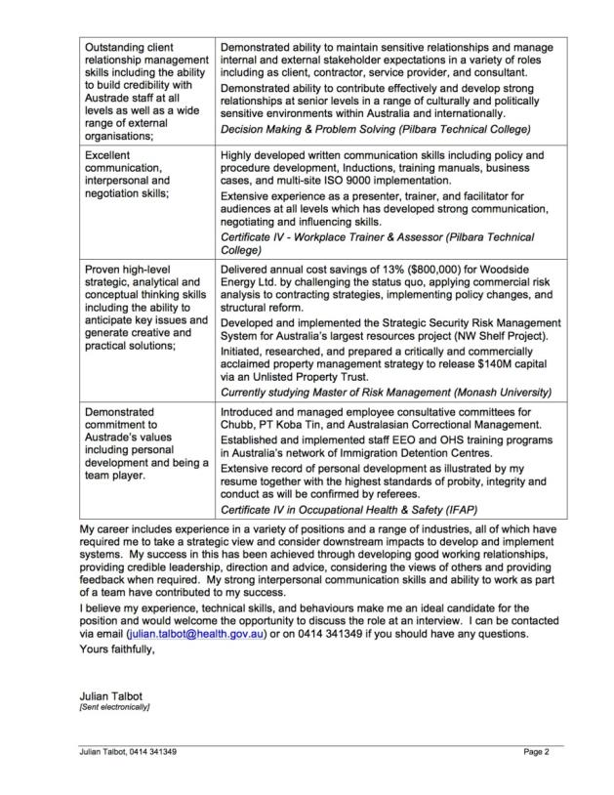
Application Letter

Slide 41
Response to Selection Criteria
Your requirements: | My Experience and Skills:
Proven leadership and management skills sufficient to manage a highly skilled and diverse team of professionals. | Proven executive leadership and mentoring experience at departmental level in complex environments with staff of up to 200. Team leader in a range of organisations including public sector, defence force, volunteer groups, security, and the resources industry. Performance Leadership Program (Woodside/McKinsey)
Appropriate qualifications combined with substantial senior level experience in managing a large portfolio of leased and owned properties, preferably within a public sector environment; | Strong commercial experience including responsibility for property portfolio’s to $200M and annual property services budgets to $8M. Team Leader on a review project for a $25M property services contract which delivered savings of 10% per annum through development of audit systems, Codes of Practice, contractor management systems, and Business Process Re-engineering. Specification, tendering, evaluation, and implementation of a $17M Security contract which delivered ongoing savings of 15% ($3M). Professional Certificate in Property Portfolio Management (UWS)

Slide 42
Resume
Main purpose is to create curiosity
Second purpose is justify your recruitment to your recruiters boss (after they decide to hire you)
Leave out anything that could get you excluded

Slide 43
What should be in a Resume
“The truth, the whole truth and nothing but the truth”
Anything that suggests that you have the appropriate experience
Information about your past employers (never assume we’ve heard of BHP)
Numbers, figures, quantitative data

Slide 44
What should be in a Resume
Contact details
Memberships
Credentials
Education
Work experience
Other experience
Directorships, Not-for-Profit, Volunteer experience

Slide 45
What’s OUT?
Hobbies and personal information
Unless absolutely relevant
Anything that could exclude you from interview

Slide 47
Tell us about your employers
Woodside Energy Ltd. is operator and part owner of Australia’s largest resources project, the $24 billion North West Shelf Venture (NWSV).
PT Koba Tin is a subsidiary of Malaysian Smelting Corporation (MSC), a multi-national resources group, conducting mining, smelting and exploration activities in Malaysia, Indonesia, Myanmar, and Australia.

Slide 48
Employer first. Then you
The Australian Trade Commission (Austrade) is the Australian Government agency that helps Australian companies win overseas business by reducing the time, cost and risk involved in selecting, entering and developing international markets.
My role as Manager, Property and Physical Security involved leading the Property and Security team to develop policy, strategies and standards to protect Austrade’s 1,300 staff and assets at 120 locations in 60 countries as well as to optimise and manage a global portfolio of 200 properties.

Slide 49
Numbers speak louder than words
Don’t assume I know what NPP means
Developed and managed a $60 million risk budget, new policy proposal (business case) and subsequent project management for security upgrades and training across 60 countries
Design and implementation of a $1 million security and safety training program
Analysis and management of a $60 million property portfolio of 200 properties in 60 countries

Slide 50
Numbers speak louder than words
Management of 30 staff to provide 24 hour security services, first aid, ambulance, marine radio and emergency response activities for onshore, offshore and marine assets in excess of $20 billion
Developed and delivered over 700 logged hours of competency based training and assessment including First Aid, Security, Leadership, Fire fighting, electronic Security systems and Emergency Response

Slide 51
Numbers speak louder than words
Delivered annual cost savings of $800,000 (13%) through challenging the status quo, applying commercial risk analysis to contracting strategies and implementing structural reform and policy changes.
Concurrently managed projects to $1.4M including a $500,000 building refurbishment project, with tight end of year budget deadlines. Applied strong project management principles which resulted in the project exceeding deliverables, coming in ahead of schedule, under budget ($434K) and safely (no one was hurt, risks were identified and managed by applying techniques such as focussing staff on HSE while managing scheduling and resourcing from the top down).

Slide 52
Career Management
Professional Development Series
The Secrets of Job Interviews
Julian Talbot

Slide 53
Demonstrate
Enthusiasm
Commitment
Interest
Knowledge of the employer

Slide 54
FIGJAM
Tell people how good you are
But do it by answering their questions using SOAR:
Situation
Options
Action
Result

Slide 55
FIGJAM (SOAR) Process
Write down a list of all the things you are great at:
Project management
Communication
Leadership
Etc
Think of a story to illustrates each strength
Google a list of typical interview questions
Link questions with your stories

Slide 56
Communicate
Question: Tell me about how you coordinated an awareness program for Senior Management
Situation: When I first proposed the adoption of a risk management framework at Health, the first step was to gain senior management support.
Options: I considered one-on-one meetings, a written proposal, and video conference.
Action: I spoke with my boss, then her boss and arranged a presentation to outline my proposal. Given the difficulties of gaining snr mgmt attention, I arranged with the AS for the presentation to take place following a normal meeting when all the key people would be present. I kept the information short and concise, outlining the benefits of the program. It was the first of a number of presentations.
Result: unanimous support for the initiative

Slide 57
Communicate
Q Give an example where you have encountered resistance to an initiative and how you overcame it
Situation: when with PTKT I attempted to conduct a base line risk audit. There was considerable resistance. It was perceived as threatening.
Options: It was too important to let it drop.
Action: Discussed it further, Circulated the questions, removed the scoring system
Result: Gained support in some areas, eg maintenance. and used this to introduce the concept to others.

Slide 58
Connect
Spend your time before the interview relaxing and preparing by reading your SAR
Be pleased to see them
Remember names
You’ve got roughly 90 seconds to make a first impression
Mirror and match your body language
Your likelihood of success is proportional to the amount of time you spend listening rather than talking
Thank everyone at the conclusion

Slide 59
Non-verbal communication
Examples of non-verbal?
Most honest part of the body?
How to tell if someone is lying?
How to use non-verbal comms as a manager?
How to emphasize a point? (hint: quietly)

Slide 60
Career Management
Professional Development Series
The Secrets of Growing Your Income
Julian Talbot

Slide 61
Salary increases
Don’t be afraid to ask but before you ask, know:
What have I done to earn it?
Market value - what would I earn elsewhere?
What could I take on to justify an increase?
What skills, capabilities, or education have I acquired since I came to the role?

Slide 62
Promotions
Let people know that you are ambitious
Understand what you are passionate about and what jobs would suit you perfectly
Work on gaining the necessary skills, knowledge, abilities and EXPERIENCE
If you want to be a Leader, behave like a leader

Slide 63
Investments
Three avenues to a healthy income:
Running a (successful) business
Investing
Increasing your salary
So why not do more than one?

Slide 64
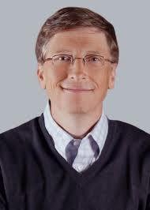
A salary is more likely to make you comfortable or mildly wealthy
Most business people
Bill Gates

Slide 65
Four Steps
Opportunities to interview
Prepare
Networks
Education
Apply
Research
Interview
Demonstrate
Communicate
Experience
Resume
Grow Income
Raises
Investments
Promotions
Connect
Application
Options and choices
Earning a higher salary

Slide 66
Career Management
Professional Development Series
The Secrets of Doing The Job
Julian Talbot

Slide 67
Stress management 101
The known universe
Sphere of concern
Sphere of influence
Sphere of control
Focus on your sphere of influence
And your sphere of influence will grow

Slide 68
Achieving Success
PROFESSIONAL DEVELOPMENT SERIES
Theory
What is success
How to achieve it
Practice
Commit to a plan
Monitor and review
Reality
Stay on track
It takes persistence!

Slide 69
Success is the…
“The starting point of all achievement is DESIRE. Keep this constantly in mind. Weak desire brings weak results, just as a small fire makes a small amount of heat.”
Napoleon Hill
accomplishment of an aim or purpose

Slide 70
The Secrets…
“To be successful, you must decide exactly what you want to accomplish, then resolve to pay the price to get it.”
Nelson Bunker Hunt
Success requires objectives
Take responsibility
Clarify your values and beliefs
Decide your purpose
Make a plan
Start at the beginning
Associate with the right people
Design your future
Measure your progress
Modify the plan

Slide 71
Take charge of your life
“Whether you think you can, or you think you can’t – you're right!”
Henry Ford
YOU are responsible for where you are today!
Imagine you could do, be or achieve ANYTHING tomorrow?
Choose your future.

Slide 72
Career Management
Professional Development Series
The Secrets of Dealing With Boards And CEOs
Julian Talbot

Slide 73
The Basics
Time is valuable
Come with solutions
Always have two options
Always have a backup plan (Plan B)
If you need signoff, get everyone into the room
They don’t see risk the same way you do
They care about objectives, not pretty frameworks
Ask for what you want but include “ … because … ”

Slide 74
Reports and Documents
Thorough, detailed, summarized
Heavier documents are perceived as more important/accurate/reliable
A bound document is perceived as final, whereas a stapled document is ‘a draft’ for comment
99% of the time only the Executive Summary is read so make it brilliant
Revise, edit, no typos
“So if I fix that typo, it’s good to go?”

Slide 75
Communication
Put yourself in their shoes
Eight step problem solving
Non-verbal communication
Visual
Succinct
Can’t tell them what to think – but you can tell them what to think about
Bigger picture and more information than you have

Slide 76
8 Step Problem Solving Methodology
What is the problem?
Define the problem in as few words as possible.
Why is it a problem?
The customer (internal or external)
What causes the problem?
Materials
What is the best fix (or fixes)?
Why is it the best fix?
What action must be taken to implement the best fix?
Question Time
Search in advance whether there are possible flaws in your solutions, which will be exposed by a question from management.
What are the possible fixes?
The definition must be comprehensive, leaving no room for error about what is really meant.
Use one sentence if possible to describe the 4Cs: condition (what is happening), criteria (what should be happening), cause (underlying root cause) and consequence(s).
The people in the process
People working in other departments
Costs
Profitability
Machinery
Methods
Measurements
People
Environmental factors
Brainstorm a list of possible fixes regardless of how unusual or difficult
All ideas should be listed
Does it directly address the underlying cause of the problem so carefully defined in question one?
Will it alleviate or remove symptoms listed in question 2?
Will it lead to correction or removal of the cause(s) identified in question 3?
Include costing and benefits in your recommendation when they can be obtained.
5Ws: Who has to do What, When, Where and with Which resources.
Any question the managers can think of, you can think of. Include it - and the answer - in your presentation to management.
The suppliers
Various forms of waste (time, materials, resources)
Management Systems
Morale
Try to aim for at least 50 as some of the best solutions are the least obvious or simple appear ‘impossible’ until they are examined in depth
Select the one (or more) that the group feels is most appropriate.
If need be, produce a sequential list of tasks.
This process will work on any problem in any situation, for both individuals and organizations.
HOW TO USE THIS PROCESS
You can use this as an individual exercise, in which case you can download a template from www.juliantalbot.com but it also works extremely well as a group brainstorming session or creative workshop processes to hellp a team resolve a particularly challenging problem.
The First Step is the most important one (and the one that sometimes takes the longest the most time). The reason most intractable problems appear intractable, is that they haven't been clearly defined and agreed. Define it in as few words as possible, but ensure that it is comprehensive, leaving no room for error about what is really meant. You might for example (as one of our clients did) identify an issue related to ongoing operational losses associated with cost overruns. This unfortunately isn’t a problem than can be addressed because it hasn't been defined. From this initial 'issue' however, you might with the help of a workshop or three, establish that the cost overruns occur because managers don’t receive timely or accurate financial reports. This could be due to a number of issues and would almost certainly take volumes to fully describe, but it might for example come back to something like “Failure to deliver organizational objectives within budget due to cost overruns, as a result of inadequate financial reporting”. You might still need lengthy descriptions, graphs or data to define the exact issues and solutions, but at least everyone can now see the underlying issue and describe it in a single sentence. So how do we do this consistently? The 4 C’s are a handy guide to clarify our understanding:
Criteria - What should be going on? What are the organizational objectives? Are we compliant with internal or external standards and guidelines?
Consequence - What might happen if we do not fix it?
Condition - What is going on?
Cause - Why is this happening? What is the root cause?
Once you've worked through the full process, the results can be implemented immediately in many cases. In more complex situations or where the solution is expensive, this process forms the basis of a report or business case. Just change the headings and you're report is written. Eg: Change "What is the problem?" to "Background" and "What are the possible fixes?" to "Options considered", etc and you've got your action plan documented.

Slide 77
Career Management
Professional Development Series
The Secrets of Achieving
Julian Talbot

Slide 78
Clarify your values and beliefs
“If you can't do great things, do small things in a great way.”
Napoleon Hill
What are your core values?
What kind of person are you?
What do you believe in?
What qualities do you admire most in other people?
Do you have a personal code of conduct that you follow?
How do you behave when no one is watching?
Take an inventory of your values!
Where do you spend your time?

Slide 79
Personal Values
“The easiest way to determine your values is to look at where you spend your time.”
Julian Talbot
Achievement Adventure Autonomy Balance Contributing Creativity Financial security Emotional well-being Freedom Honesty Humor/Fun Independence | Intellectual Challenge Justice/Fairness Love/Family Money Physical challenge Power Religious/Spiritual Stability Structure Tranquility Variety

Slide 80
“Your beliefs become your thoughts, your thoughts become your words, your words become your actions, your actions become your habits, your habits become your values, your values become your destiny.”
Mahatma Gandhi

Slide 81
Personal Values
“Surround yourself with only people who are going to lift you higher.”
Oprah Winfrey
Accomplishment Adaptability Approval Beauty Calm Charity Collaboration Community Competition Courage Craftiness Decisiveness Democracy Discovery Efficiency Excellence Faith Family Fortitude Fun Goodwill Happiness Heroism Humility Individuality Integrity Joy Knowledge Love Merit Nature Oneness Patience Perfection Philanthropy | Accountability Adventure Awareness Being the Best Challenge Charm Commitment Compassion Confidence Cooperation Creativity Determination Dignity Diversity Enjoyment Exuberance Faithfulness Fidelity Freedom Generosity Goodness Harmony Sympathy Thankfulness Tolerance Trust Unity Victor Power Preservation Prosperity Realism y Truth Uniqueness Well-being | Accuracy Ambition Balance Benevolence Change Cleanliness Communication Competence Connection Coordination Daring Delight of being Discipline Dynamism Equality Fairness Fame Flair Friendship Gentleness Rule of Law Satisfying others Self-reliance Significance Solving Problems Stability Strength Systemization Thoughtfulness Tradition | Resilience Responsiveness Sacrifice Security Sensitivity Simplicity Speed Standardization Success Teamwork Timeliness Tranquility Understanding Variety Wisdom Gratitude Health Honor Independence Innovation Intensity Kindness Liberty Meaning Money Obedience Originality Peace Perseverance Popularity Pragmatism Progress | Honesty Improvement Inner peace Intelligence Justice Leadership Loyalty Mindfulness Nonconformity Open-mindeness Patriotism Personal Growth Pleasure Practicality Privacy Prudence Regularity Resourcefulness Results-oriented Safety Self-control Sensuality Skill Spirituality Status Punctuality Reliability Respect for others

Slide 82
Make some space
Meditate
Mini-retirements
Reflection
Time for self
Time for others

Slide 83
Career Management
Professional Development Series
The Secrets of the Effect of Uncertainty on Objectives
Julian Talbot

Slide 84
Determine your objectives
“A goal is a dream with a deadline.”
Napoleon Hill
“I want to be rich” …is a daydream
“$2 million net worth by Dec 2023” …is an objective!

Slide 85
Determine your objectives
“You can’t build a reputation on what you are going to do.”
Henry Ford
SMART
Specific
Measurable
Achievable
Realistic
Timeframe
3 P’s of Goals
Personal
Present tense
Positive

Slide 86
Determine your goals
“A man does not show his greatness by being at one extremity, but rather by touching both at once.”
Blaise Pascal

Slide 87
Decide your purpose
“You are the master of your destiny. You can influence, direct and control your own environment. You can make your life what you want it to be.”
Napoleon Hill
What is your higher purpose?
What will sustain your goals!?!
Why are you here?
To make the world a better place?
Provide great IT solutions?
Raise a wonderful family?
To adventure?
Work out what your purpose is:
How you spend your time?
Who is it for or who does it serve?
What brings you joy?
Why did you choose your current life?

Slide 88
Start at the beginning
“When your desires are strong enough, you will appear to possess superhuman powers to achieve.”
Napoleon Hill
Take an inventory of where you are now:
Assets, liabilities, income, expenses
Family, relationships, adventure, career
Be realistic and honest

Slide 89
Make a plan
“…plans are useless, but planning is everything.”
Dwight D. Eisenhower
Start with the end in mind.
Eat the elephant one bite at a time!

Slide 90
Associate with the right people
“My best friend is the one who brings out the best in me.”
Henry Ford
Associate with positive people
ONLY share your goals with people who will truly support them/you!
Build a team
Accountant
Solicitor
Advisors
Mentors
Supporters

Slide 91
Visualise
“Whatever the mind can conceive and believe, it can achieve.”
Napoleon Hill
How will you feel when you achieve your objective(s)?
Where will you live?
What will you do?
What colour is your objective?

Slide 92
Review your objectives
“Set your mind on a definite goal and observe how quickly the world stands aside to let you pass.”
Napoleon Hill
Daily
Weekly
Annually
Take personal responsibility:
If they’re not achieved… Why? Understand your contribution and move on – revise timeline and/or plan.
If they are… celebrate, take the credit and set new objectives & plans!

Slide 93
Measure your progress
“When defeat comes, accept it as a signal that your plans are not sound, rebuild those plans, and set sail once more toward your coveted goal.”
Napoleon Hill
Review your objectives frequently
Measure the progress
Check and adjust your action plan

Slide 94
Take Action Today!
“Do not wait: the time will never be 'just right'. Start where you stand and work whatever tools you may have at your command and better tools will be found as you go along.”
Napoleon Hill
Work out what you want
Work out how to achieve it
Do something today!
Do SOMETHING toward your goals EVERY day!

Slide 95
Don’t stop at the 99-yard line!
Just do it!
And keep doing it!
“Before success comes in any man’s life, he is sure to meet with much temporary defeat, and, perhaps, some failure. When defeat overtakes a man, the easiest and most logical thing to do is to quit. That is exactly what the majority of men do. More than five hundred of the most successful men this country has ever known told the author their greatest success came just one step beyond the point at which defeat had overtaken them.”
Napoleon Hill

Slide 96
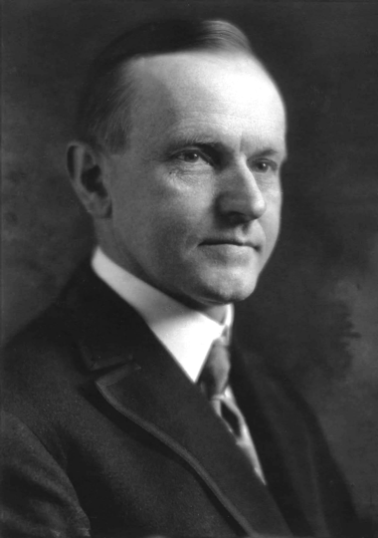
Persist
“Nothing in the world can take the place of persistence. Talent will not; nothing is more common than unsuccessful men with talent. Genius will not; unrewarded genius is almost a proverb. Education will not; the world is full of educated derelicts. Persistence and determination alone are omnipotent. The slogan ‘Press On!’ has solved and always will solve the problems of the human race.”
Calvin Coolidge 30th President of the United States (1923–1929)

Slide 97
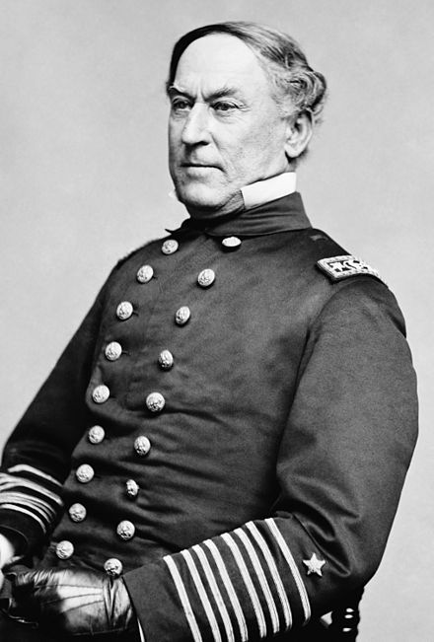
Some further material
"Damn the torpedoes, Full speed ahead!”
Admiral David Glasgow Farragut
Napoleon Hill
Brian Tracy
Jon DeMartini
If you read one hour per day…
You will read 50 books per year!
In 4 years you can know more on ANY subject than 99.99% of the planet!

Slide 98
Triple 3
Set an smart objective.
“I will increase my income 33% every 3 years for the rest of my life.”
Objectives
Intersection of top 3 = top 1%
Systems for success
Get known, let jobs find you
Non-verbal communication
Volunteer and contribute
Sphere of Influence
Persistence
Make some space

Slide 99
Additional ideas?
Questions?

Slide 100
The game of
Life is like a Game
You play, you work, you play some more, you plan and prepare, but most of all you persist.
The harder you work, the luckier you get.
Whatever you can conceive and believe, you can achieve.
Know the rules. And if you don’t like them, change them.
Business &
LIFE
BE CREATIVE & BUILD YOUR OWN CUSTOM BOARD GAME!
WHAT MILESTONES ARE IMPORTANT TO YOU
YOUR OWN
WORDS
HERE!
START
YOUR FIRED
GO BACK TO START!
YOUR FIRED
GO BACK TO START!
YOUR
GAME
CREATE YOUR TEXT ADD INS HERE
MOVE ITEMS AS WELL AS CHANGE THE COLOR OF SQUARES
INSERT YOUR TEXT
GO TWO STEPS BACK!
Insert your personal
words

Slide 101
Homework
Write a list of objectives
Write 200 ways that more income will help you
Systems to take some small action every day

