Slide 1
Five insights in Risk Management
Julian Talbot
#RISKAWARENESSWEEK2020
Notes:
I’ve worked as a risk manager, executive, CEO, and consultant for a lot of organizations, Each of them has taught me something along the way. For the past few years I’ve been working as aa investment manager, a mentor and company director for a range of companies. Some of them are start-ups, some of them are household names you would recognize, You might even be working for one of them now.
One of the most satisfying roles is being a coach and mentor for senior managers and entrepreneurs. If you’ve ever had a mentor, you’ll already know how powerful it can be to have someone who you can speak with confidentially and with confidence that they are on your side. That one hour a week or one hour a month? A mentor is someone who can answer your questions, speaking from experience, can give you a new sense of perspective, and perhaps most importantly, lead you to fresh insights.
I’d like you to think of this presentation as a free one hour of mentoring. Imagine you’ve paid $500 for this hour.
I know it's tempting to multi-task. I've been guilty of doing email while listening to a webinar. You may be doing that right now. But ask yourself. How important is the seemingly urgent neverending list of tasks? Will you achieve more over the next 2 years , 3 months and 8 days if you give your attention to the insights in presentation?

Slide 2
The Insights
Swiss Cheese = Causal Chains
It isn’t what you think
The inevitable
The matrix we all use
The matrix we should use
Cyber!
Rock pools of risk
RIP Black Swan
Thank you COVID19
Dinosaurs rule the world
Plan B is priceless
Blind spots
Future management
Defining risk
Geniuses they may be
Fooled by randomness
Intuition
Road to hell
Culture = performance
Anxiety is your friend
DRD4 has a lot to answer for
Who makes your decisions?
Nothing is as important as you think
Notes:
For the first 45 minutes I’m going to discuss 20 or so key insights that are common for all organizations. I know, the presentation was only supposed to be 5 but I tend to get a bit carried away and I wanted you to have as much of the the best insights I could possibly provide in this short period.
I’ve also got a few giveaways and sources for you so stay tuned to the end.
You’ll no doubt know a few of these insights but if you can take away just one additional insight from this next hour it will have been worth it.
We’ll cover off a lot of ground and I’m going to go very quickly, but you can come back to this presentation as often as you like and use the pause button during the re-runs.

Slide 3
The Evidence
Notes:
I’ve also built a website just for you which provides links to some of the best research on these insights and the evidence behind them. I’ve found the most user-friendly videos and books, most of which then lead you to the peer-reviewed research.
Ask any questions in the comments because if you are thinking of a question, other people will also have the same question.
I asked you to think of this presentation as an hour of personalized mentoring so if you have sensitive questions that rather not raise in this public forum, get in touch with me, preferably today and we can organize a free 15-minute conversation.
Basically, a chance to have someone on your side you can speak with in confidence, knowing that it won’t get back to your boss or client. If you don’t already have that, drop me a line because it’s your chance to tap into 40 years of risk management and leadership experience for free.

Slide 4
What project or issue is my biggest challenge?
Notes:
Last but not least, I want you to get the most out of this so before we start, I’d like you to think about something. Ask yourself ‘what is the biggest problem I have right now?
Jot it down on your notepad or phone as a message to yourself. Lets see if any of these insights can answer your current challenge.
At the end, I’ll share with you the link to get in touch with me if we haven’t already answered it. Professional, personal, societal, whatever is currently troubling you Go on. I’ll wait.
Just kidding. I’ll start now. But I do encourage you to write down at least in bullet points, your current challenge, or challenges. That single act will help you get the most out of this presentation.
But now, here are some insights and answers to questions that the people I’ve been mentoring have typically benefited from professionally and personally.

Slide 5
It isn’t what you think
Notes:
8
https://amzn.to/3hUqz5A
High Reliability Organizations (Managing the Unexpected)
Woodside ESRA. Not comms, not pipeline, not turbines, but electrical distribution

Slide 6
Risk... it's NOT the effect of uncertainty on objectives
Notes:
10

Slide 7
Risk management = future management
Against The Gods
Volcanoes
Gods
Risk management
What next?
Notes:
12

Slide 8
Blind spots
Notes:
14
Thinking, Fast & Slow

Slide 9
RIP Black Swan
Notes:
16

Slide 10
The matrix we all use Stroud Matrix
Notes:
18

Slide 11
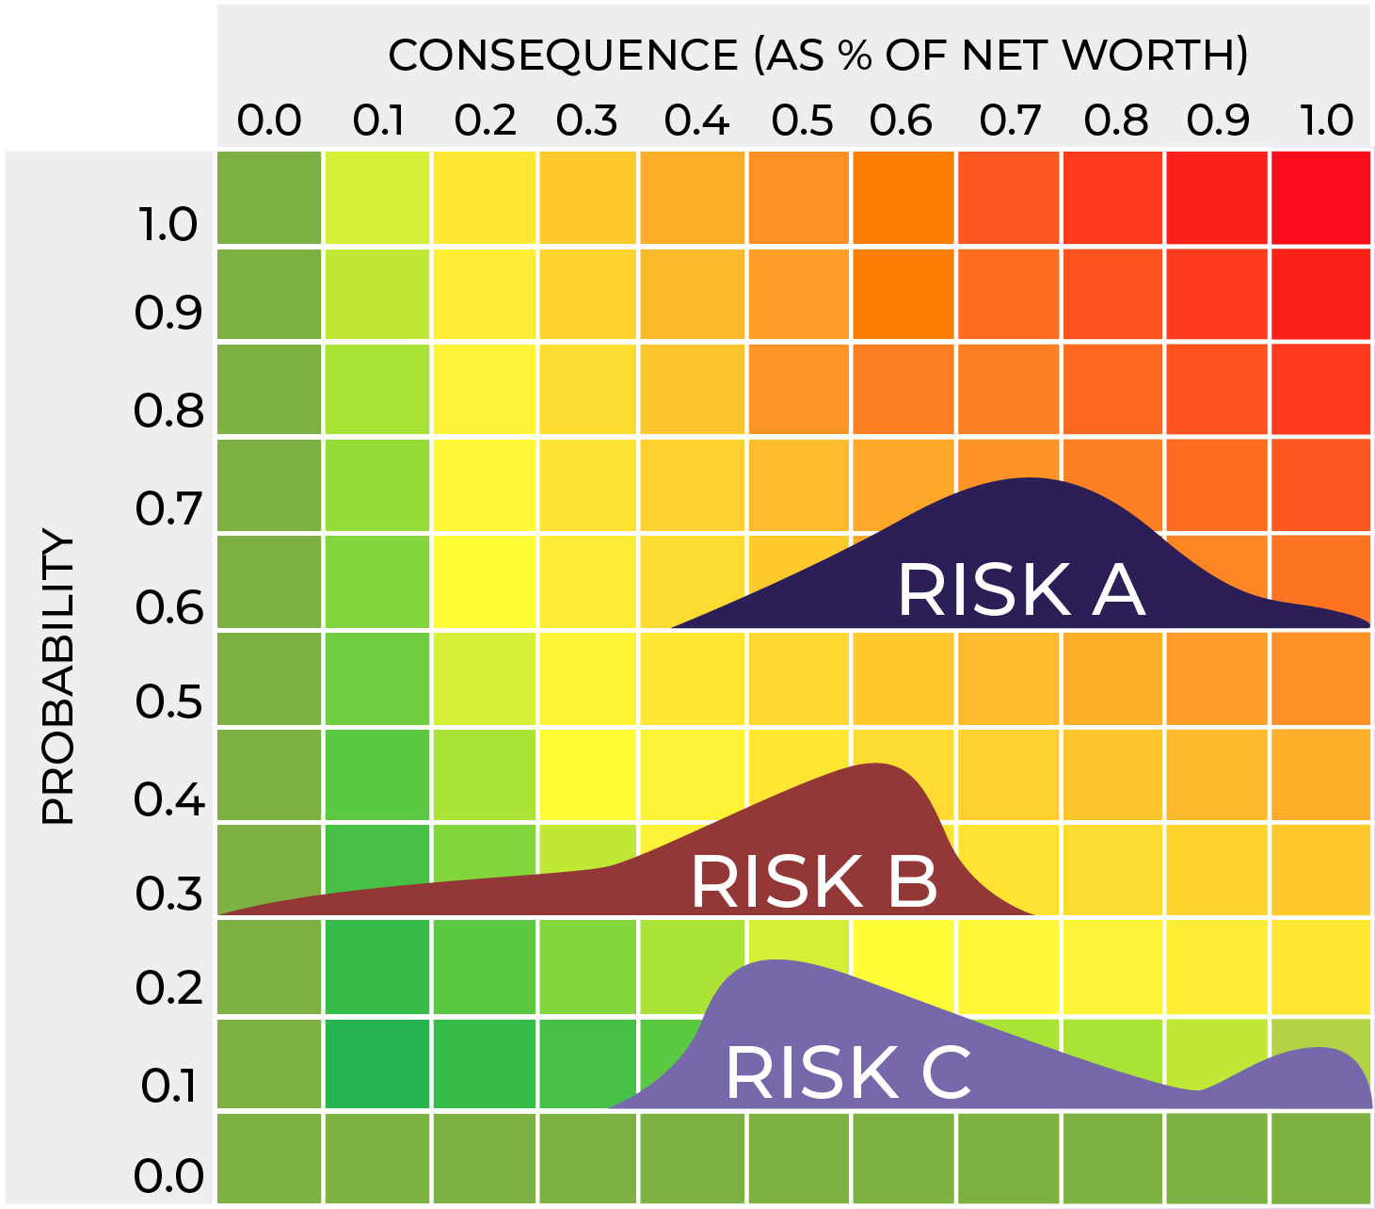
The matrix we should use
Notes:
20

Slide 12
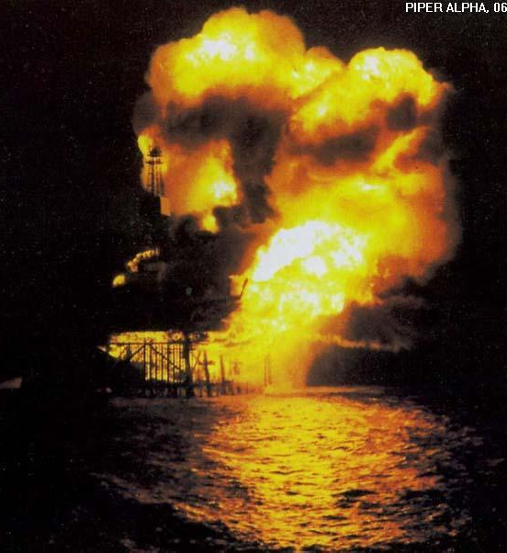
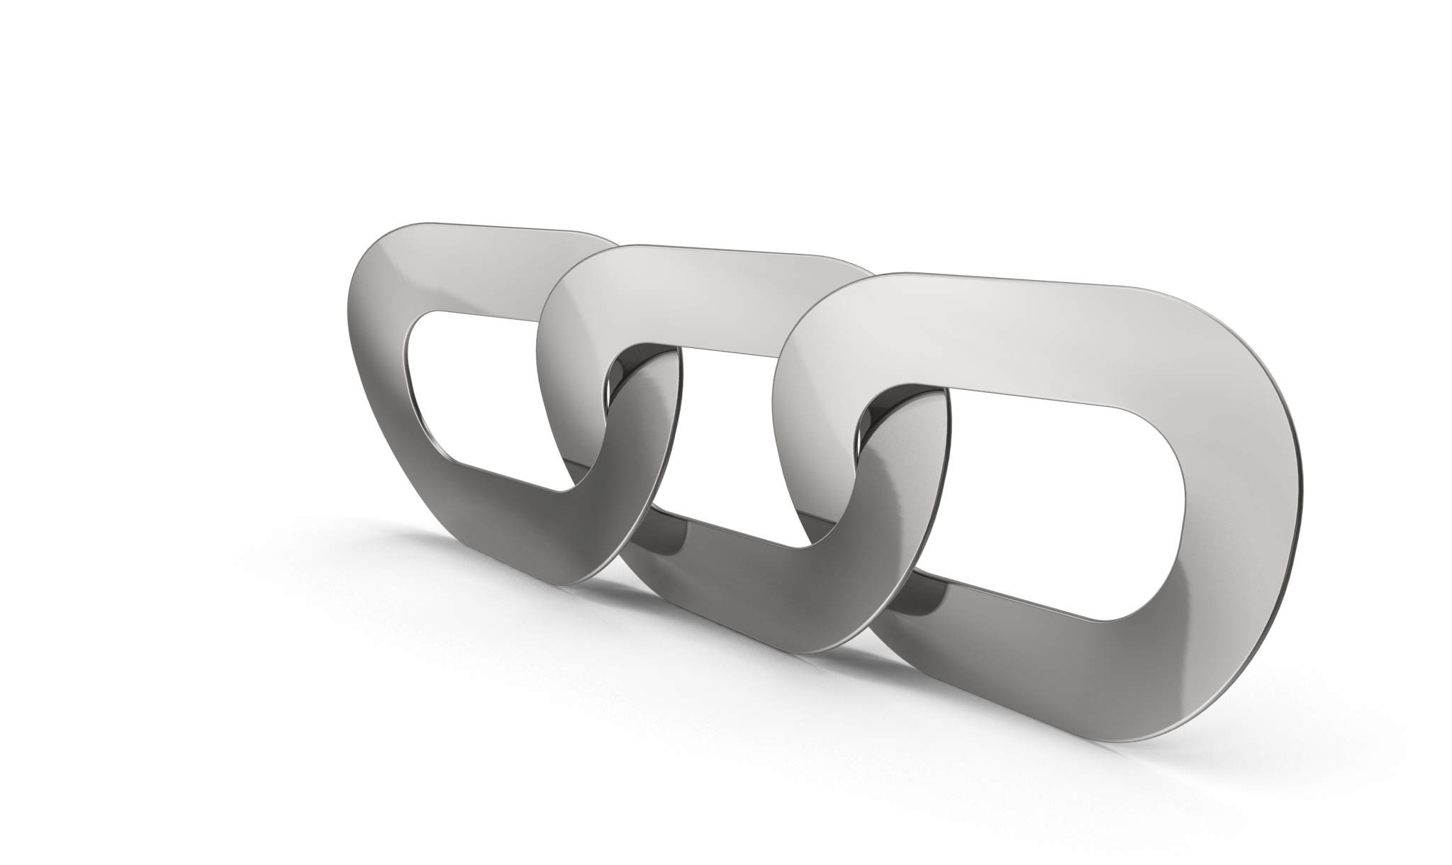
Swiss Cheese = Causal Chains
Piper Alpha case study
Our modelling needs to improve
Notes:
24

Slide 13
Rock pools of risk
Notes:
26

Slide 14
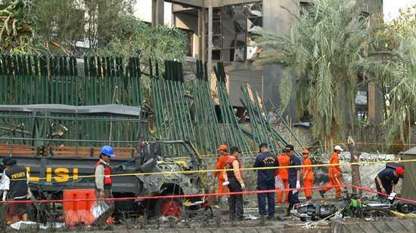
Thank you COVID19
The next pandemic
Jakarta Embassy
Notes:
28

Slide 15
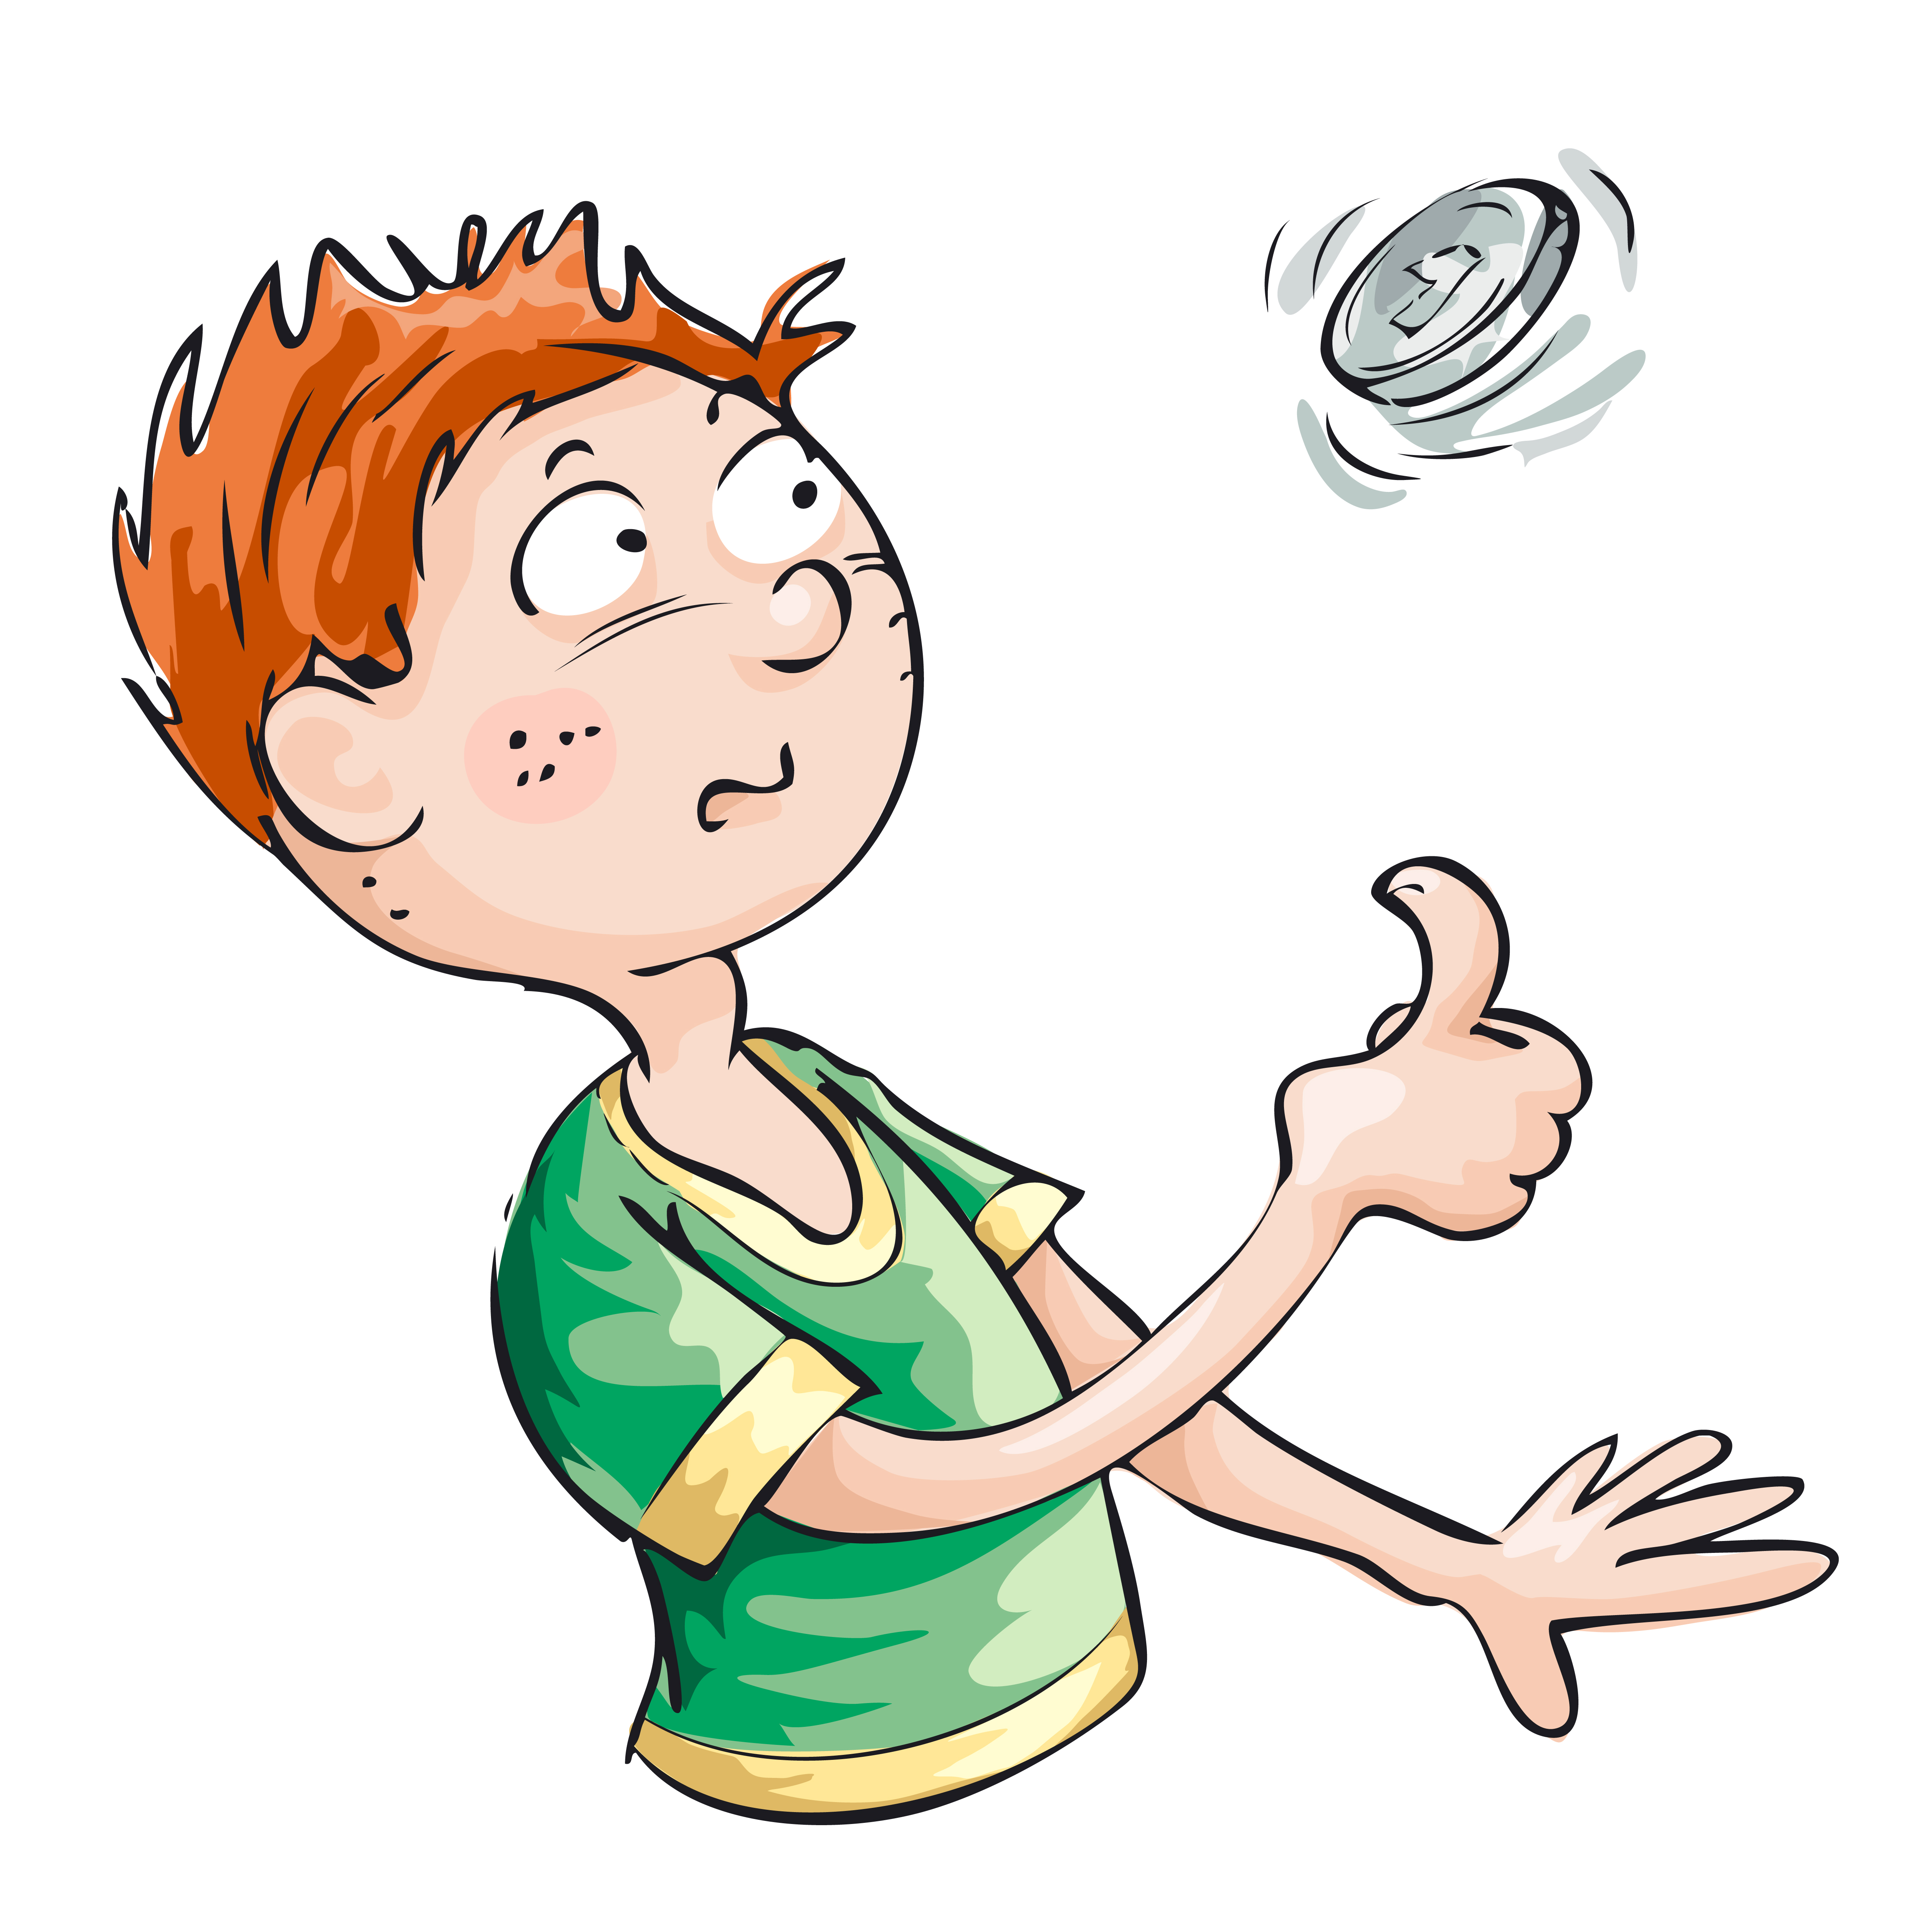
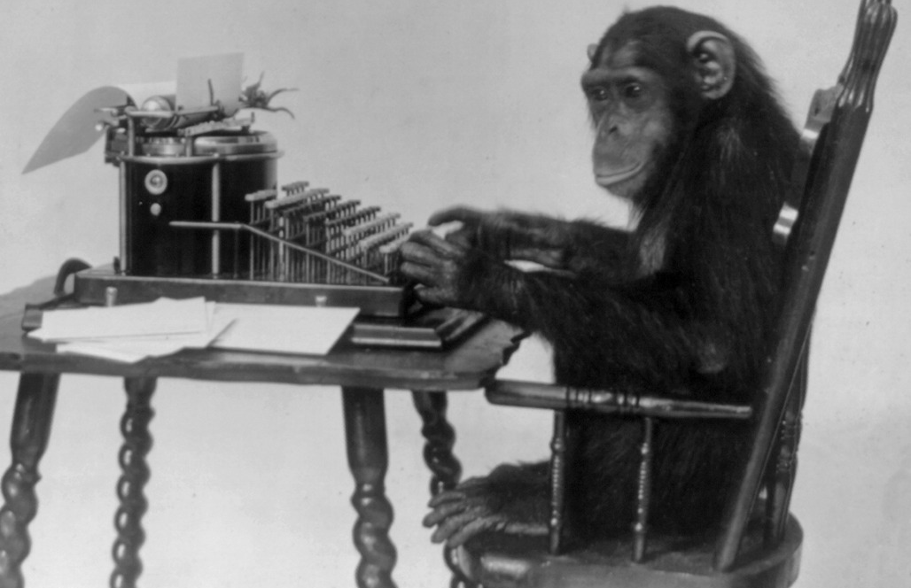
Fooled by Randomness
95% of managed funds don’t beat the market
1,024 → 512 →256 → 128 → 64 → 32 → 16 → 8 → 4 → 2 = 1 successful investor
Infinite number or monkeys with infinite time and typewriters will produce the complete works of Shakespeare
Notes:
30

Slide 16
Geniuses they may be
“Don't be buffaloed by experts and elites. Experts often possess more data than judgment. … Don't be afraid to challenge the pros, even in their own backyard.” – Colin Powell
Long Term Capital Management: the case study of when genius fails
Notes:
32

Slide 17
Anxiety is your friend
Many people have trouble dealing with ambiguity
Anxiety serves a purpose
Define uncertainty and make it your friend
Notes:
34

Slide 18
Plans may be worthless, but a good Plan B is priceless
Notes:
36

Slide 19
Intuition as a 4 step process
Listen
Recognise
Trust
Act
Notes:
38

Slide 20
The Road to Hell
We judge ourselves by our intentions but others by their behavior
Ergo: people judge you by what you do – not what you intended
And if you want to impress on people, what exactly is important… People don’t judge what is important by what you tell them is important, they don’t judge what is important by what you do. They judge what is important by where you spend your time.
If you talk big about risk management but then spend all your time working on marketing and finances – that is what your people will spend their time on also.
Notes:
40

Slide 21
Culture = performance
Objectives
Training Needs Analysis
Training
Behavior
Attitude
Culture
Performance
Outcomes
Notes:
42

Slide 22
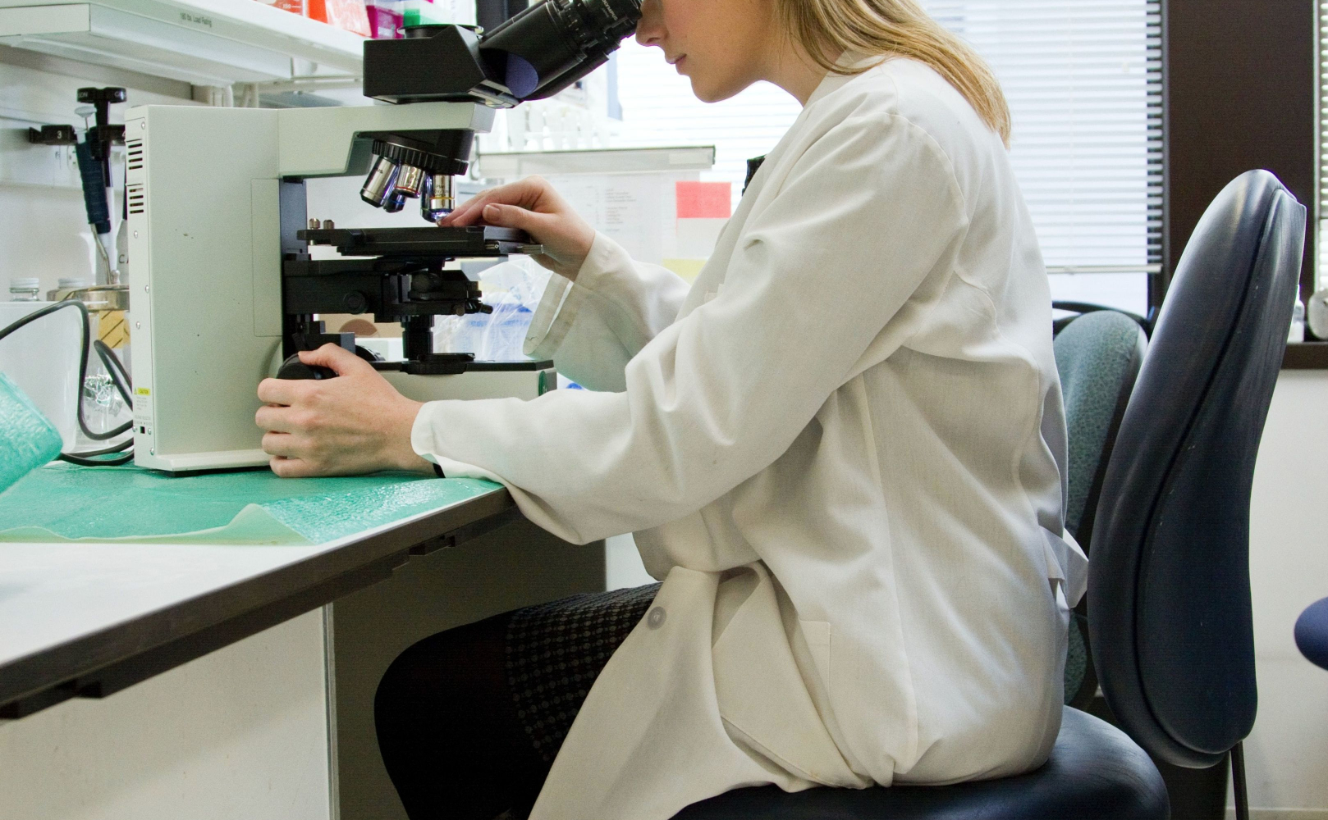
DRD4 has a lot to answer for
Risk Homeostasis
Risk taking
Training
Notes:
44

Slide 23
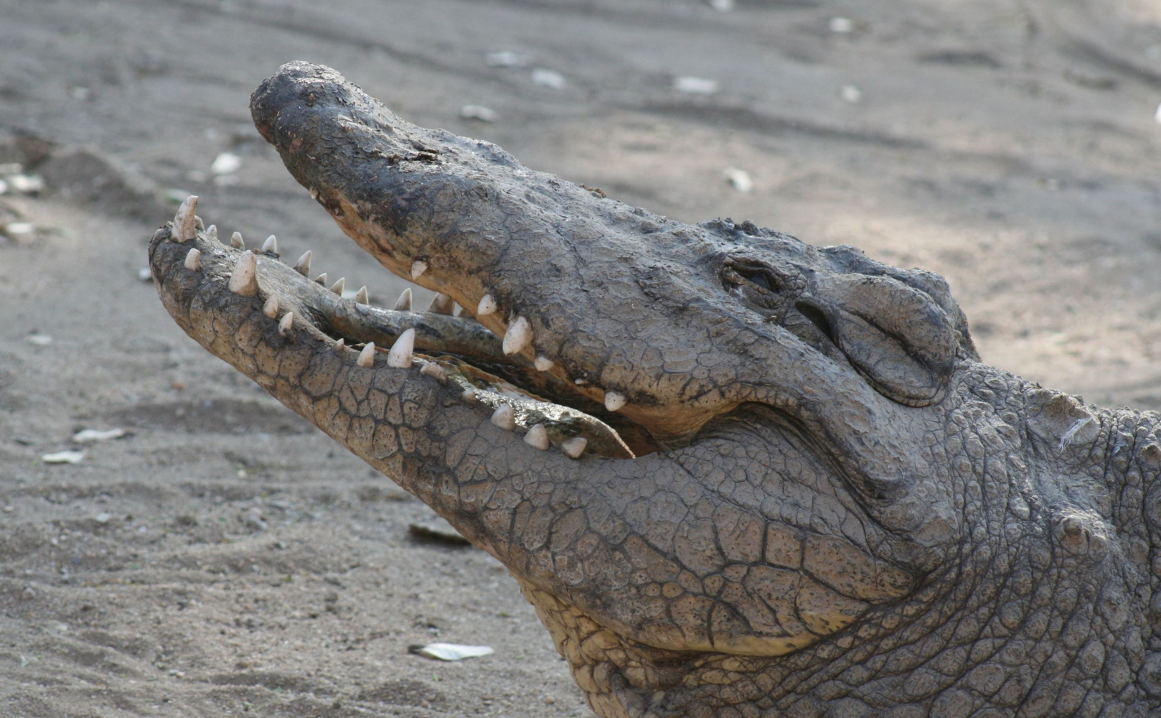
Dinosaurs (still) rule the world
Notes:
46

Slide 24
Who makes your decisions?
Notes:
48

Slide 25
Cyber!
Notes:
50

Slide 26
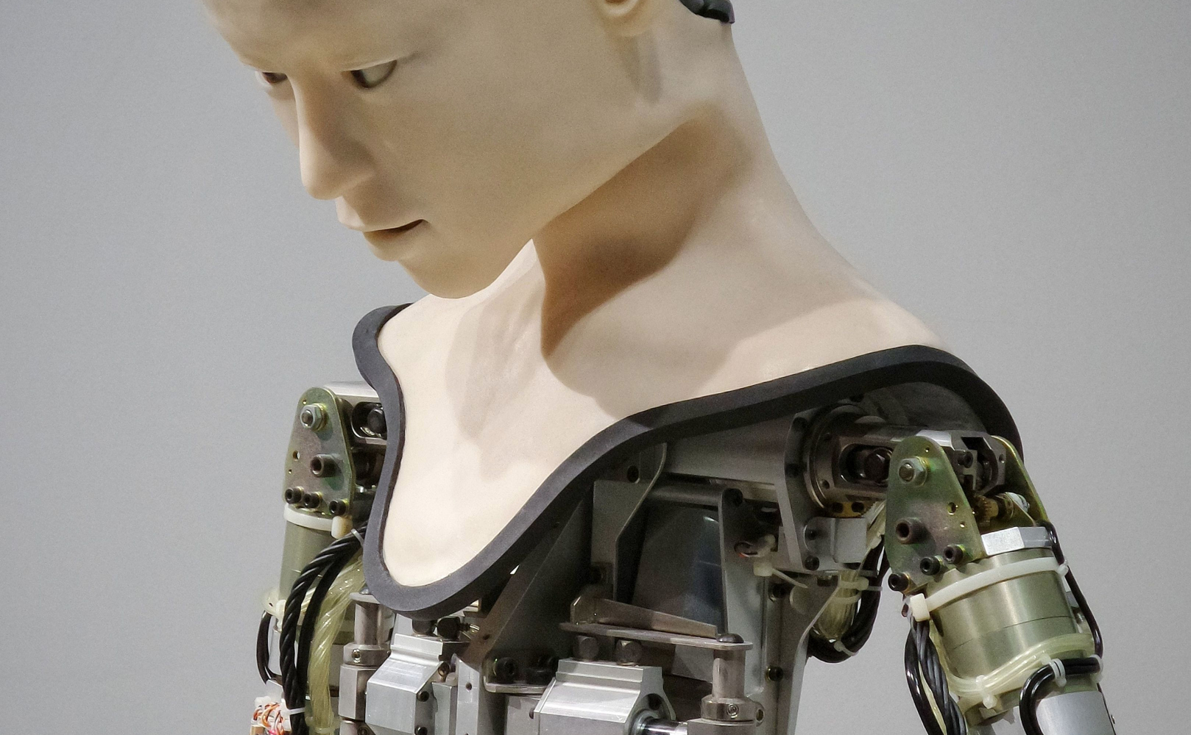
The inevitable
Artificial Intelligence → Artificial General intelligence → Artificial Super Intelligence
Convergence
Data → Information
Integration
Genetics
Nanotechnology
Robotics
Quantum computing
Entanglement
Notes:
52
"Thousands of years from now, when historians review the past, our ancient time here at the beginning of the third millennium will be seen as an amazing moment. This is the time when inhabitants of this planet first linked themselves together into one very large thing. Later the very large thing would become even larger, but you and I are alive at that moment when it first awoke. Future people will envy us, wishing they could have witnessed the birth we saw. It was in these years that humans began animating inert objects with tiny bits of intelligence, weaving them into a cloud of machine intelligences and then linking billions of their own minds into this single supermind. This convergence will be recognized as the largest, most complex, and most surprising event on the planet up until this time. Braiding nerves out of glass, copper, and airy radio waves, our species began wiring up all regions, all processes, all people, all artifacts, all sensors, all facts and notions into a grand network of hitherto unimagined complexity. From this embryonic net was born a collaborative interface for our civilization, a sensing, cognitive apparatus with power that exceeded any previous invention. This megainvention, this organism, this machine—if we want to call it that—subsumes all the other machines made, so that in effect there is only one thing that permeates our lives to such a degree that it becomes essential to our identity. This very large thing provides a new way of thinking (perfect search, total recall, planetary scope) and a new mind for an old species. It is the Beginning. The Beginning is a century-long process, and its muddling forward is mundane. Its big databases and extensive communications are boring. Aspects of this dawning real-time global mind are either dismissed as nonsense or feared. There is indeed a lot to be legitimately worried about because there is not a single aspect of human culture—or nature—that is left untouched by this syncopated pulse. Yet because we are the parts of something that has begun operating at a level above us, the outline of this emerging very large thing is obscured. All we know is that from its very beginning, it is upsetting the old order. Fierce pushback is to be expected. What to call this very large masterpiece? Is it more alive than machine? At its core 7 billion humans, soon to be 9 billion, are quickly cloaking themselves with an always-on layer of connectivity that comes close to directly linking their brains to each other.”
Link to: https://www.linkedin.com/pulse/our-inevitable-future-julian-talbot/?published=t

Slide 27
Nothing is as important as you think it is when you are thinking about it
Attention is the new oil
Big data = selling certainty = human capitalism
Social media is addictive and millions of years of evolution are being co-opted by 25 to 35-year-old white guys in silicone valley
Notes:
54
Attention is the currency that Google, Facebook, etc are competing for. Where our attention is placed isn't something we often think about. And yet, it's worth billions to many corporations. And, it turns out that it is one of our most powerful tools.
Big data = selling certainty = human capitalism
Social media is addictive. Millions of years of evolution are being co-opted by 25 to 35-year-old white guys in silicone valley.

Slide 28
The Evidence
Notes:
6

Slide 29
JulianTalbot.FYI.to/5insights
Notes:
Please go to my website JulianTalbot.com and sign up for my newsletter because I will send you lots of free templates and will let you know when I make my books available free on Kindle..
And last but not least, did I help answer your question, or at least get you closer to resolving your challenge. Drop me a line via my website and mention RAW2020 because there’s 15 minutes of my 40 years experience available free to help get you to the next step on the journey.

