Slide 1
Enterprise Security Risk Assessment
Julian Talbot

Slide 2
What?
Why?
How?
How much?

Slide 3
Enterprise Security Risk Assessment (ESRA)
What is an ESRA
Why
Process
Cost & time

Slide 4
Why?
Objectives
What does your organisation want to achieve?
How does security fit in?
Benchmark
Scope
ESRA
SRMBOK
Outcomes
Analysis
Methodology
Plan
Metrics
Context
Criteria
ISO31000
Other

Slide 5
SCOPE
CYBER
PHYSICAL
INFORMATION
PERSONNEL
ICT
GOVERNANCE
ENTIRE ORGANIZATION
GEOGRAPHIC
FUNCTIONAL
PROJECT

Slide 6
Internet of Things
2¹²⁸ = 340,282,366,920,938,463,463,374,607,431,768,211,456
2¹²⁵ =
4.2 x 10³⁷ =
42 undecillion

Slide 7
Enterprise Security
ENTIRE ORGANIZATION
Physical | Cyber | Personnel | Information | ICT

Slide 8
STROUD MATRIX
BAU – Petty Theft
ROUTINE - Fraud
SWANS – Insider Threat
DZ – Cyber Attack

Slide 9
Four processes
Strategic
Operational
Tactical
Background

Slide 10
Tactical Processes
ISO31000
SRMBOK
Custom

Slide 11
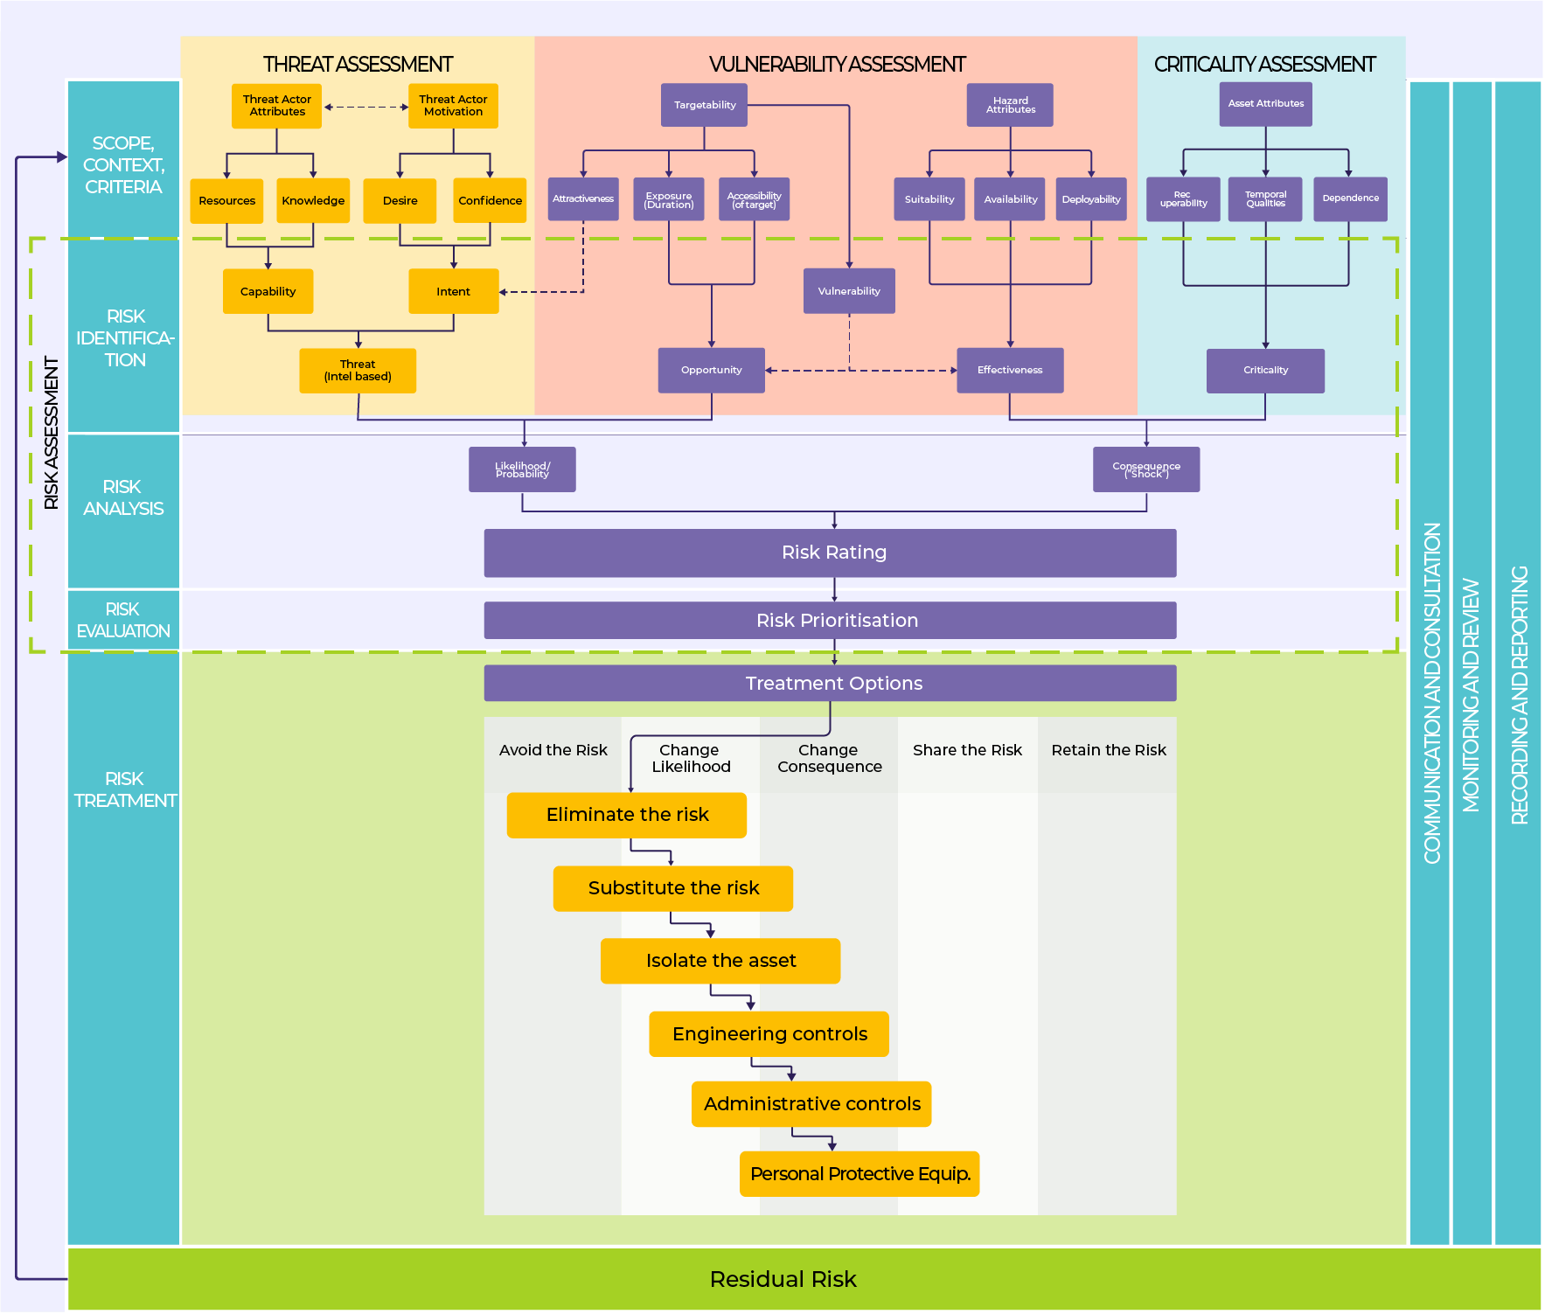
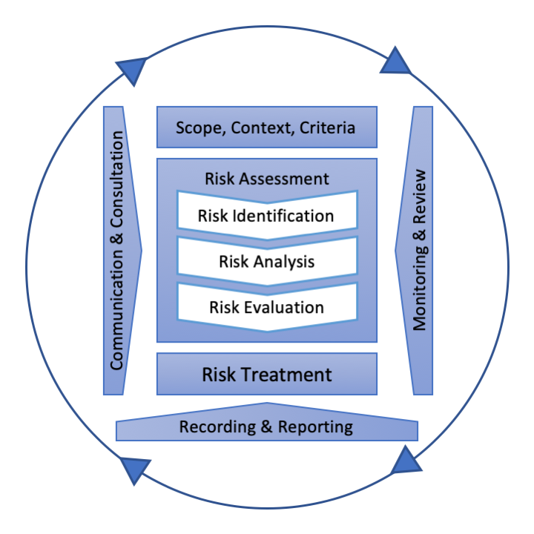
SRMBOK Process
ISO31000

Slide 16
Strategic Process
Governance
Objectives
Integration
Resourcing

Slide 17
Tides and rock pools

Slide 20
Operational Process
1. Scoping
2. Investigation
3. Analysis
4. Treatments
5. Presentation

Slide 21
BACKGROUND PROCESS
SCOPE
EXECUTE
PROCURE
PLAN
REVIEW
TREAT

Slide 22
COSTS
Team of 3 or 4 people
50 to 100 days effort
Internal labor commitment of 10 to 20 days to procure, assist, provide information, attend interviews
Management review

Slide 23
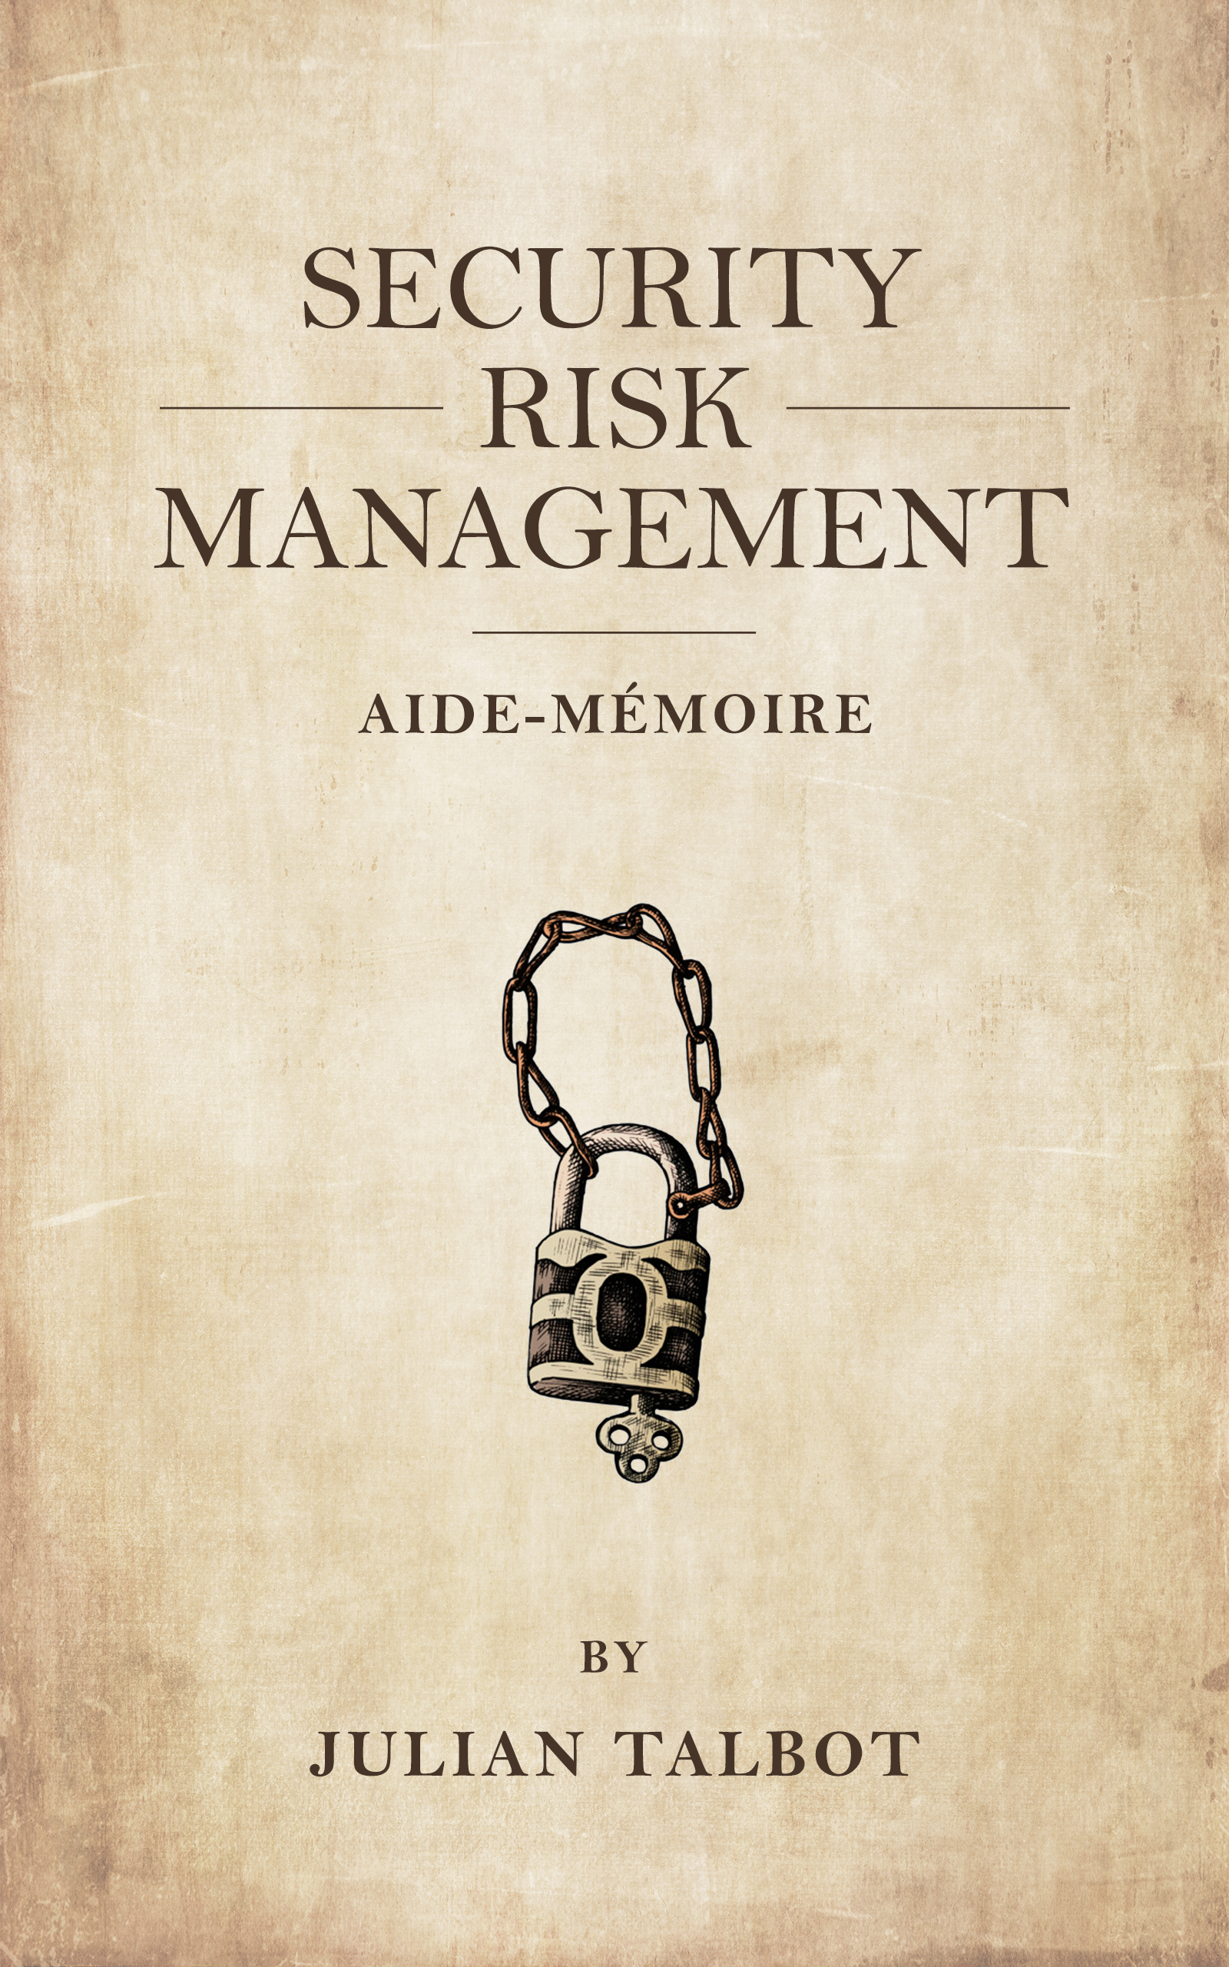
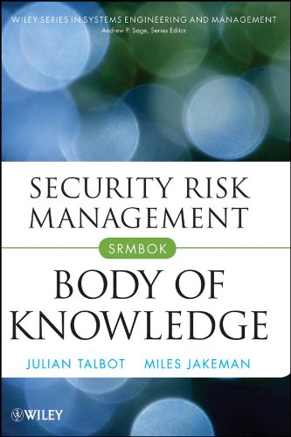
JulianTalbot.com
Security Risk Management Aide-Mémoire
www.srmam.com
Security Risk Management Body of Knowledge (SRMBOK)

