Slide 1
Security Risk Assessment
Julian Talbot

Slide 2
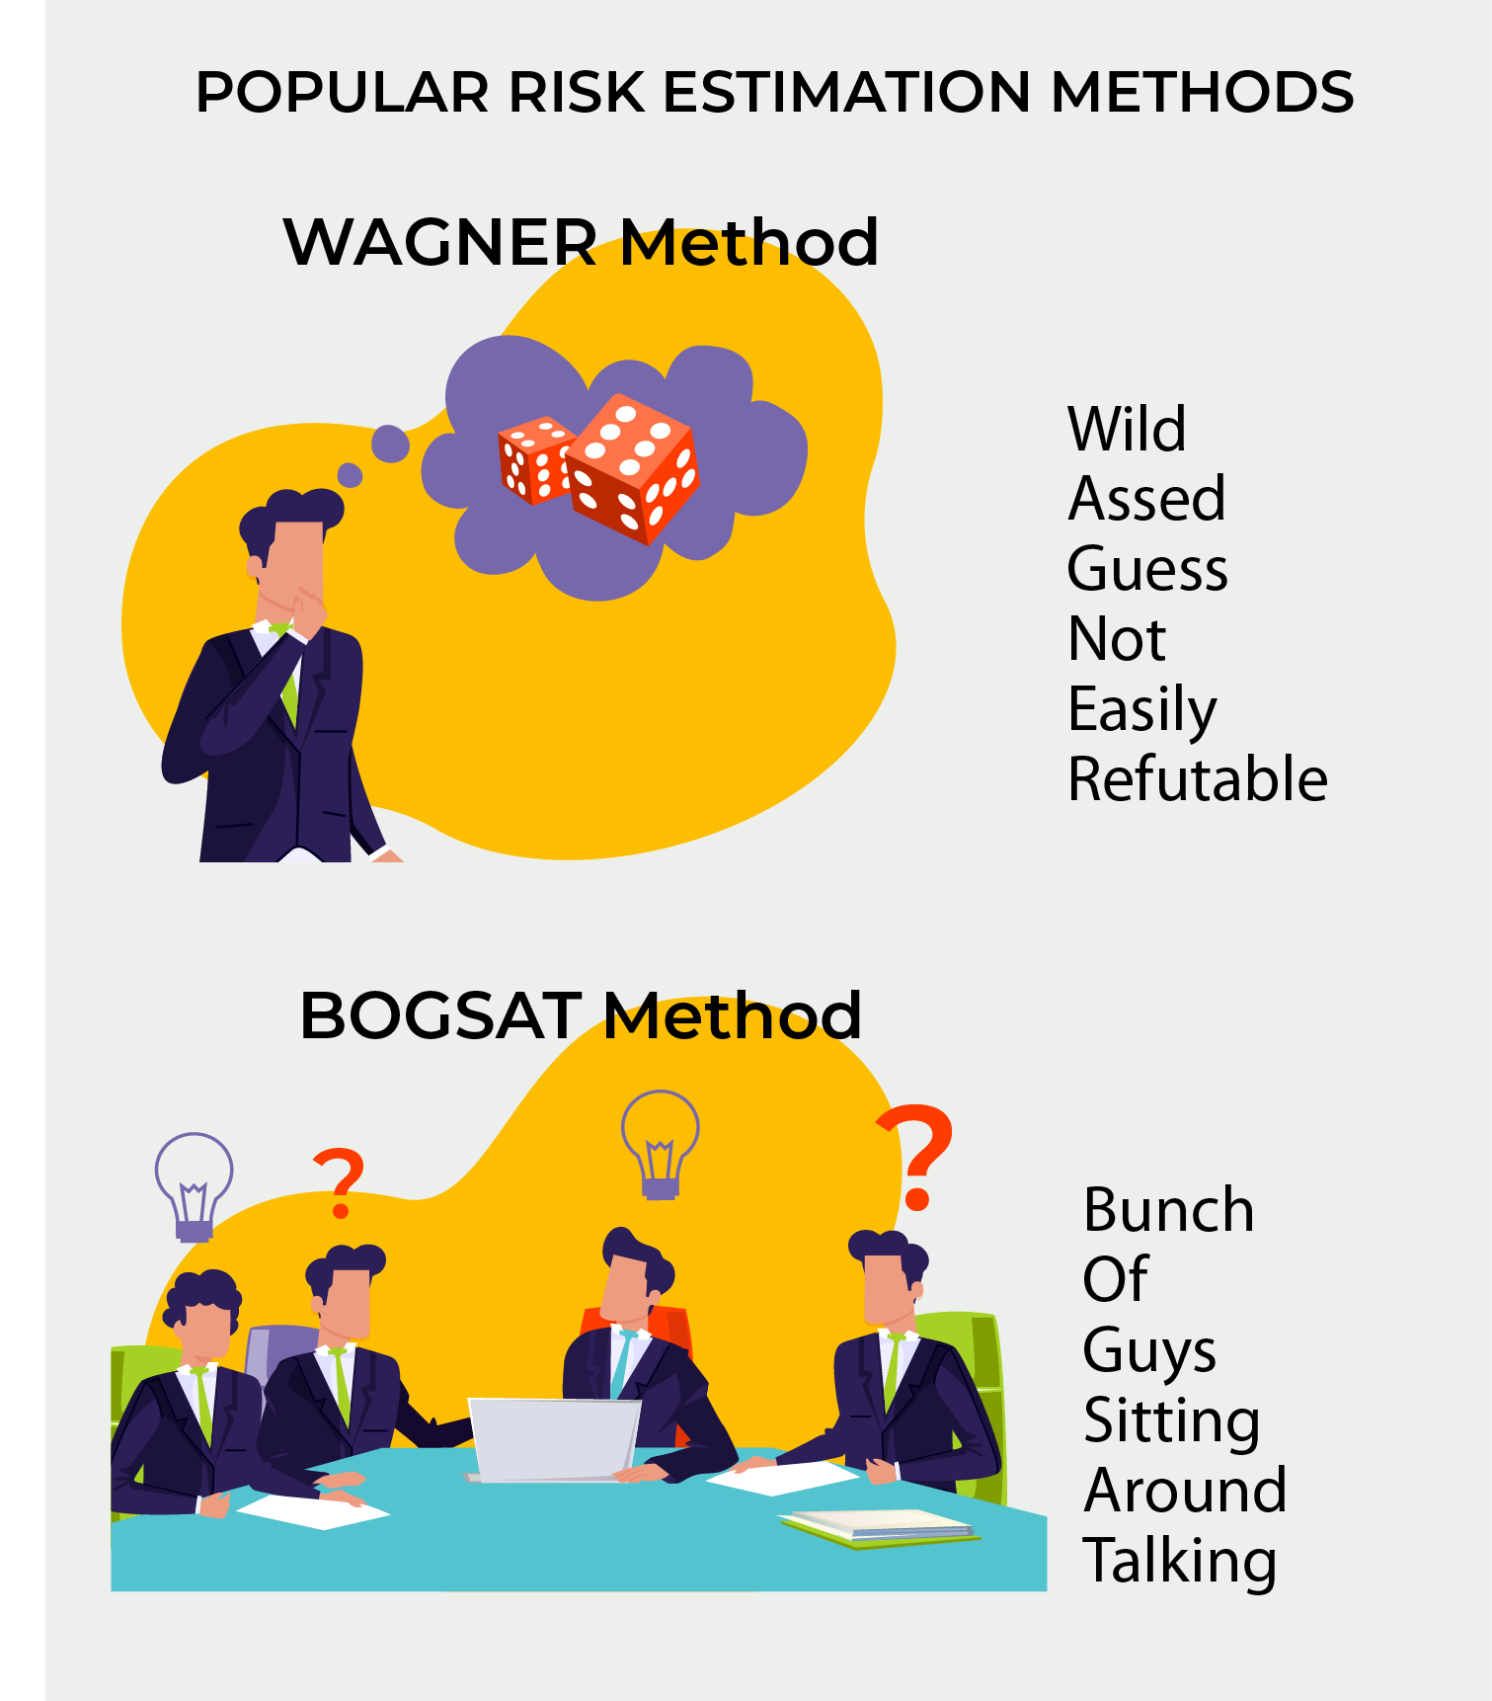
Risk Assessment

Slide 3
Flow Chart Start
Step 1
Step 2
Step 3
Step 4
Flow Chart End

Slide 5
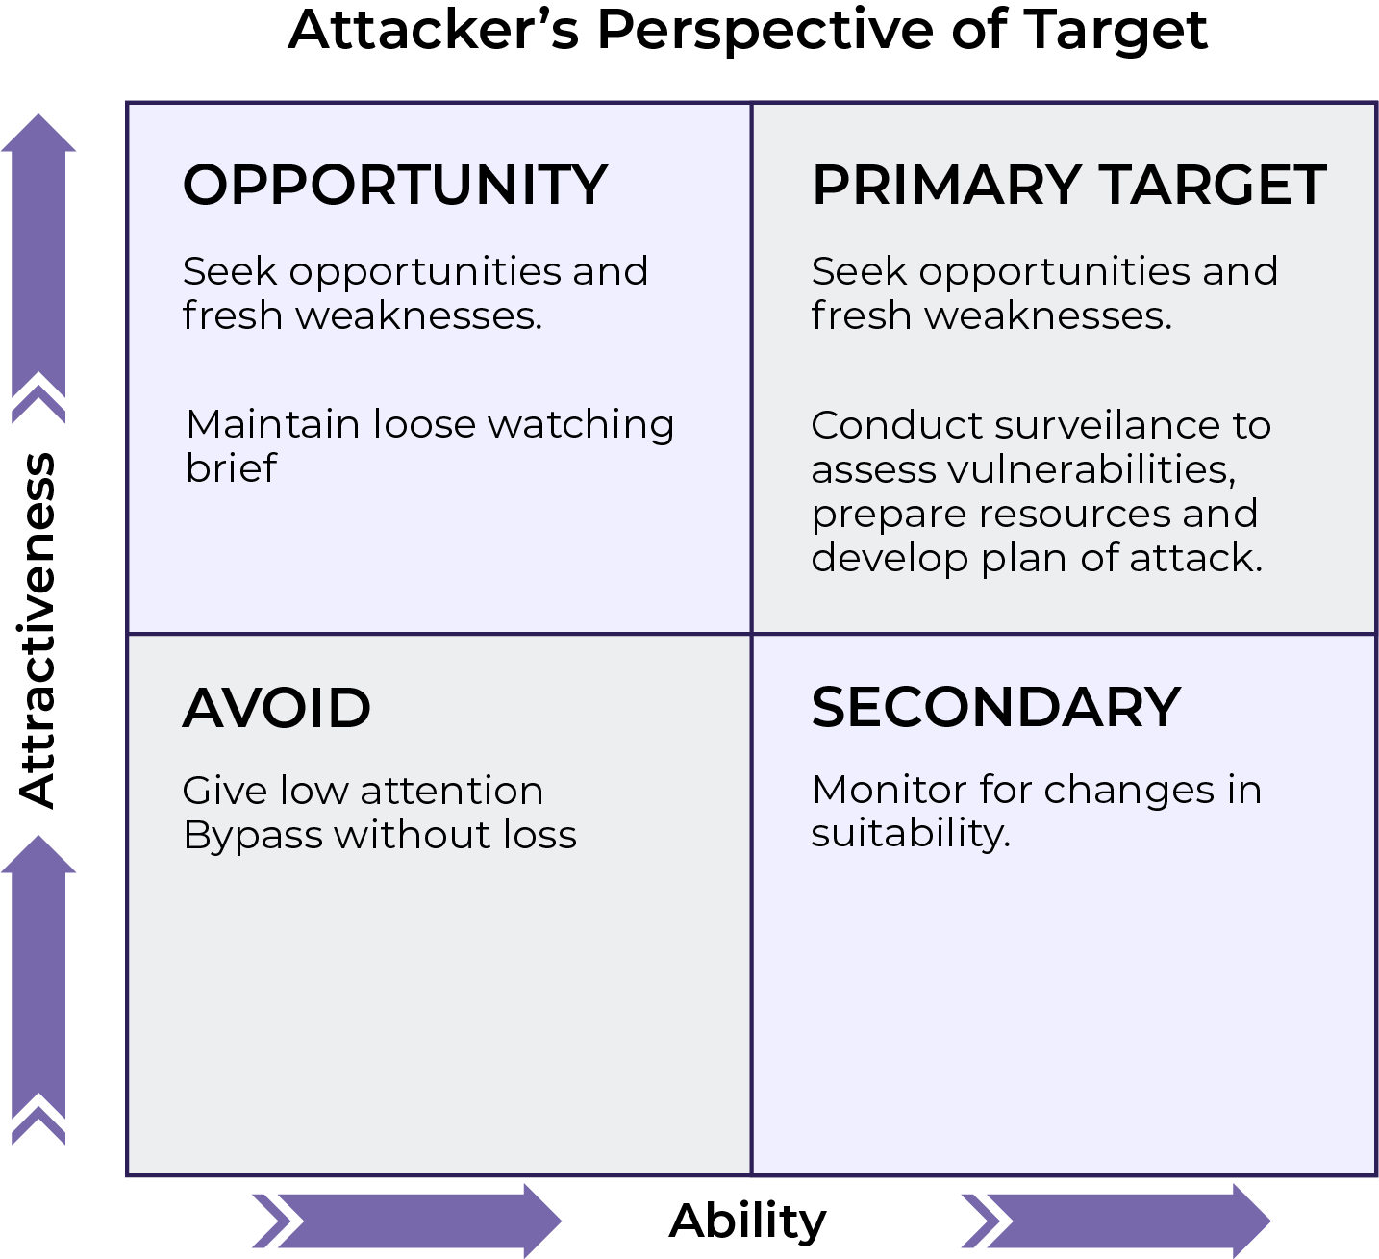
Attacker / Red Team Perspective

Slide 6
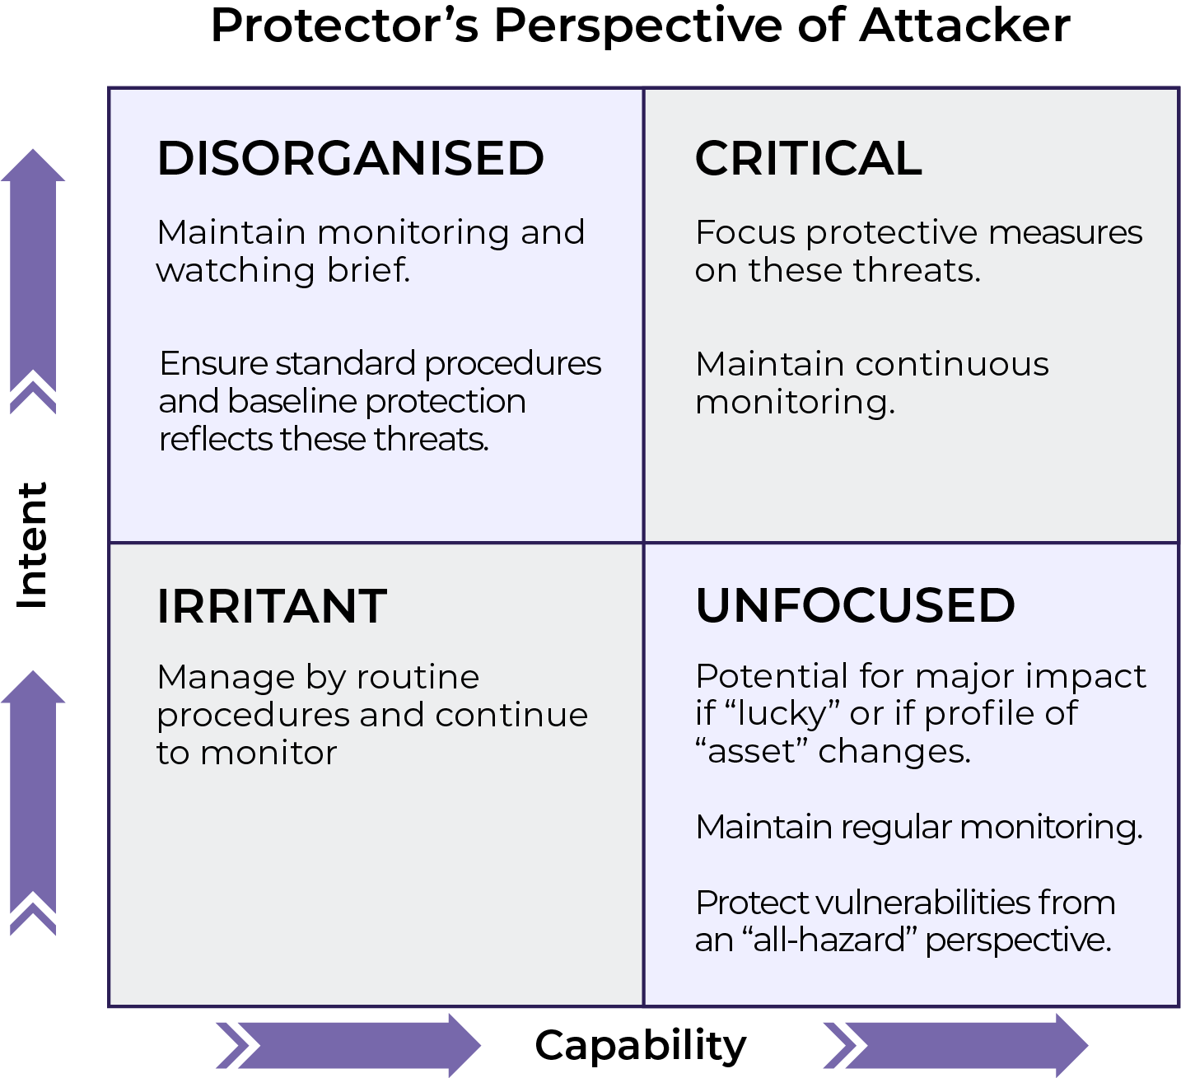
Your perspective
Security’s perspective of potential attackers

Slide 7
SRMBOK SRA Model

Slide 8
Insert your own text here
Heading
Your text goes here.
Heading
Your text goes here.
Your text goes here.
Your text goes here.
Your text goes here.
Your text goes here.
Your text goes here.
Heading
Your text goes here. Your text goes here. Your text goes here. Your text goes here. Your text goes here. Your text goes here. Your text goes here. Your text goes here. Your text goes here. Your text goes here. Your text goes here. Your text goes here.
Heading
Your text goes here. Your text goes here. Your text goes here. Your text goes here. Your text goes here. Your text goes here. Your text goes here. Your text goes here. Your text goes here. Your text goes here. Your text goes here. Your text goes here. Your text goes here. Your text goes here. Your text goes here. Your text goes here. Your text goes here. Your text goes here. Your text goes here. Your text goes here. Your text goes here. Your text goes here. Your text goes here. Your text goes here.
Your text goes here. Your text goes here. Your text goes here. Your text goes here. Your text goes here. Your text goes here.
Heading
Your text goes here.
Heading
Your text goes here.
Heading
Your text goes here.
Your text goes here.
Your text goes here.
Your text goes here.
Your text goes here.
Your text goes here.
Heading
Your text goes here. Your text goes here. Your text goes here. Your text goes here. Your text goes here. Your text goes here. Your text goes here. Your text goes here. Your text goes here. Your text goes here. Your text goes here. Your text goes here.
Heading
Your text goes here.
Heading
Your text goes here.
Heading
Your text goes here. Your text goes here. Your text goes here. Your text goes here. Your text goes here. Your text goes here. Your text goes here. Your text goes here.
Heading
Your text goes here. Your text goes here. Your text goes here. Your text goes here. Your text goes here. Your text goes here. Your text goes here. Your text goes here.
Enterprise Security Risk Assessment
The way we do it at our company
ESRA Process

Slide 9
ISO31000

Slide 10
Sources Assets (Resources) Events Likelihood Consequences

Slide 11
RISK Matrix

Slide 12
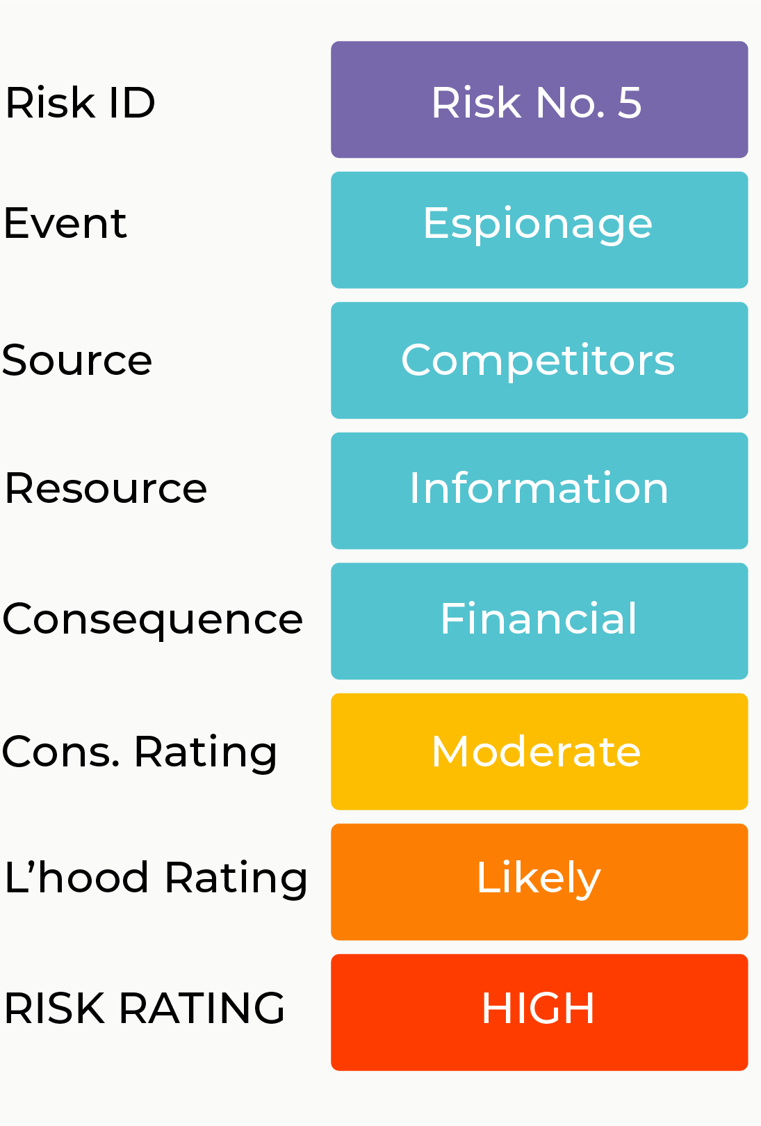
Elements of a Risk Statement
Compromise of sensitive information (Resource) due to untrained staff (Source) inadvertently posting incorrect files to a public website (Event) causing competitive disadvantage and resulting in financial losses (Consequence).

Slide 14
Risk Analysis
Limitations of matrices
Limitations of quantitative analysis
Causation and connectedness

Slide 15
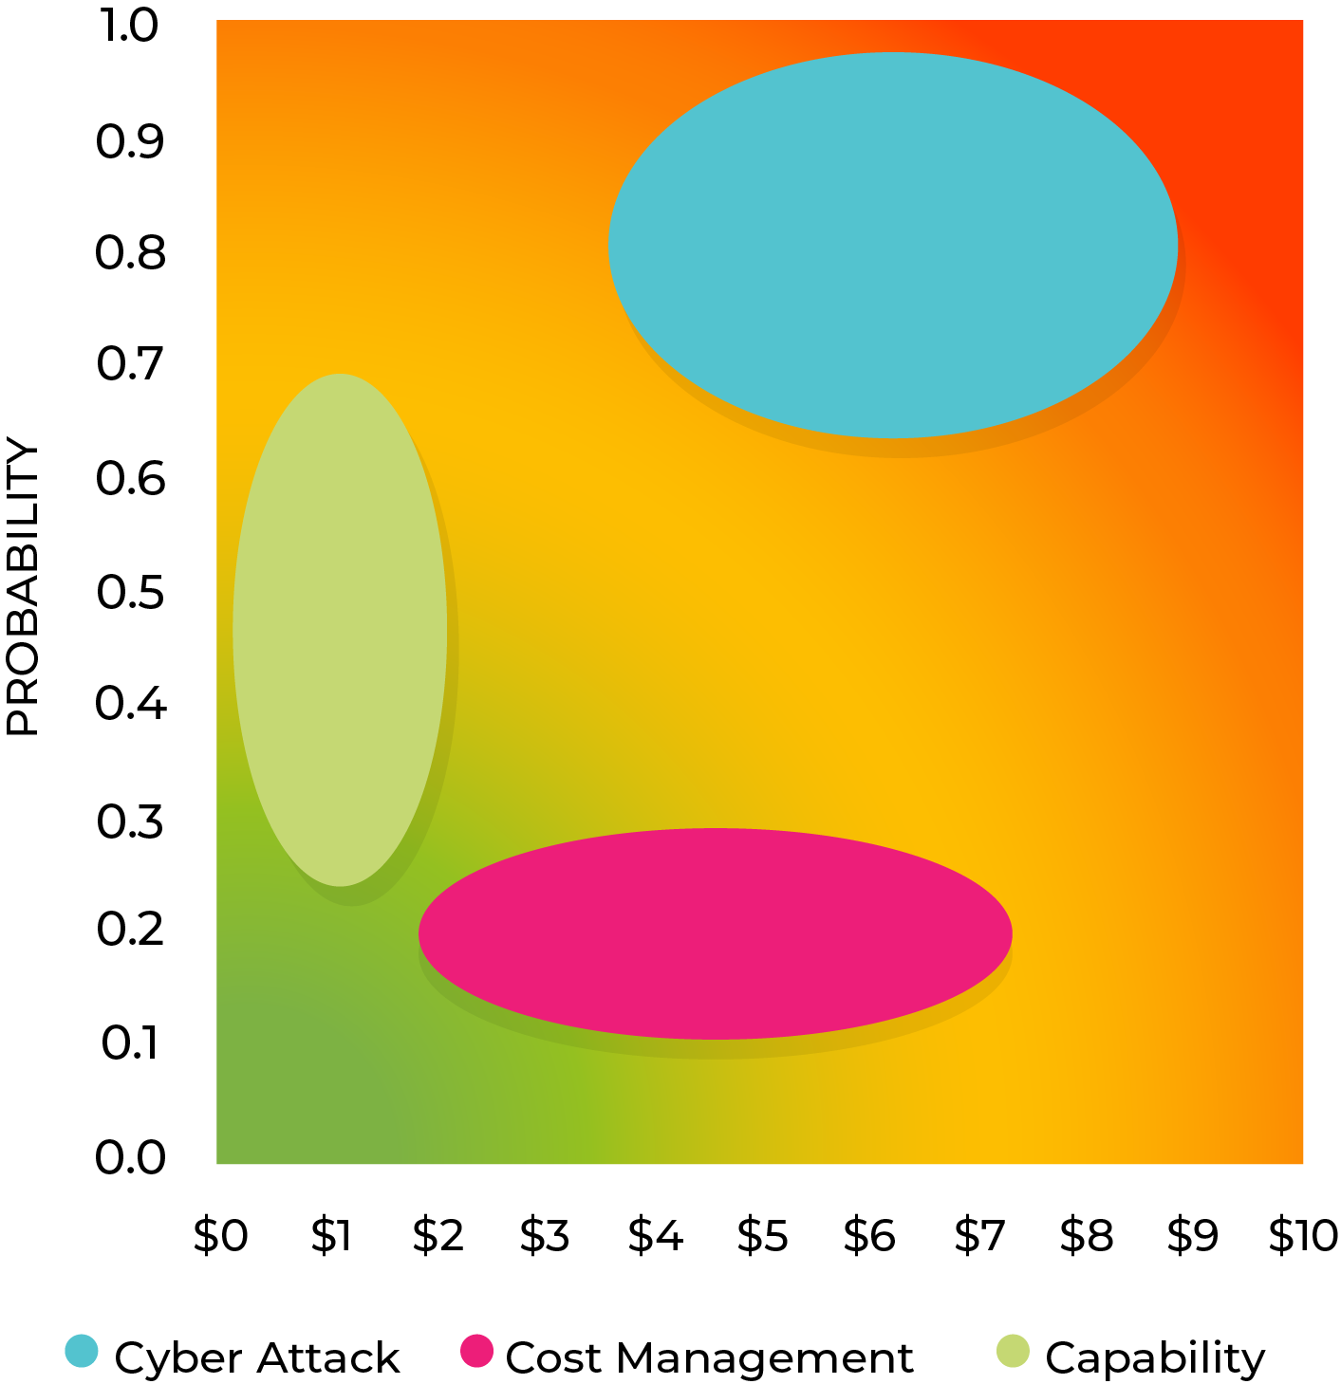
BUBBLE CHART

Slide 16
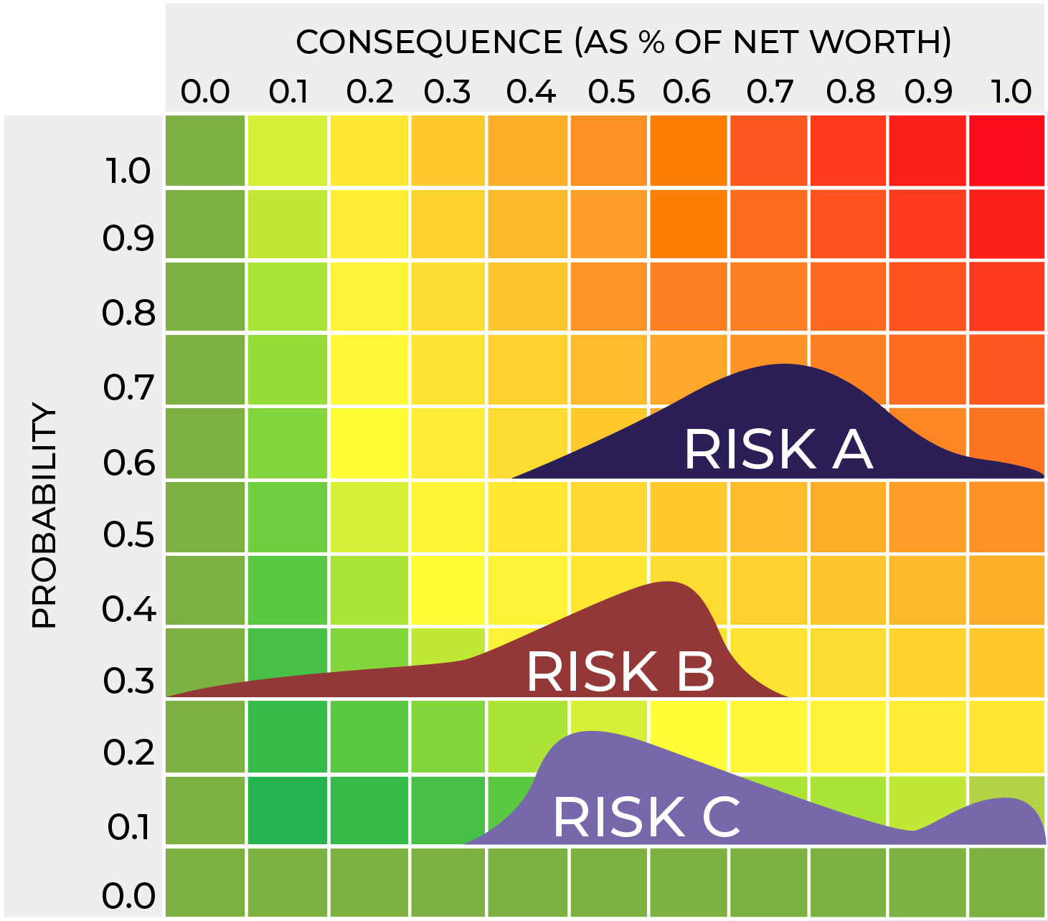
Risk Matrices
Risk is not a ‘point value’ on a matrix
Probability distribution curve
Outliers

Slide 17
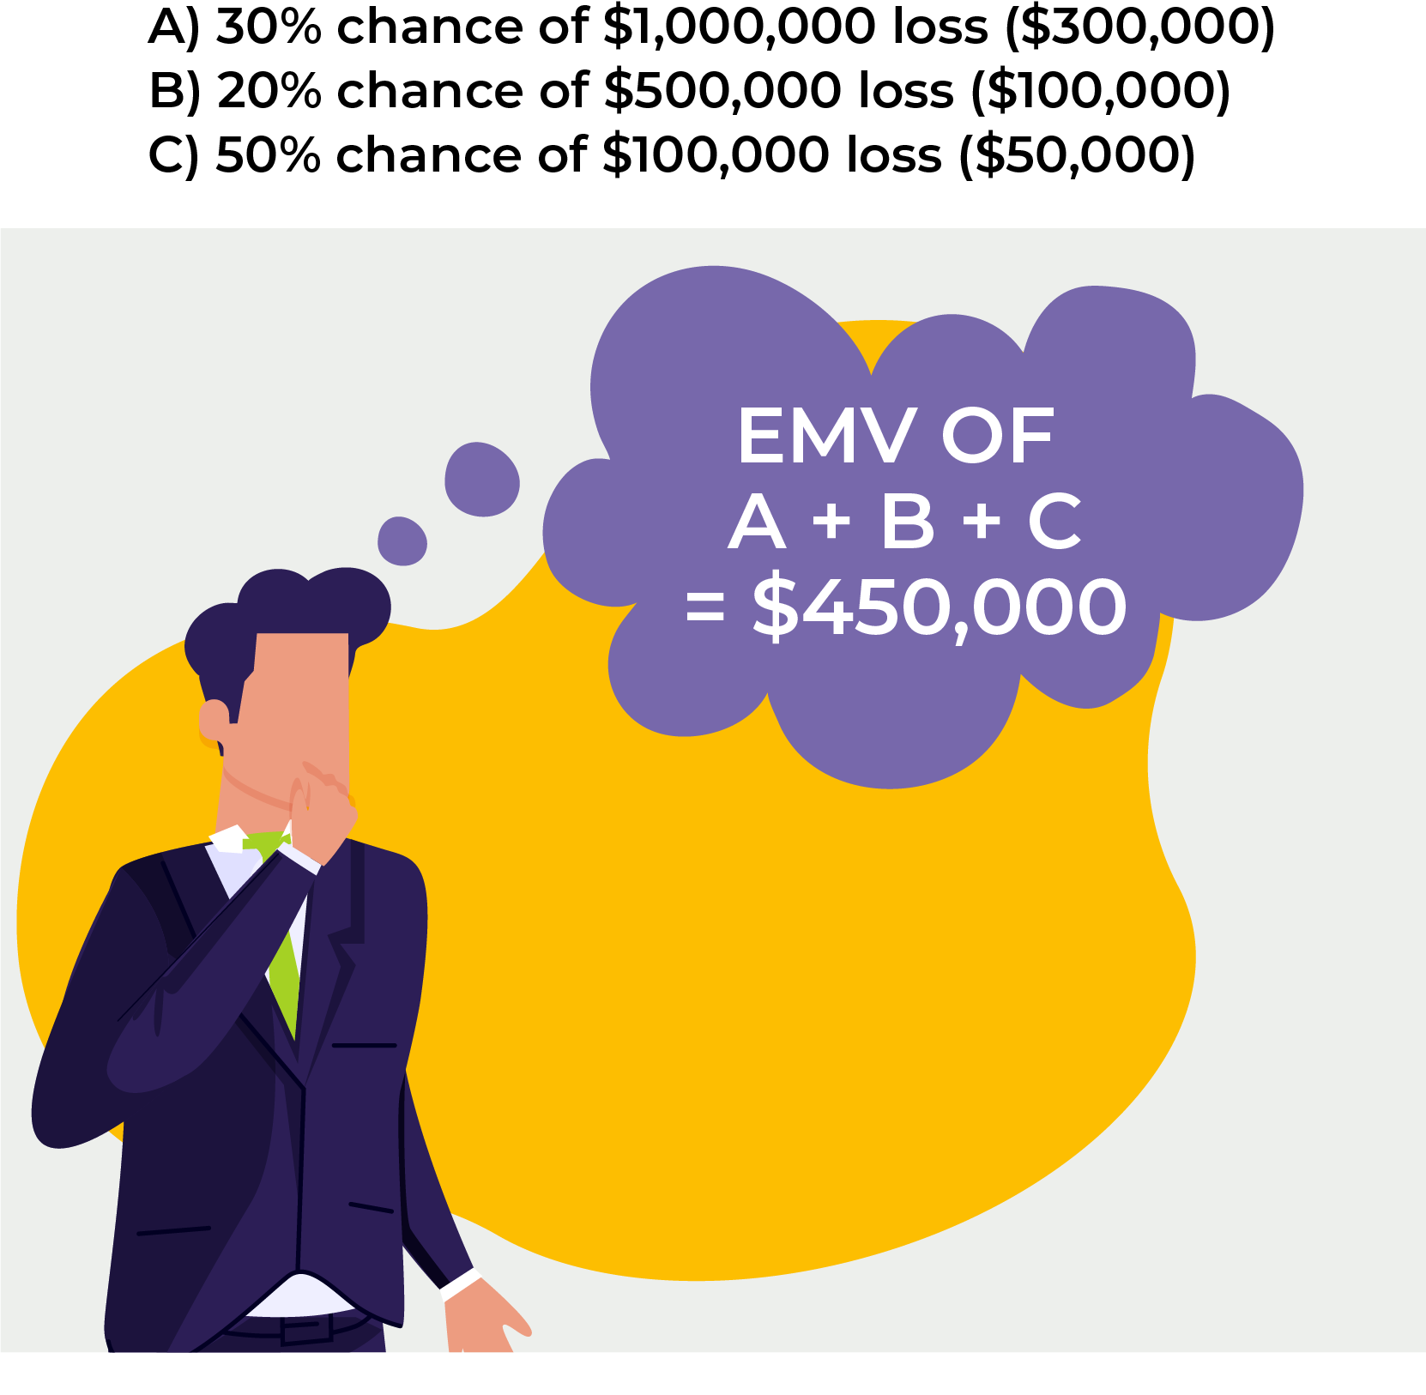
EMV
Expected
Monetary
Value

Slide 18
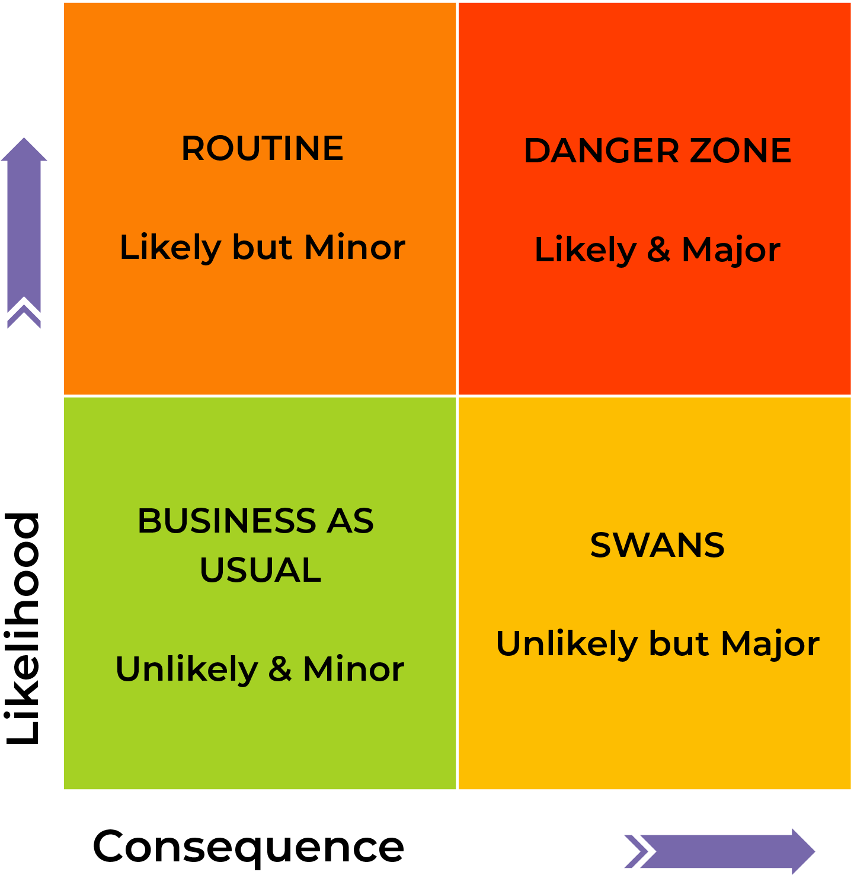
STROUD Matrix

Slide 19
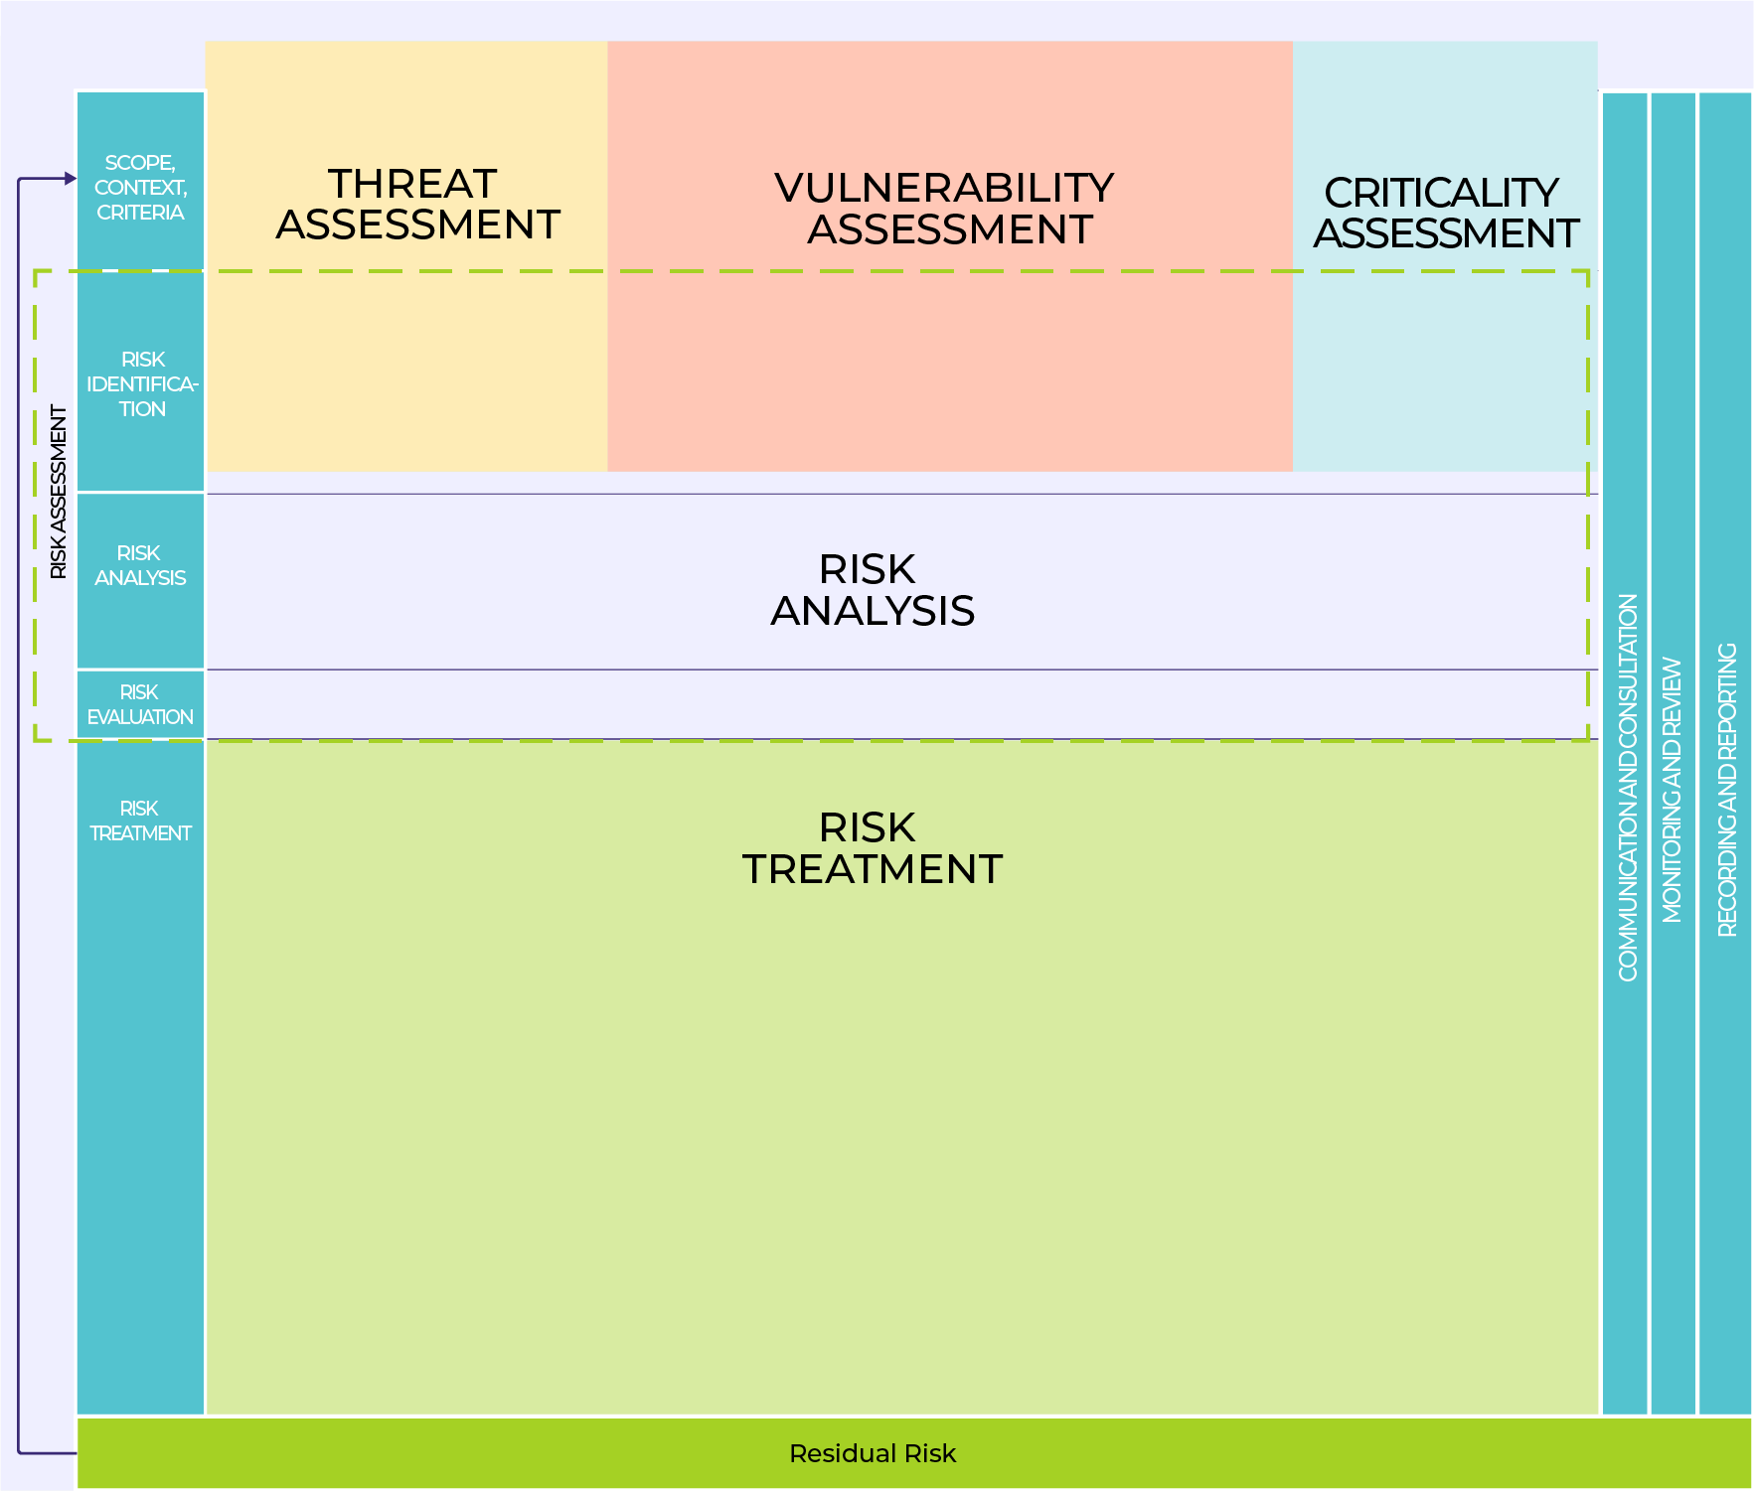
ISO3100
The big picture for enterprise security risk assessment

Slide 20
SRMBOK SRA Model

Slide 21
External Context
TECHNOLOGICAL
ENVIRONMENTAL
ECONOMIC
POLITICAL
SOCIAL
LEGAL
PESTLE

Slide 22
Internal Context
TECHNOLOGIES
RELATIONSHIPS
ACCOUNTABILITY
MANAGEMENT SYSTEMS
ORGANIZATION
RESOURCES
MORTAR
Source: Security Risk Management Aide-Mémoire
www.srmam.com

Slide 23
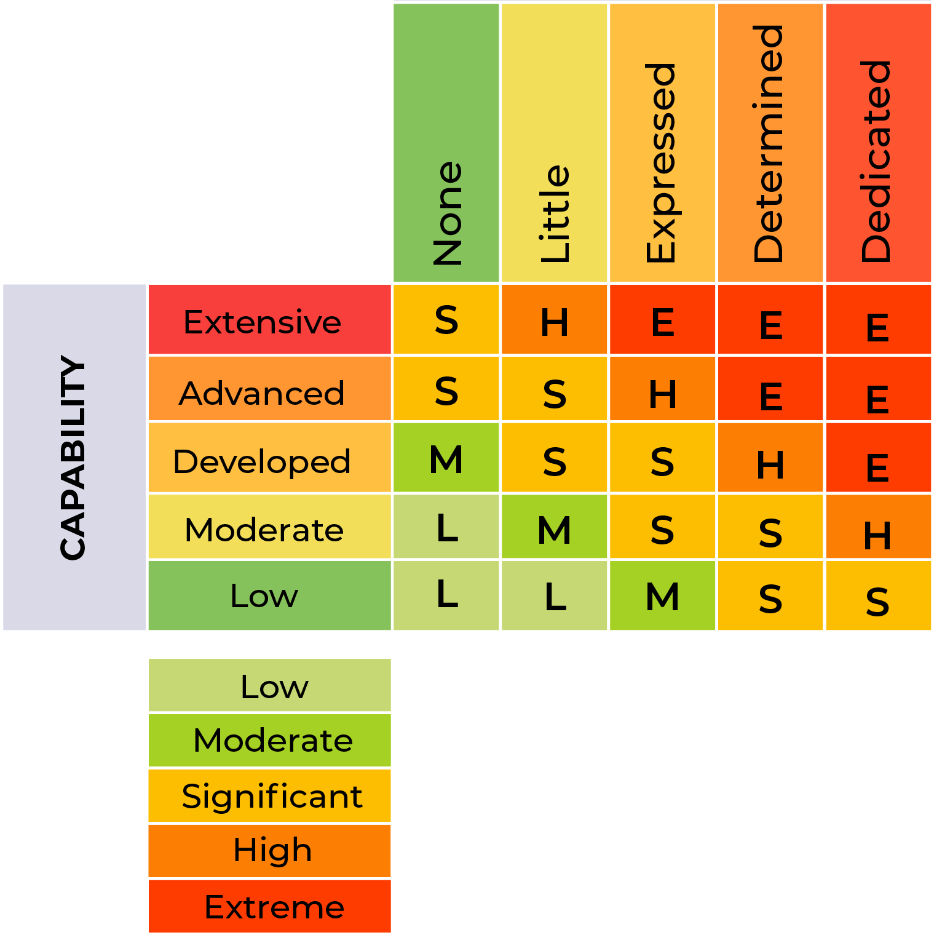
Threat
Intent
Capability

Slide 24
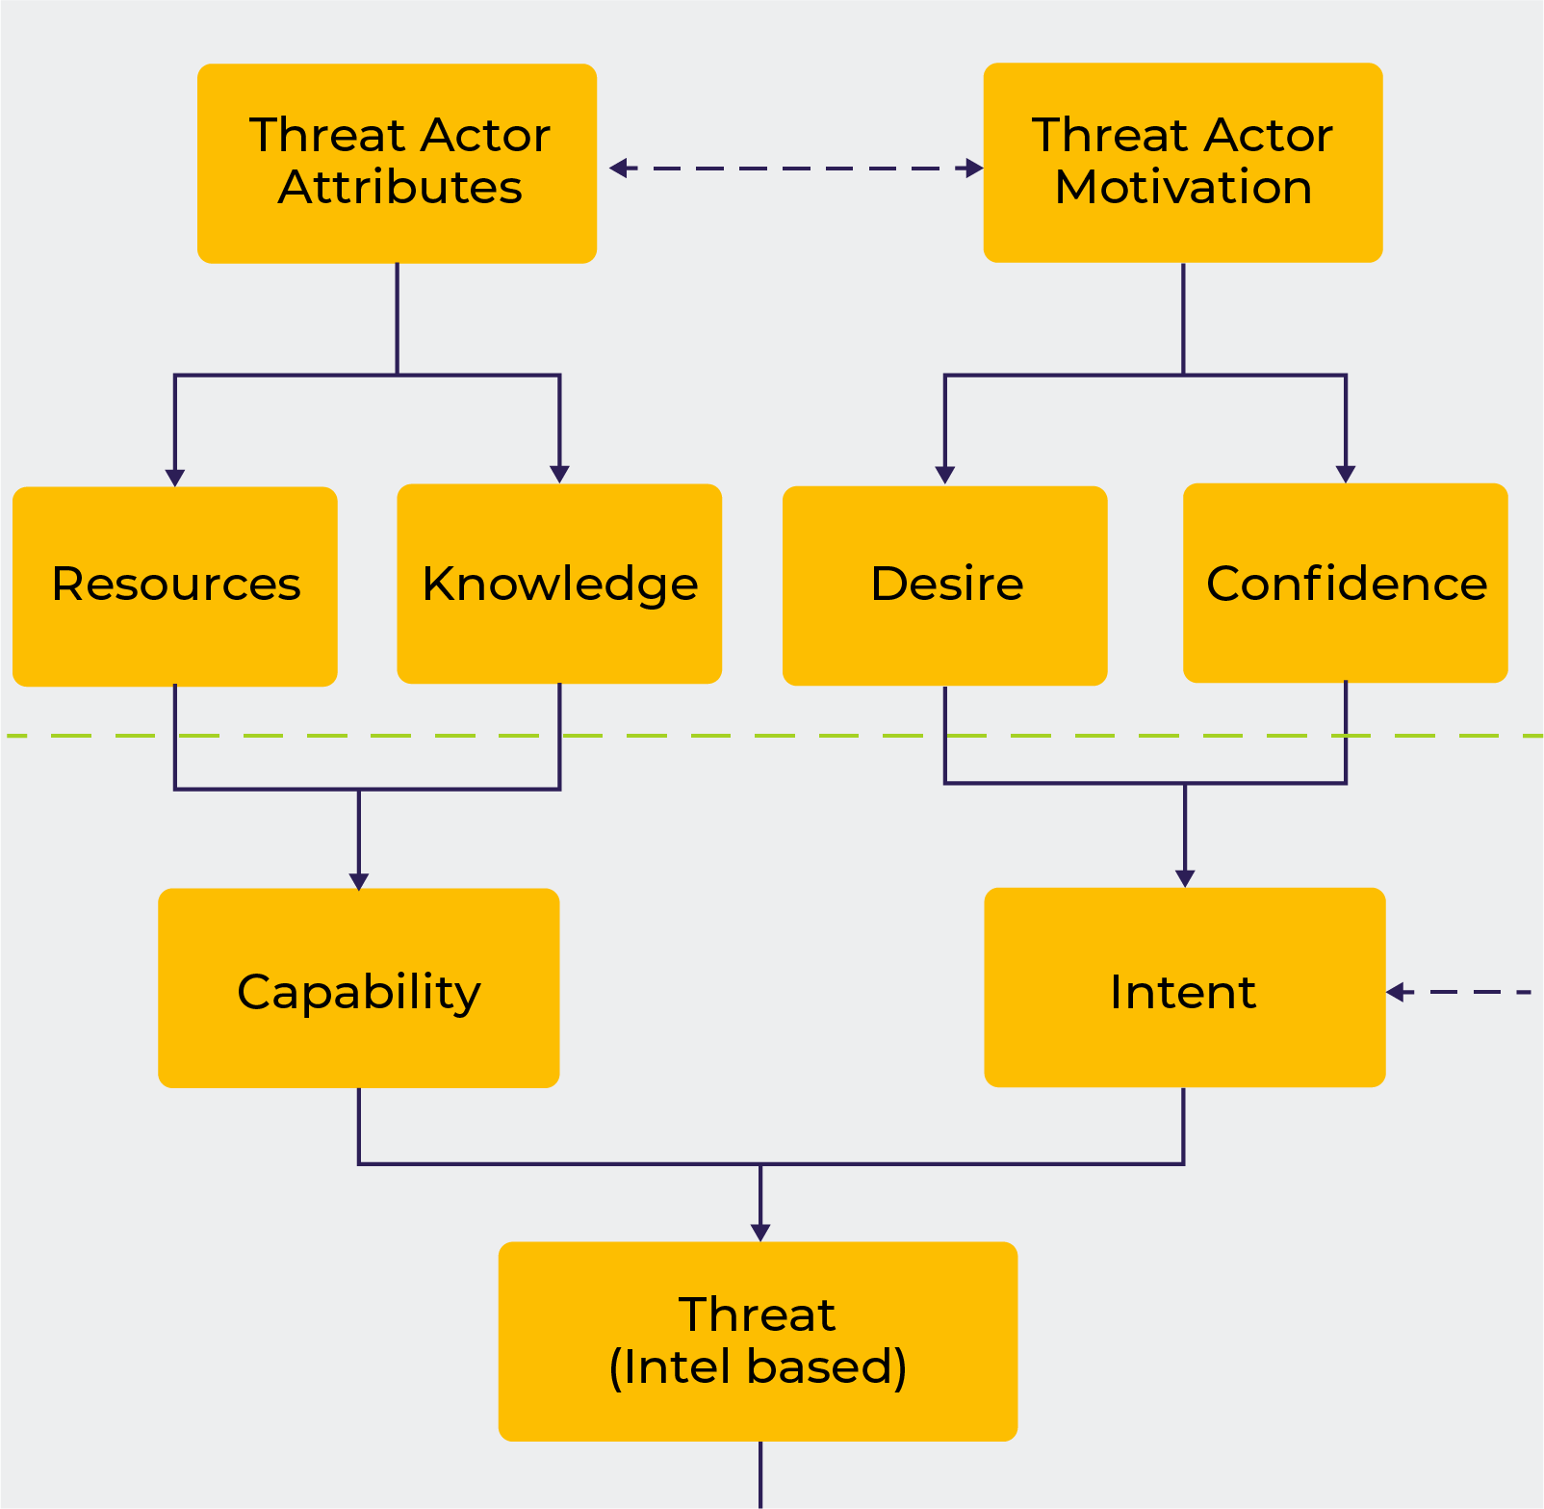
Threat
Modelling the inputs
Attributes
Motvations
Threat level

Slide 25
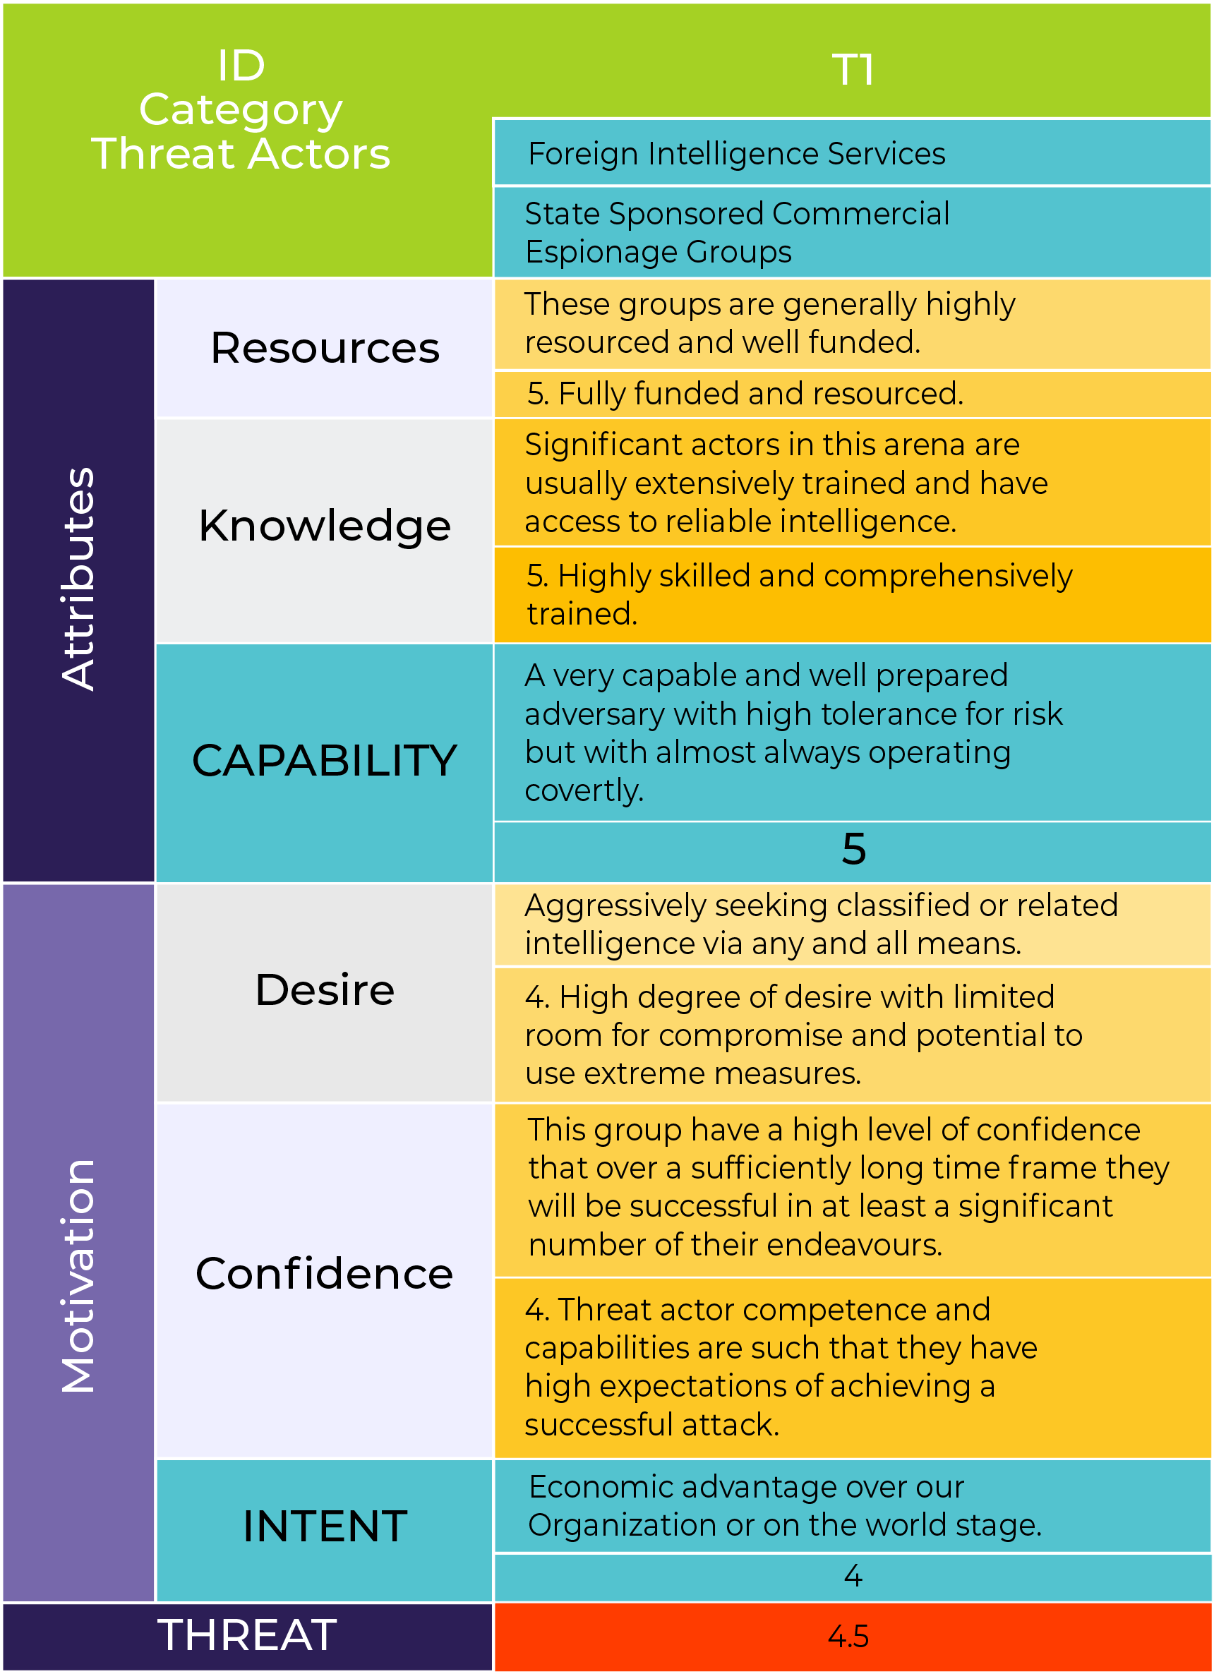
Threat Assessment
Capability
Resources
Knowledge
Intent
Desire
Confidence

Slide 26
Vulnerability

Slide 27
Criticality

Slide 28
Risk

Slide 29
Treatment
Avoid
Change Likelihood
Change Consequences
Share the risk
Retain the risk
ESIEAP

Slide 30
SRMBOK & ISO31000 Security Risk Assessment Model

Slide 31
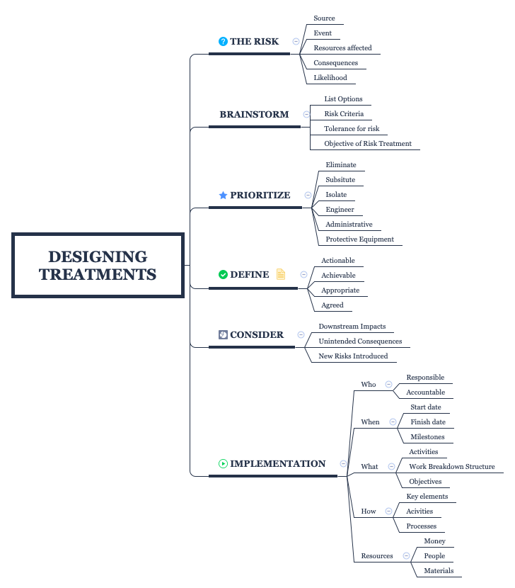
Treatments

Slide 34
One Page Per Treatment Security Plan

Slide 35
One Page Per Treatment Security Plan
Description:
Actions:
Achieved when:
Risks Treated:
Agreed by:
Scope:
Schedule:
Resources:
Quality:
Actionee:
Implementation Parameters:

Slide 36
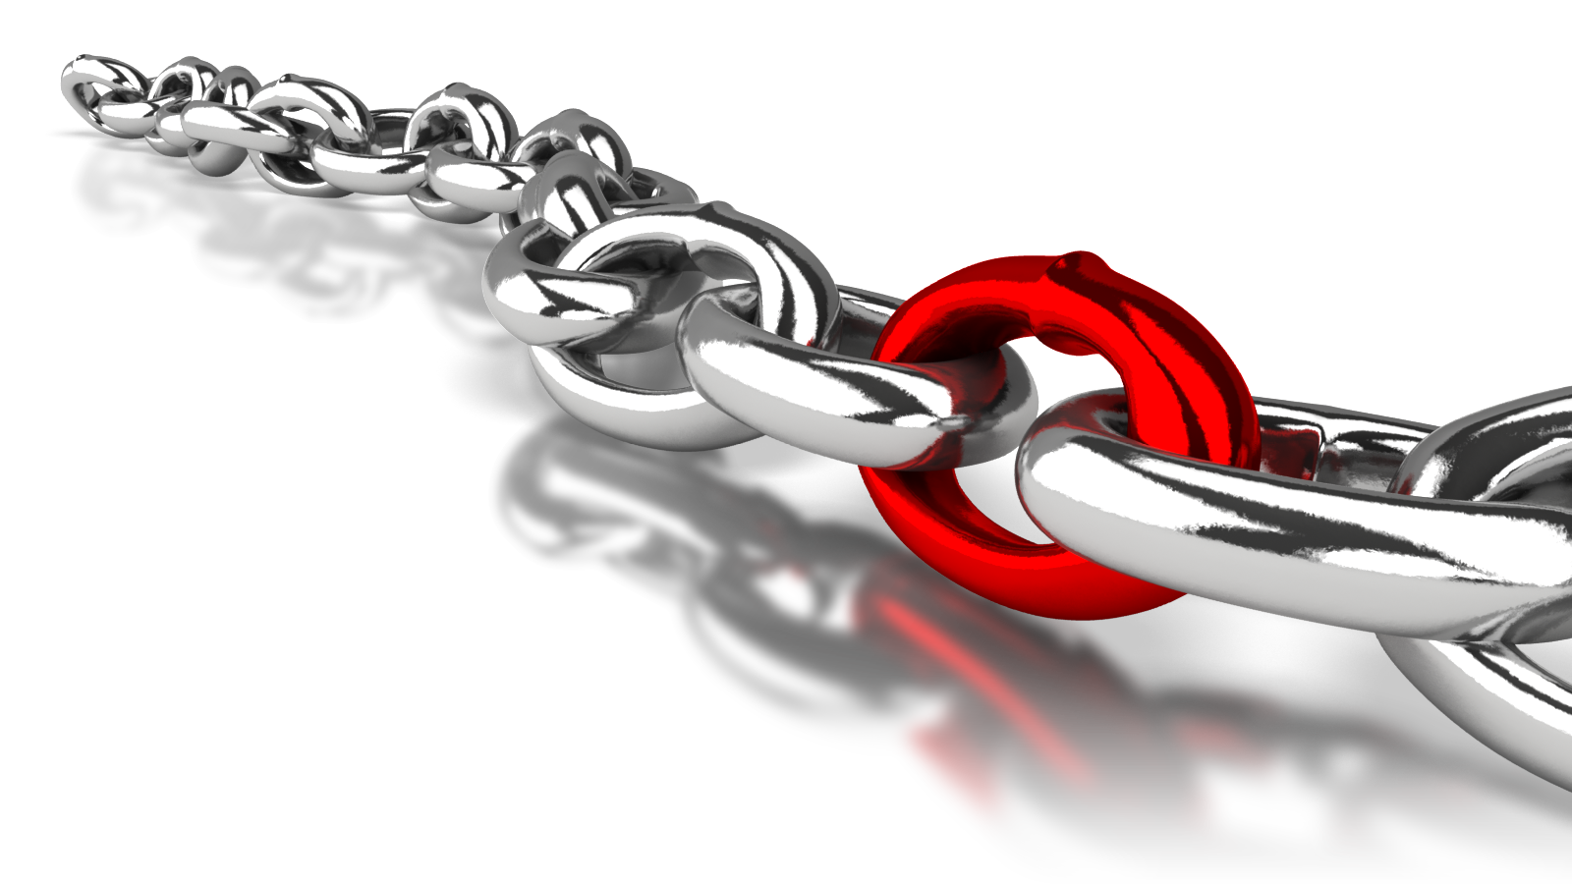
The Weakest Link = Swiss Cheese
Equally important is the causal chain

Slide 37
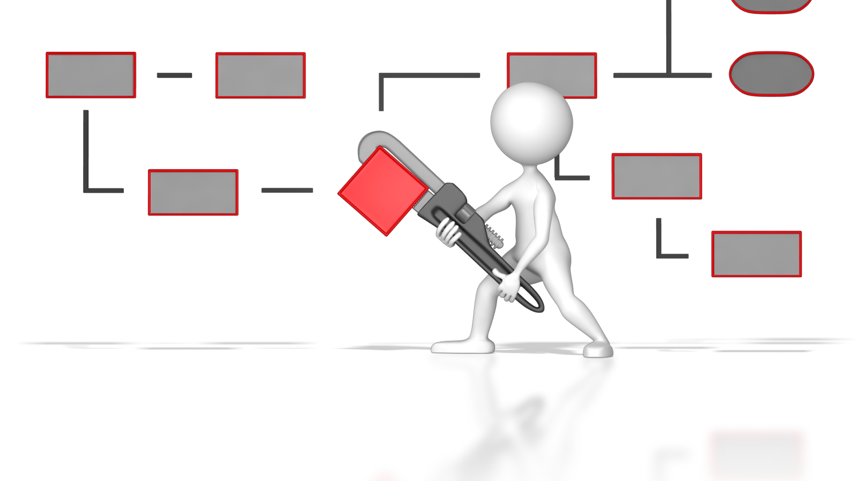
Unintended consequences

Slide 38
Downstream events

Slide 39
Risk → Treatment → Risk

Slide 41
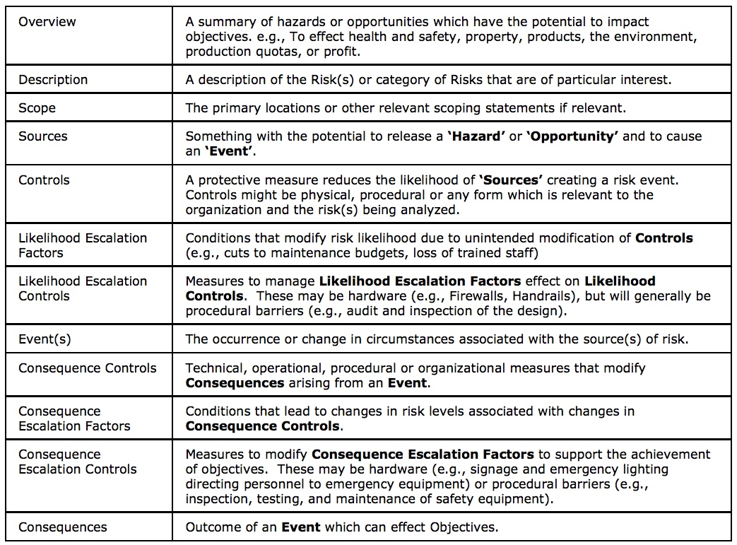
Bow-Tie Table

Slide 44
Thanks
julian@juliantalbot.com

